Slide 1
Distance-Time Graphs
Combined Science - Physics - Key Stage 4 - Forces
Mr Saville
Miss Whittick

Slide 2
Warm Up Task
What type of quantity is speed? (scalar or vector?)
Can you recall the average speeds (in m/s) for a person walking and jogging?
Define speed.
How do you calculate the speed of an object?
What is the average speed of sound?

Slide 3
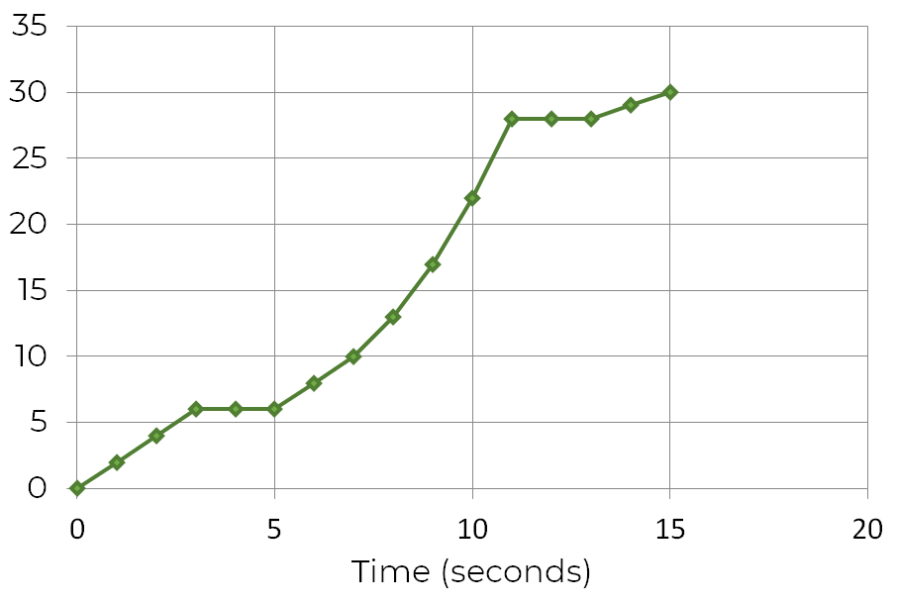
Identify what each area represents on the graph:
A:
B:
C:
How many times did the object remain stationary?
How far did the object travel?
How long did the journey take?
Distance (m)
C
B
A

Slide 4
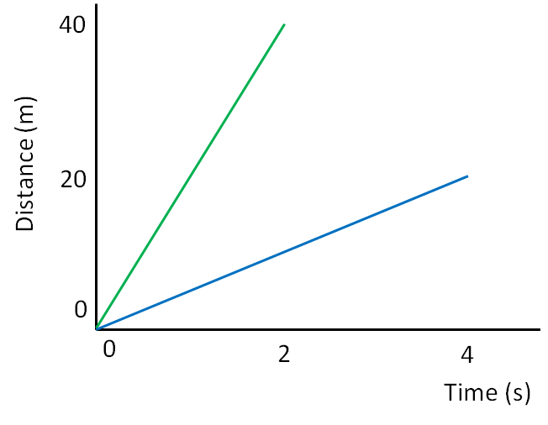
Calculate the speed of the 3 represented in the graph.
A:
B:
C:
80
A
Distance (m)
B
40
C
0
0
4
8
Time (s)

Slide 5
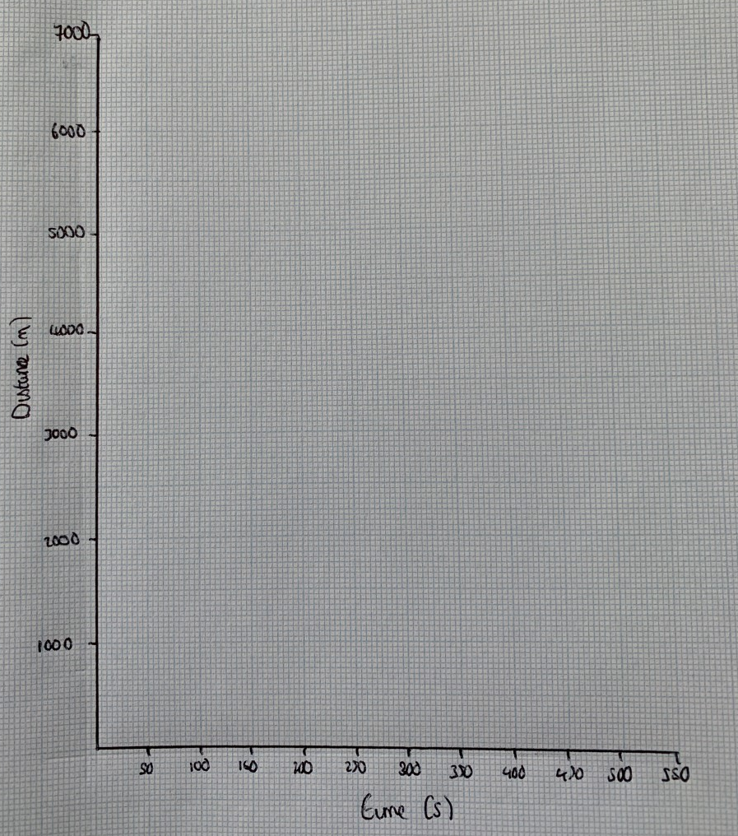
Independent Practice
A man left his house this morning and travelled 1000 metres in 50 seconds before he stopped at the traffic lights for 100 seconds. He then travelled 4,000 meters in 200 seconds. He then waited for 100 seconds in traffic. He then travelled the remaining 2000 metres in 100 seconds.
He travelled a total distance of 7000 m, in a total time of 550 seconds
Construct the graph and calculate his speed when he travelled 4000 m.
Notes:
Have a go at drawing this graph yourself

Slide 6
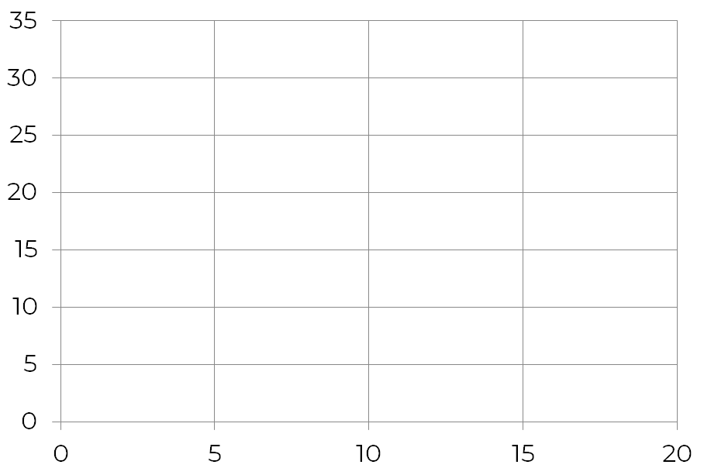
HT Only - Independent Practice
Calculate the approximate speed of the object once it has travelled 20 m.
Distance (m)
Time (s)

