Slide 1
Comparing similar objects by size.
Mathematics
Mrs Harris

Slide 2
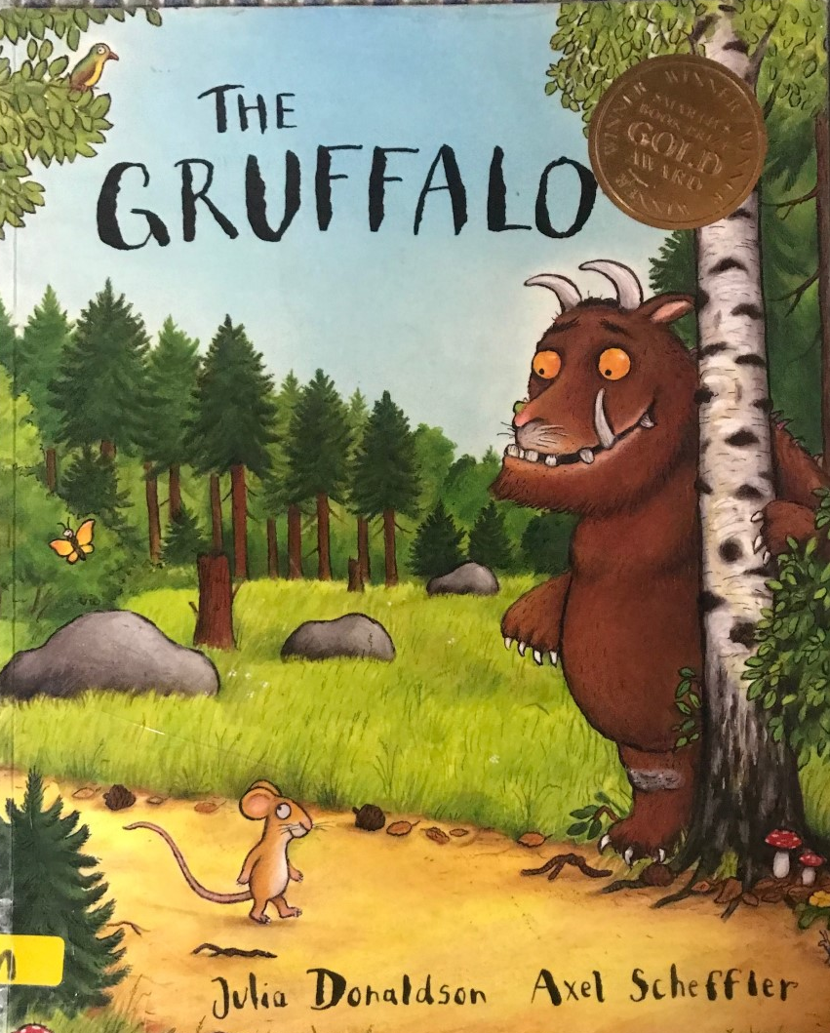
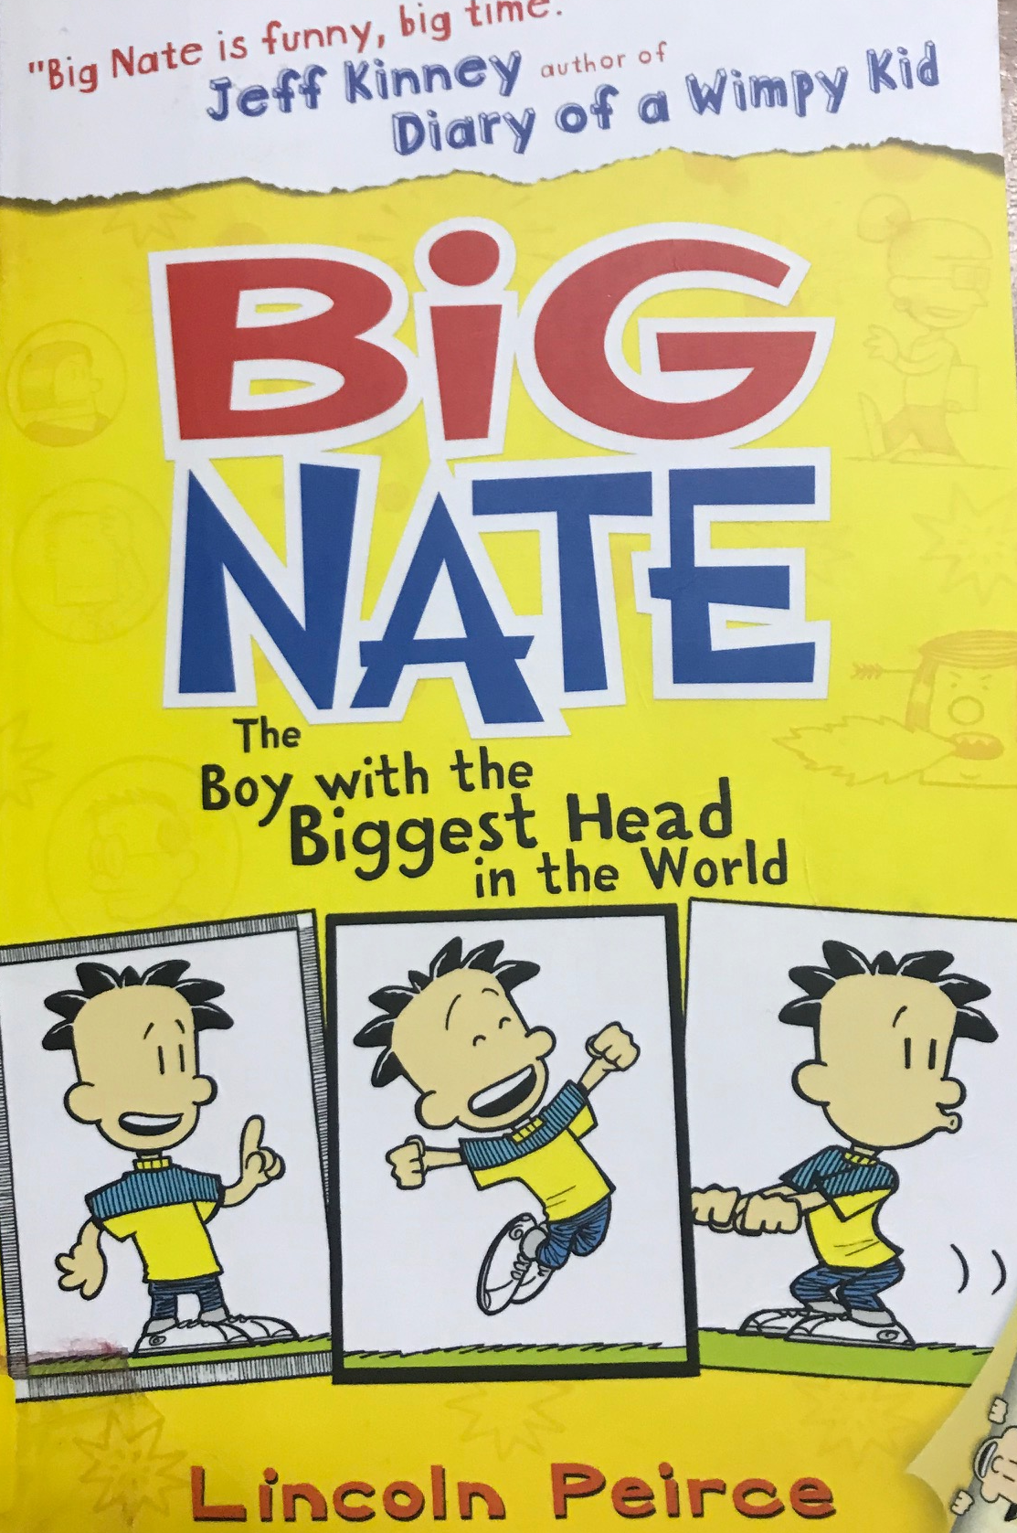
Source: Each Peach Pear Plum, Janet and Allan Ahlberg, Penguin Books, The Gruffalo, Julia Donaldson, Macmillan, Big Nate; The Boy with the Biggest Head in the World, Lincoln Peirce, Harper Collins,
Notes:
Exit slide

Slide 3
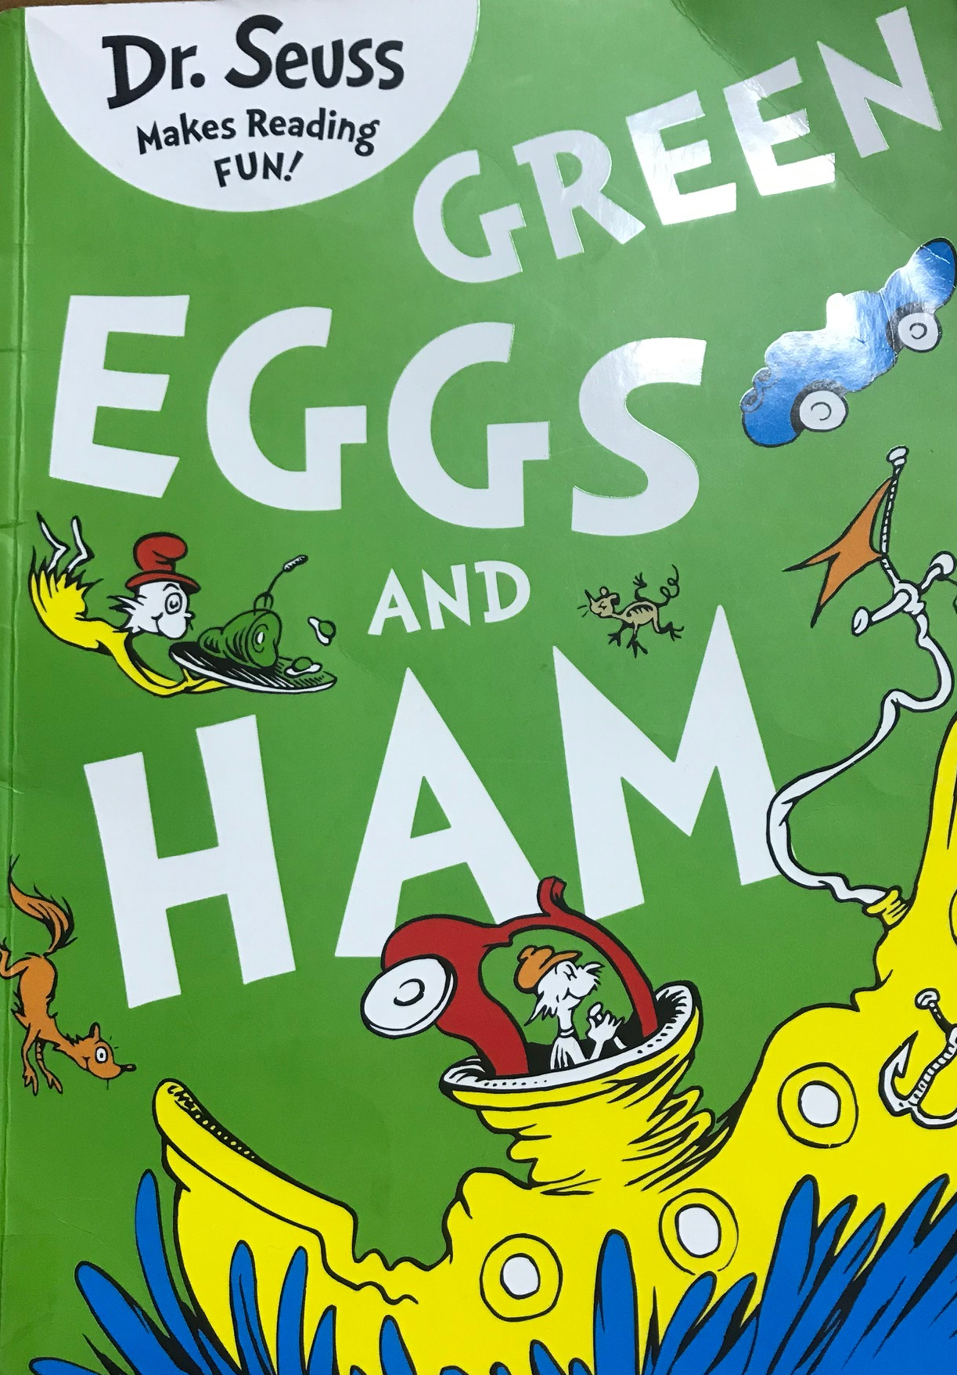
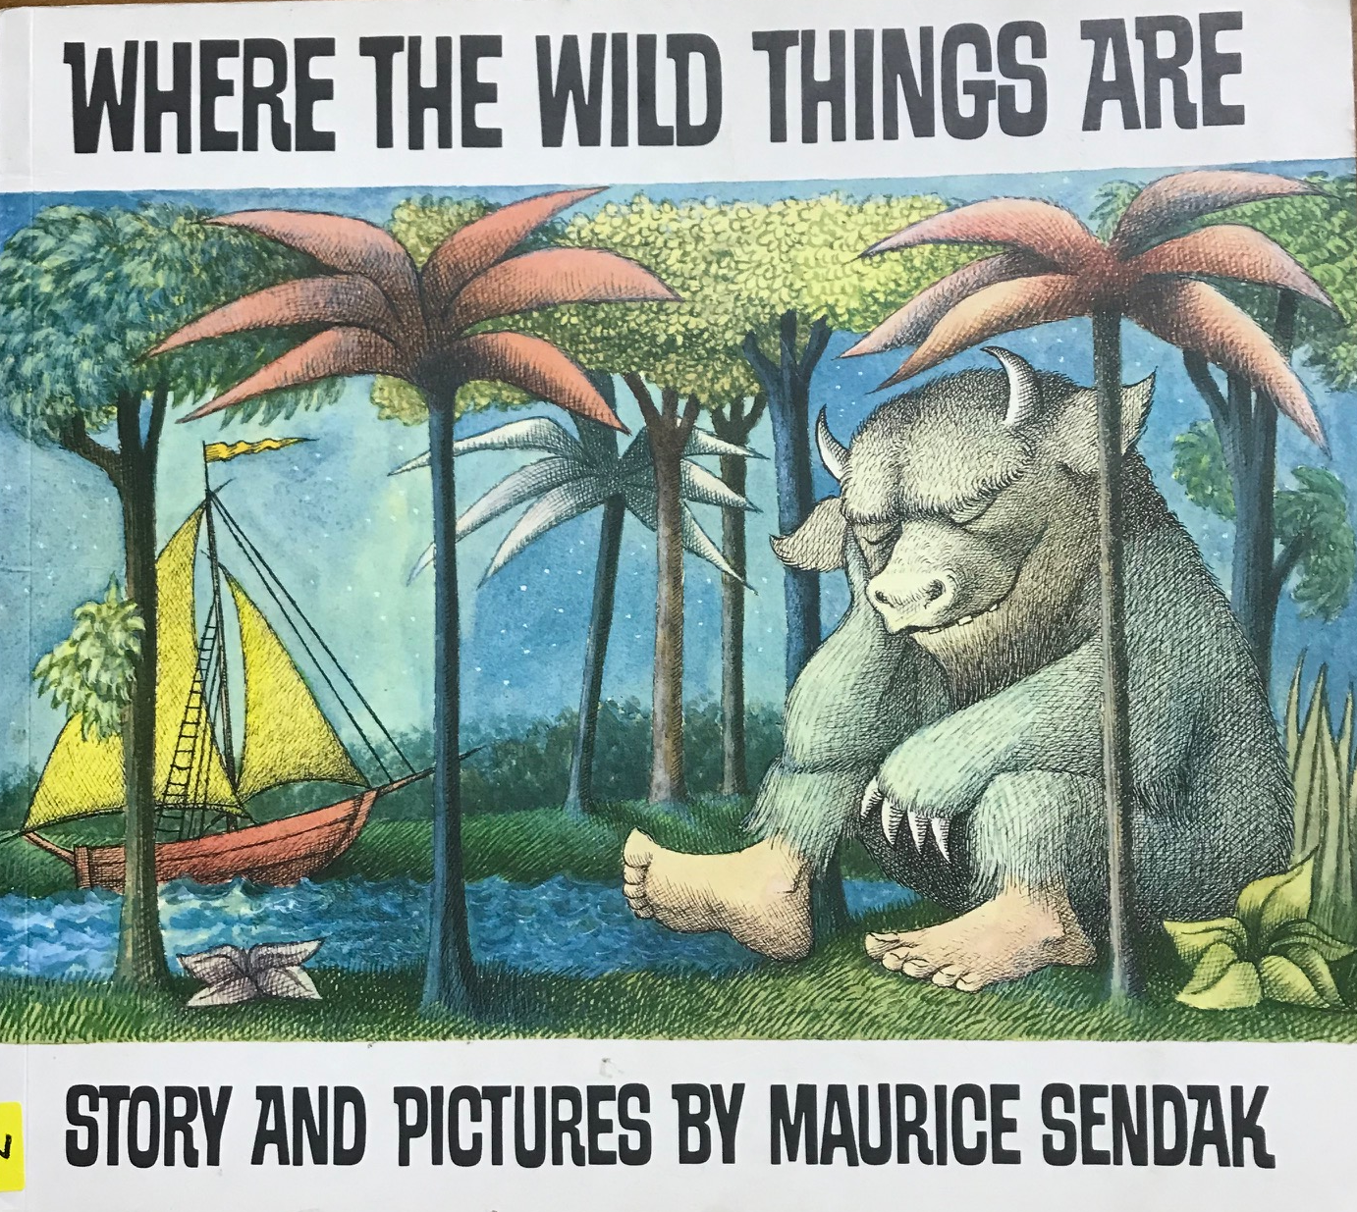
Source: Green Eggs and Ham, Dr Seuss, Harper Collins, Mr Happy and the Wizard, Rogar Hargreaves, Egmont, Where the Wild Things Are, Maurice Sendak, A Red Fox Book.
Notes:
Exit slide

