Slide 1
Deriving decimal multiplication facts
Mathematics
Natalie Sew
Notes:
In this lesson pupils derive multiplication facts involving decimal numbers, exploring a range of language structures and models. By the end of this lesson pupils will use a known fact (e.g. 2 x 6 = 12) to derive a decimal calculation (e.g. 0.2 x 6 =1.2)

Slide 2
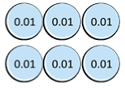
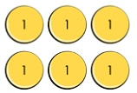
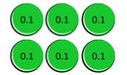
Independent Task: 1 of 2
Write 2 multiplication statements for each of the sets of place value counters.
When you have six equations write two sentences using the sentence stem:
If I know _____ x ____ = _____ then I know ____ x ____ = _____.
This is because ____ is ___ times smaller than ______.
Notes:
Read through task instructions. Note this is task 1 of 2 and you will have to unpause the video to get task 2!

Slide 3
Independent Task: 2 of 2
This time you only have your arrays in ones. Complete the equations, using If I know… then I know… to support. This time, you also need to use thousandths.
6 x 7 =
7 x 6 =
7 x 0.6 =
6 x 0.7 =
7 x 0.06 =
6 x 0.06 =
7 x 0.006 =
6 x 0.007 =
Challenge: What do you notice when you multiply by a decimal less than 1?

