Slide 1
Music
Finding the pulse
Lesson 1 of 6: Worksheet
Miss Hart

Slide 2
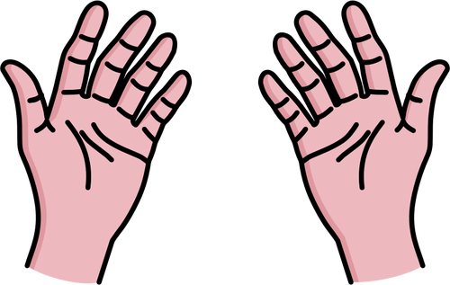
Music worksheet for lesson 1, activity 2
Instructions:
For this activity you are going to compose your own body percussion pattern.
I have included my example on the sheet.
Can you think of some different body actions for your pattern?
Can you perform your pattern to another family member and keep a steady pulse?
Challenge:
1 | 2 | 3 | 4
1 | 2 | 3 | 4
Images: Free svg, Human feet cartoon clip art, Vector image of open your palms.
My example
Your pattern

