Slide 1
Ratio and proportion in geometry
Lesson 2 of 4
Downloadable Resource
Mathematics
Miss Kidd-Rossiter

Slide 2
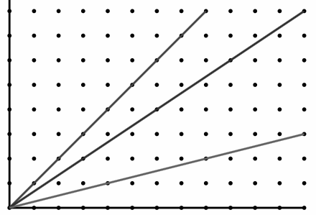
C
Q
Y
A
Notes:
𝐴𝐻 :𝐴𝐶=3 :8 𝐴𝐻 :𝐻𝐶=3 :5
𝐴𝐻/𝐴𝐶=3/8 𝐴𝐻/𝐻𝐶=3/5
Same information about the relative size of the part(s) and the whole.
Different representation.

Slide 3
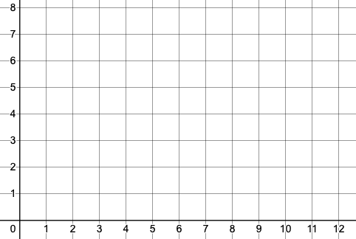
B
What is the midpoint of line segment AB?
What is the ratio of AM : AB?
What is the ratio of AM : MB?
A

Slide 4
B
A

Slide 5
The line AMB is drawn on the axes to the left, where M is the midpoint. B has coordinate (10, 8). What is the coordinate of A if:
M is (5, 4)?
M is (7, 5)?
M is (10, 5.5)?
M is (10.5, 6.25)?

Slide 6
The line AQB is drawn on the axes to the left, where Q is a point on the line. B has coordinate (10, 8). What are the coordinates of:
Q if A is (1, 2) and AQ: QB is 1 : 2?
Q if A is (1, 2) and AQ: AB is 2 : 3?
A if Q is (4, 5) and AQ: AB is 2 :5?
A if Q is (11, 6) and AQ: QB is 1 : 1?

