Slide 1
Mathematics
Exploring the components of numbers within 100
Miss Hughes

Slide 2
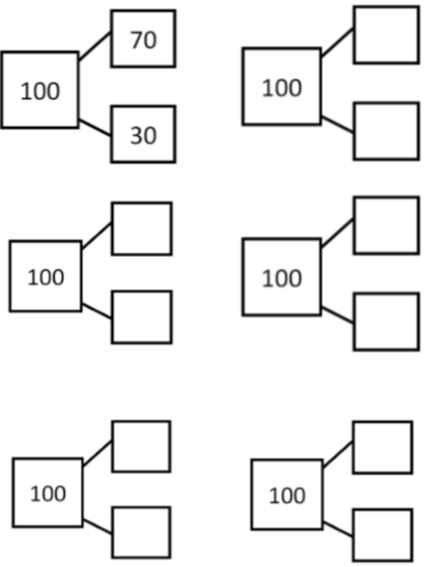
Independent Task
How many different ways can you make 100
using multiples of ten?
Can you find all the combinations?

Slide 3
Independent Task
60
40
How many different ways can you make 100
using multiples of ten?
Can you find all the combinations?
90
50
10
50
80
100
20
0

