Slide 1
Saying how you do things and how you enjoy them (Part 2/2)
Using adverbs of time and combining them with adverbs of manner in sentences in the present tense
Downloadable Resource
German
Herr Scales

Slide 2
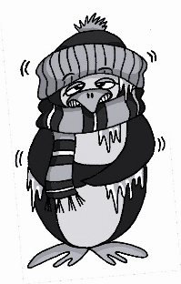
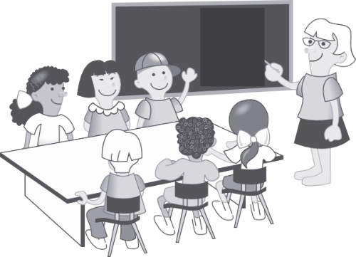
a
lang
Mann
6 Meter
kalt
Klasse
danke
Gast
[guest]
Rachel Hawkes
Notes:
Introduce and elicit the pronunciation of the individual SSC ‘a’ and then the source word again (with gesture, if using). Then present and elicit the pronunciation of the five cluster words. The cluster words have been chosen for their high-frequency, from a range of word classes, with the SSC (where possible) positioned within a variety of syllables within the words (e.g. initial, 2nd, final etc.). Additionally, we have tried to use words that build cumulatively on previously taught SSCs (see the Phonics Teaching Sequence document) and do not include new SSCs. Where new SSCs are used, they are often consonants which have a similar symbol-sound correspondence in English.
Word frequency rankings (1 is the most common word in German): kalt [875]; lang [95] Mann [131]; Klasse [619]; Gast [675]; danke [778]. Source: Jones, R.L. & Tschirner, E. (2006). A frequency dictionary of German: core vocabulary for learners. Routledge

Slide 3
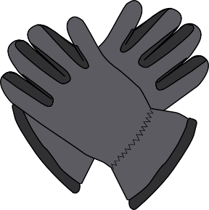
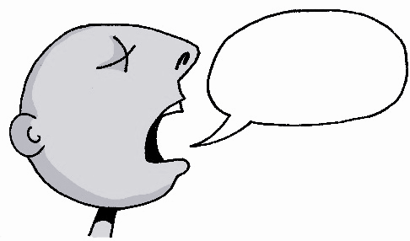
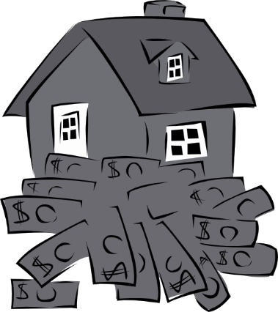
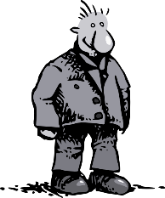
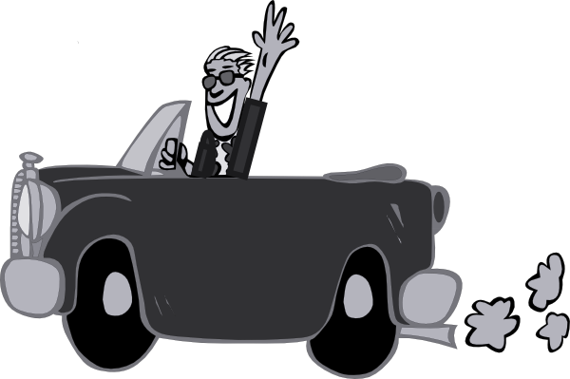
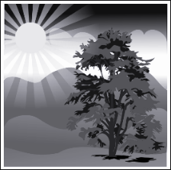
a
Paar
haben
sagen
fahren
Tag
klar
Rachel Hawkes
Notes:
Introduce and elicit the pronunciation of the individual SSC ‘a’ and then the source word again (with gesture, if using). Then present and elicit the pronunciation of the five cluster words. The cluster words have been chosen for their high-frequency, from a range of word classes, with the SSC (where possible) positioned within a variety of syllables within the words (e.g. initial, 2nd, final etc.). Additionally, we have tried to use words that build cumulatively on previously taught SSCs (see the Phonics Teaching Sequence document) and do not include new SSCs. Where new SSCs are used, they are often consonants which have a similar symbol-sound correspondence in English.
Word frequency rankings (1 is the most common word in German): sagen [46]; Paar [284] haben [7]; fahren [169]; klar [255]; Tag [108]. Source: Jones, R.L. & Tschirner, E. (2006). A frequency dictionary of German: core vocabulary for learners. Routledge

Slide 4
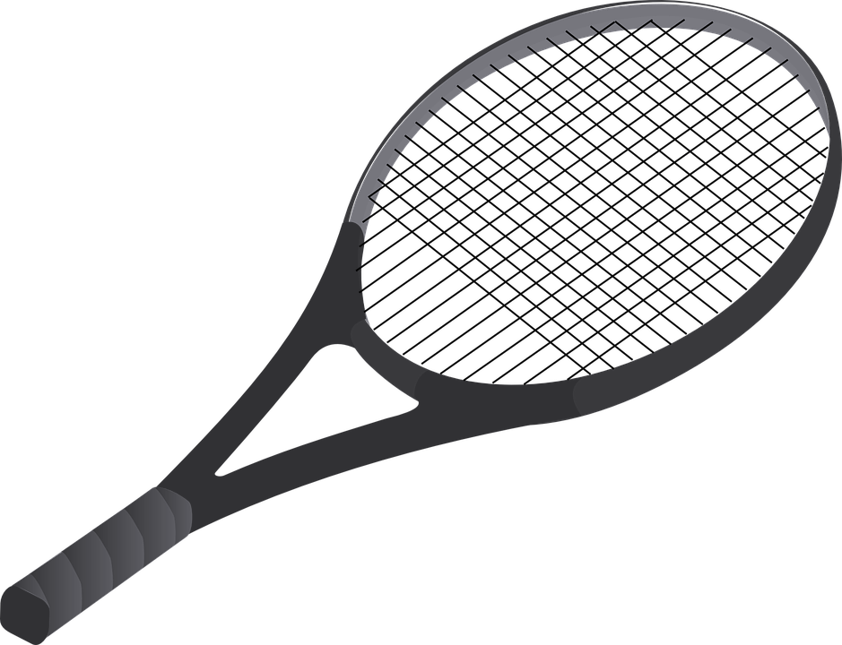
Adverbs of time eg. manchmal, oft, normalerweise, gewöhnlich, can be added to sentences to say when or how often you do or don't do something
Ich spiele oft Tennis.
subject
verb
adverb
object
I play often Tennis.
verb
verb
subject
verb
adverb
object

Slide 5
They can also be combined with adverbs of manner (see lesson 1). if they are, the adverb of time goes before the adverb of manner
Ich spiele oft gern Tennis.
subject
verb
adverb of time
adverb of manner
object
I play often willingly Tennis.
adverb of time
adverb of manner
object
subject
verb

Slide 6
Noch Beispiele!
Ich spiele manchmal gern Fußball = I play sometimes willingly football = I sometimes like playing football
Ich spiele manchmal nicht gern Fußball = I play sometimes not willingly football = I sometimes don't like playing football
Ich spiele manchmal sehr gern Fußball = I play sometimes very willingly football = I sometimes like playing football very much
Ich spiele manchmal gar nicht gern Fußball = I play sometimes not at all willingly football = I sometimes really don't like playing football

Slide 7
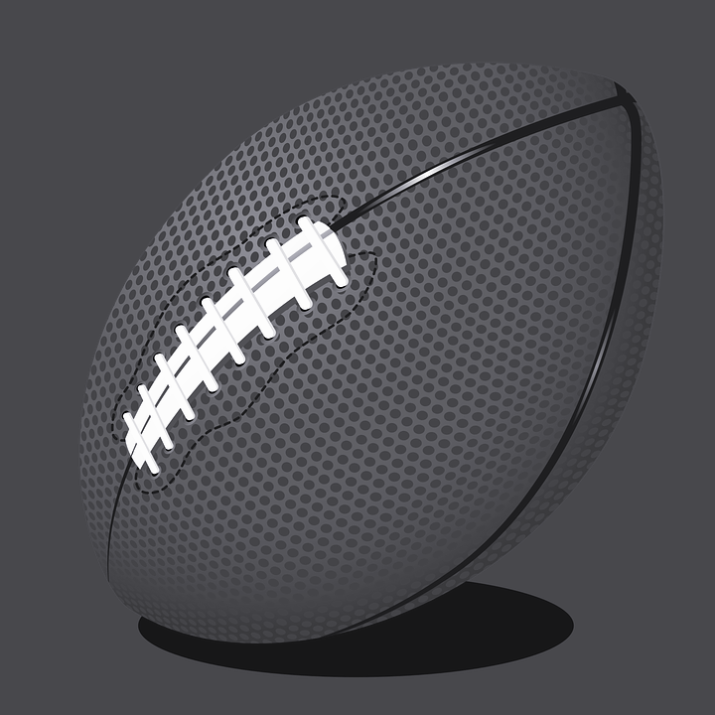
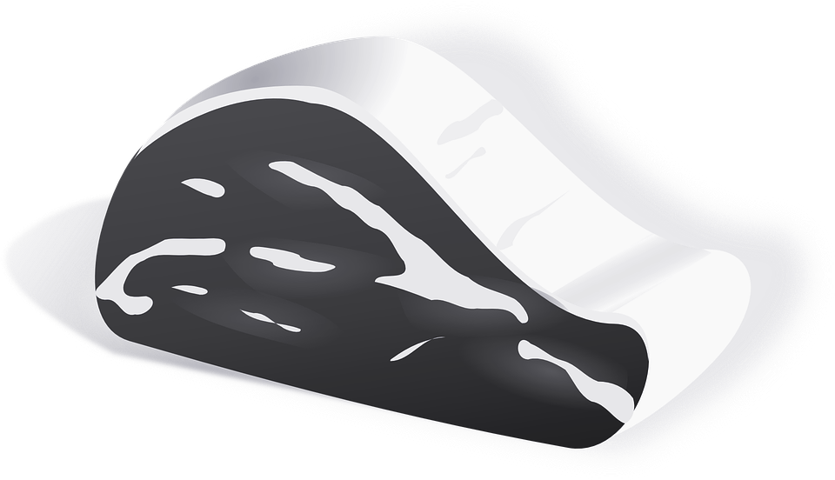
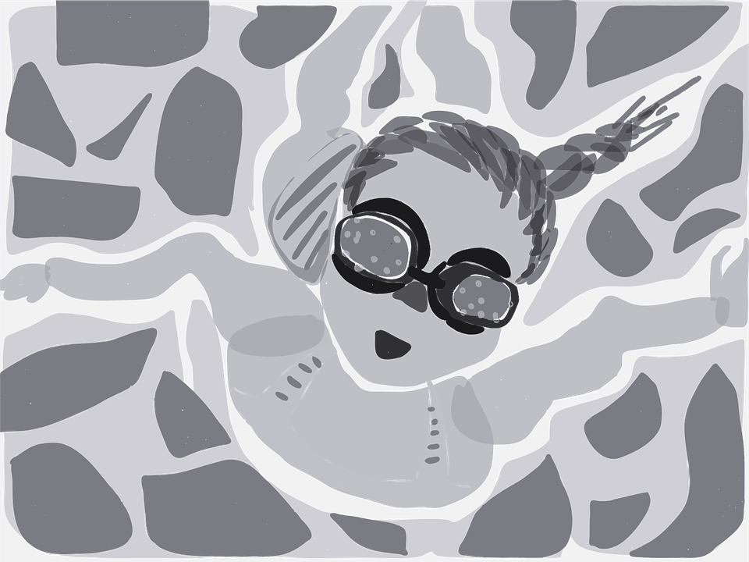
Füll die Lücken aus!
1. My brother normally really likes playing rugby
2. I never really like eating meat
3. My (female) friends always like going shopping
4. I rarely watch TV
5. You go swimming now and then, don't you?
normalerweise sehr gern
Mein Bruder spielt __________ ________ __________ Rugby
nie sehr gern
Ich esse _______ ___________ ___________ Fleisch
immer gern
Meine Freundinnen gehen __________ ______ _________ einkaufen
selten
Ich sehe _________________ fern
ab und zu
Du gehst _________ ___________ schwimmen, nicht wahr?

Slide 8
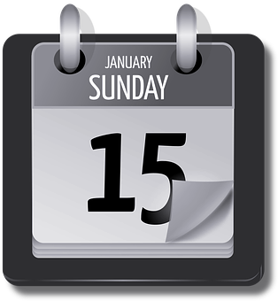
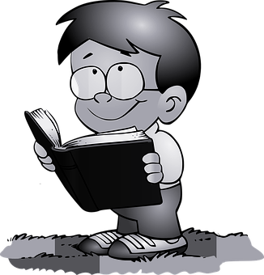
However, it is also possible to start a sentence in German with an adverb of time, or a time phrase. Here is an example from Unit 3 Lesson 1:
Am Sonntag liest er ein Buch
Time phrase
Subject
Verb
Object
Notice how this is different from English word order:
On Sunday he reads a book
Time phrase
object
Subject
verb

Slide 9
Likewise, we can also start German sentences with adverbs of time
Oft spiele ich gern Tennis.
adverb of time
adverb of manner
object
verb
subject
Notice how this is different from English word order:
Often I play willingly tennis = Often I like playing tennis
adverb of time
adverb of manner
subject
verb
object

Slide 10
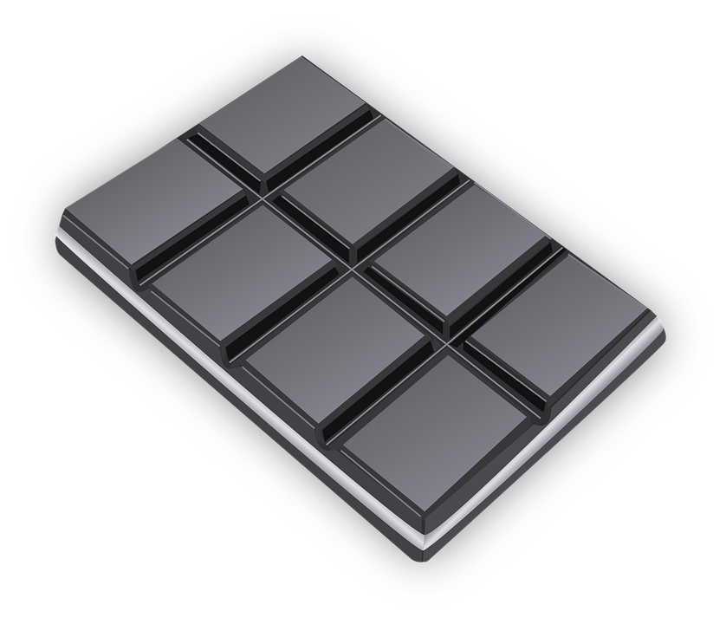
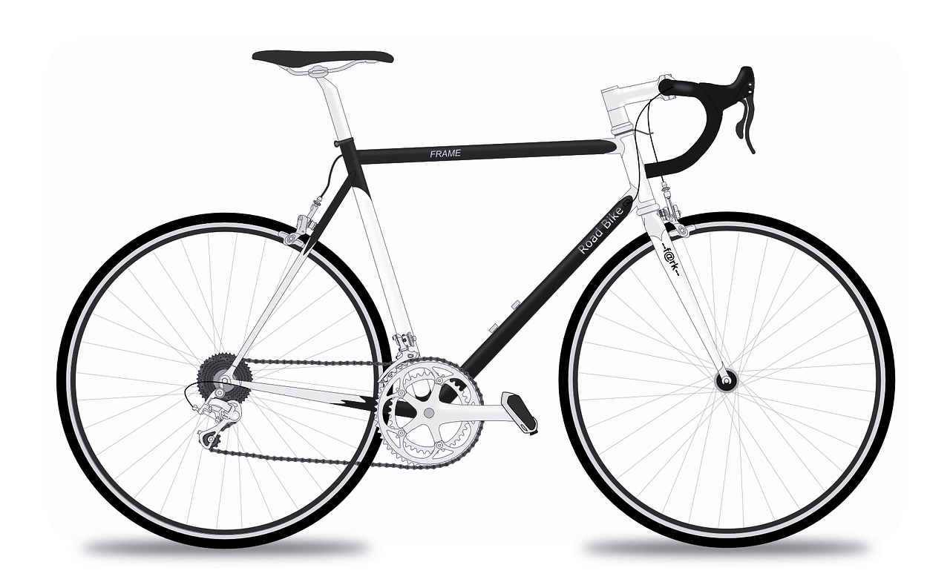
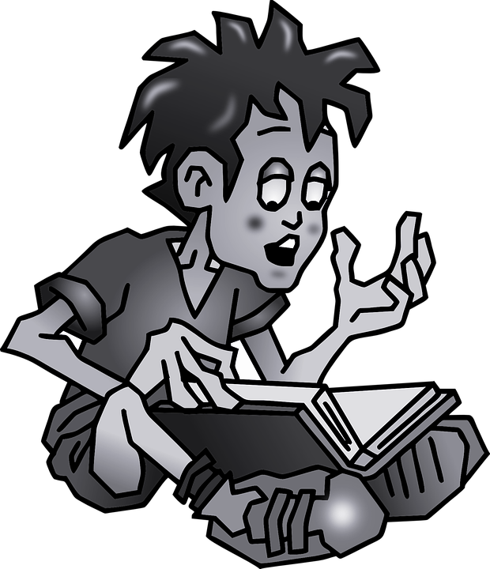
Füll die Lücken aus!
1. Sometimes, my brother plays computer games on his own
2. Normally I eat chocolate very quickly
3. Today my parents are definitely going shopping
4. Now and then I prefer cycling (I go rather bike)
5. Tomorrow you are probably doing your homework, aren't you?
Manchmal
spielt mein Bruder allein Computerspiele
Normalerweise
___________________________ esse ich sehr schnell Schokolade
Heute
_________ gehen meine Eltern bestimmt einkaufen
Ab und zu
_________ fahre ich lieber Rad
Morgen
_____________machst du wahrscheinlich deine Hausaufgaben, nicht wahr?

Slide 11
Summary of learning
In German, adverbs of time can follow directly after the verb, unlike in English, where they often follow the subject, or go at the end
Eg I sometimes play football = I play sometimes football
= ich spiele Fußball
manchmal
Adverbs of time come before adverbs of manner
eg I sometimes like playing football = Ich spiele _________ _________ Fußball
manchmal
gern
However, you can also start a sentence with adverbs of time
eg. Sometimes, I play willingly football = sometimes I like playing football
_________ spiele ich ___________ Fußball
Manchmal
gern

