Slide 1
Independent Living Daily Living Skills
Lesson 2 - Getting dressed
Oak Specialist
Building Understanding

Slide 2
Unit 3- Daily Living Skills
Lesson 1- Creating a visual schedule
Lesson 2- Getting dressed
How to make and follow a visual schedule for daily activities.
Breaking down the steps of the sequence and creating opportunities for independence.
Lesson 3- Recycling
Lesson 4- Using equipment in the kitchen
Sorting recycling items into different categories.
Labelling kitchen equipment and learning what food to use them with.
Lesson 5- Following a simple recipe
Lesson 6- Daily meals
Following simple steps to make a cheese sandwich.
Choosing food items and matching them to a meal time.

Slide 3
Teacher notes- Getting dressed
Learning Intention: To explore strategies for independence in dressing.
Skills required for dressing- introduction to each one.
How to support independent dressing- supporting environment and approach.
Backward chaining- teaching for success. Breaking a dressing sequence into steps.
Top tips for developing independence with specific clothing items- tops, zips and shoelaces.
Resources: clothing items
Notes:
This is the equivalent to a loose lesson plan/overview for teachers before starting the lesson.

Slide 4
Independent dressing
All learners will develop independence in dressing at different stages. Skills required for dressing:
Motor skills (fine and gross)
Co-ordination
Balance
Perception
Stereognosis
Body Schema

Slide 5
Motor skills (fine and gross)
Requires muscle strength and flexibility in joints and limbs.

Slide 6
Co-ordination
Requires the ability to create co-ordinated movements with limbs, e.g. pulling t-shirt down with one arm whilst pushing the other arm through a sleeve.

Slide 7
Balance
The ability to maintain balance whilst shifting position and posture, e.g. putting one leg through trousers whilst standing on the other.

Slide 8
Perception
Knowing that things are different shapes and sizes, eg. fitting buttons through holes.

Slide 9
Stereognosis
The ability to feel around clothing items without being able to see, e.g putting arms through a jumper whilst it is covering a head.

Slide 10
Body Schema
Knowing the difference between body parts and right and left.

Slide 11
2. Environment to support independence
Ensure your learner is in the right position e.g. sat on the floor or chair depending on the item of clothing they are putting on.
Sit in front of a mirror if possible.
Put clothes out in the correct order either in a pile or sequence.
Notes:
This is where slides will increase to include the content of the lesson as usual.

Slide 12
Approach to support independence
TIME - give your learner time to complete the steps they are working on.
Choose a time of the day when you will have time to teach dressing.
Follow a consistent sequence and technique to prompt your learner.
Prompt your learner to ‘fix’ their mistakes instead of doing it for them.
Praise your learner when they complete part of the dressing sequence independently!
Notes:
This is where slides will increase to include the content of the lesson as usual.

Slide 13
3. Backward chaining
When teaching dressing, choose an item of clothing and break the task into steps e.g. putting on a t-shirt
1. Open t-shirt 2. Put over head 3. Put one arm in 4. Put other arm in 5. Pull down.
Chain the steps by completing the first four together. When you get to the last step, encourage your learner to do this by themselves. Once they can complete the last step independently, complete the first three together and then let them do the last two by themselves.
Continue backward chaining each step until they can complete the sequence independently.

Slide 14
4. Top Tips: T-shirts/jumpers
Use t-shirt with an image on the front to help visually identify the front and back.
Lay t-shirt front down flat on the floor or bed so learner can pick it up from the bottom at the back (to pull over head).
Mark the inside of the front at the bottom with pen or coloured thread. Lay the top flat, facing downwards. When you roll the back of the top, this visually identifies that it is the correct way to put on.
Use labels to teach the back of a top. Encourage your learner to find this before putting on.

Slide 15
Top Tips: Zips
Practise fine motor activities to develop pincer grip needed for zipping.
First teach by putting item out on table of floor in front of the learner.
Attach a ring pull or keyring to the end of the zip to aid grip .
Support your learner to use both hands when zipping. One hand holding the bottom and one holding the zip.

Slide 16
Top Tips: Shoelaces
Practise with shoe on lap first.
Observe how much of the sequence they can already do before deciding the teaching point.
Practise ‘tying’ using string or wool.
Velcro fastening shoes.
Use elastic laces for pull on and off.

Slide 17
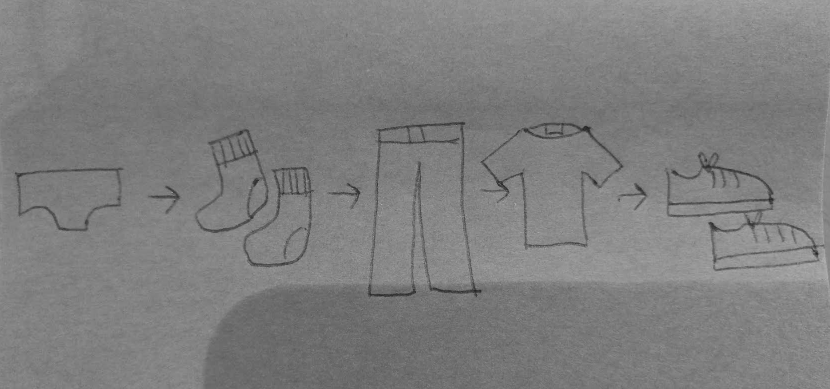
Dressing sequence
As your learner develops their independence in putting particular clothing items on, you could set up a visual sequence to follow to develop independence in the routine.
Draw or use symbols to show the steps in the dressing routine. Point to each step to encourage transition.

Slide 18
Independent Living
Daily Living Skills
Getting dressed: Suggested adaptations for teachers/parents/carers.
Make it easier
Make it harder
More ideas
Choose one item of clothing to work on and follow the backward chaining approach.
Play dress up and practice skills out of context.
Help pull clothes the right way round when emptying wet washing from the machine.
Seek advice from an Occupational Therapist for specific support strategies and activities.
Notes:
Final slide of the lesson. Suggest adaptations for teachers/parents.

Slide 19
Further Learning with Oak National
Independent Living:
Building Understanding- Fine/gross motor circuit (Unit 2)
Occupational Therapy:
Fine Motor Skills (Unit 2)
Activities of Daily Living (Unit 6)

