Slide 1
Lesson 4: Becoming a Data Master
Spreadsheets
Computing
Halima Bhayat
Materials from the Teach Computing Curriculum created by the National Centre for Computing Education

Slide 2
Example of a SUM function
SUM can be used to quickly add lots of numbers together in a row or column.
=SUM(D4:D11)
Notice at the top the formula bar shows your formula.
Credit: Google Sheets screenshot: Halima Bhayat

Slide 3
Example of a MAX
A MAX formula works out the largest value from those you select.
=MAX(D4:D11)
Credit: Google Sheets screenshot: Halima Bhayat

Slide 4
Example of a MIN
A MIN formula works out the smallest value from those you select.
=MIN(D4:D11)
Credit: Google Sheets screenshot: Halima Bhayat

Slide 5
Example of a COUNTA
A COUNTA formula works out the non blank values in a cell.
=COUNTA(D4:D11)
Credit: Google Sheets screenshot: Halima Bhayat

Slide 6
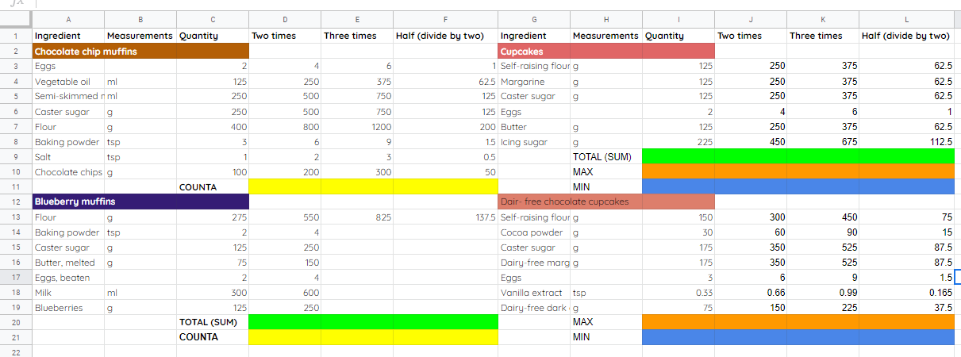
Task 1 Analysing a cake recipe
Credit: Google Sheets screenshot: Halima Bhayat

Slide 7
Analysing a cake recipe
Open your cake recipes spreadsheet from Lesson 2.
Viewing the spreadsheet image provided make use of a SUM, COUNTA, MIN and MAX functions. The cells that need to make use of the function have been colour coordinated.
SUM - Green
COUNTA - Yellow
MIN - Blue
MAX - Orange
Source: Pixabay

Slide 8
Pause the video to complete your task
Resume once you’re finished

Slide 9
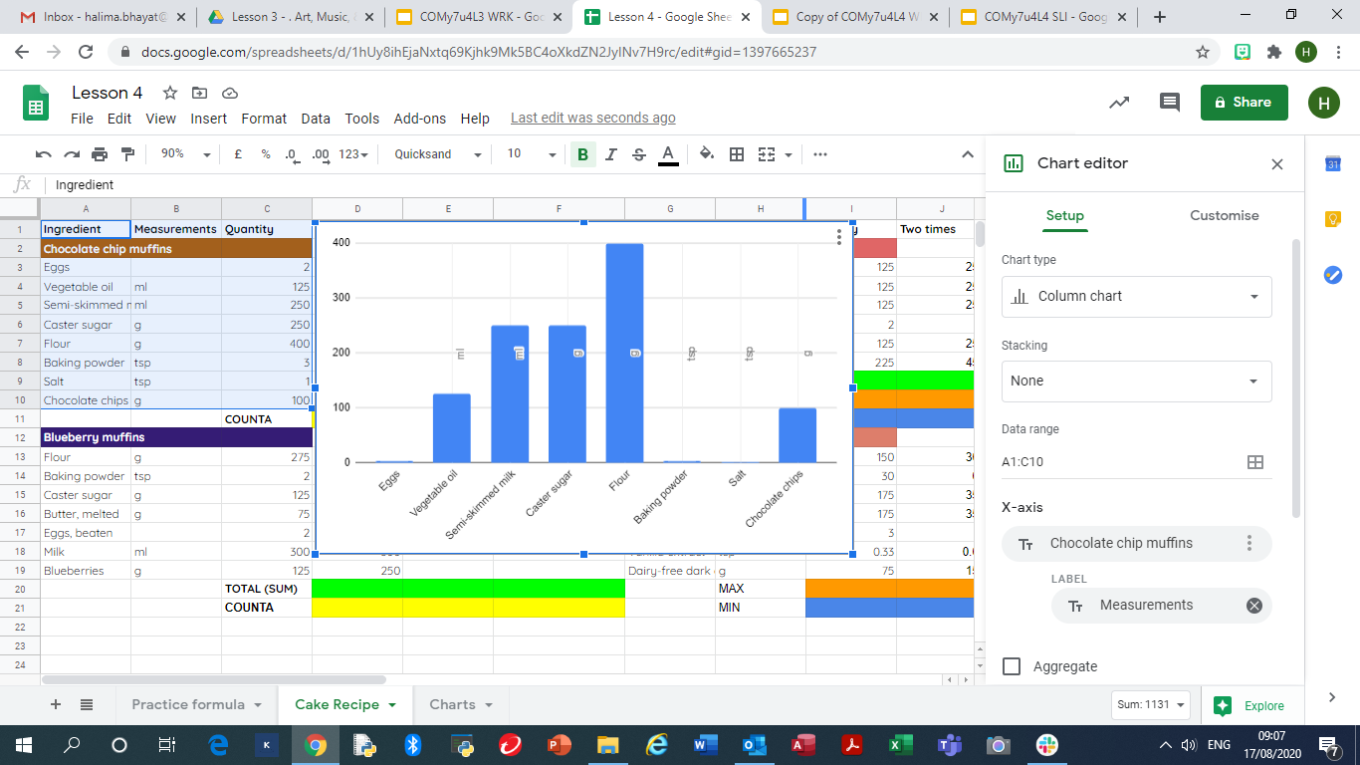
Task 2 Creating a Chart
Credit: Google Sheets screenshot: Halima Bhayat

Slide 10
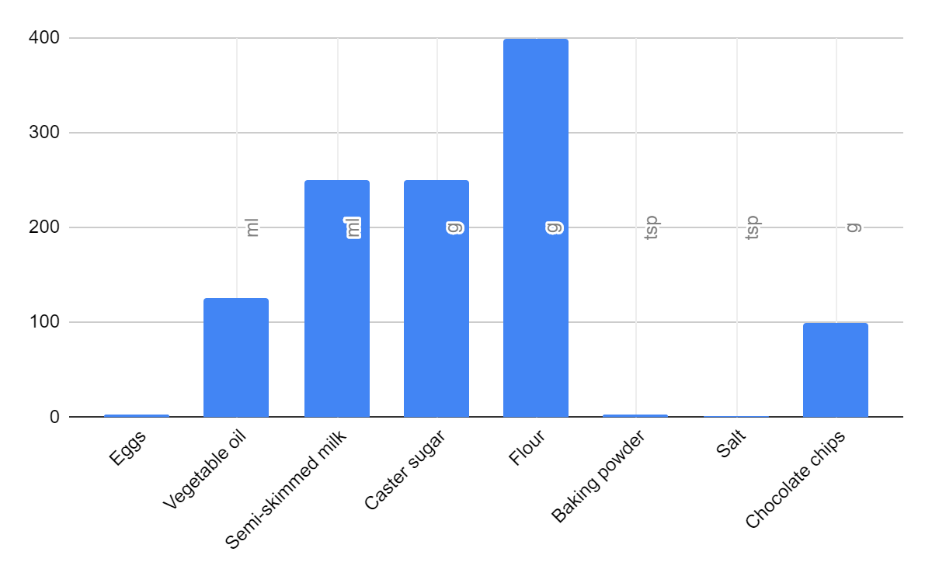
Creating a Chart
Highlight one cake recipe of your choice as seen in the spreadsheet image provided.
You only need need to highlight the measurements and Quantities.
Go to Inset chart and select a bar chart.
By using the customise tool you can change the way the chart looks.
Which ingredient has the highest quantity?
Credit: Google Sheets screenshot: Halima Bhayat

Slide 11
Pause the video to complete your task
Resume once you’re finished

