Slide 1
Review 2
Worksheet
Separate Science - Chemistry - Key Stage 4
C8 Chemical Analysis
Mr Robbins

Slide 2
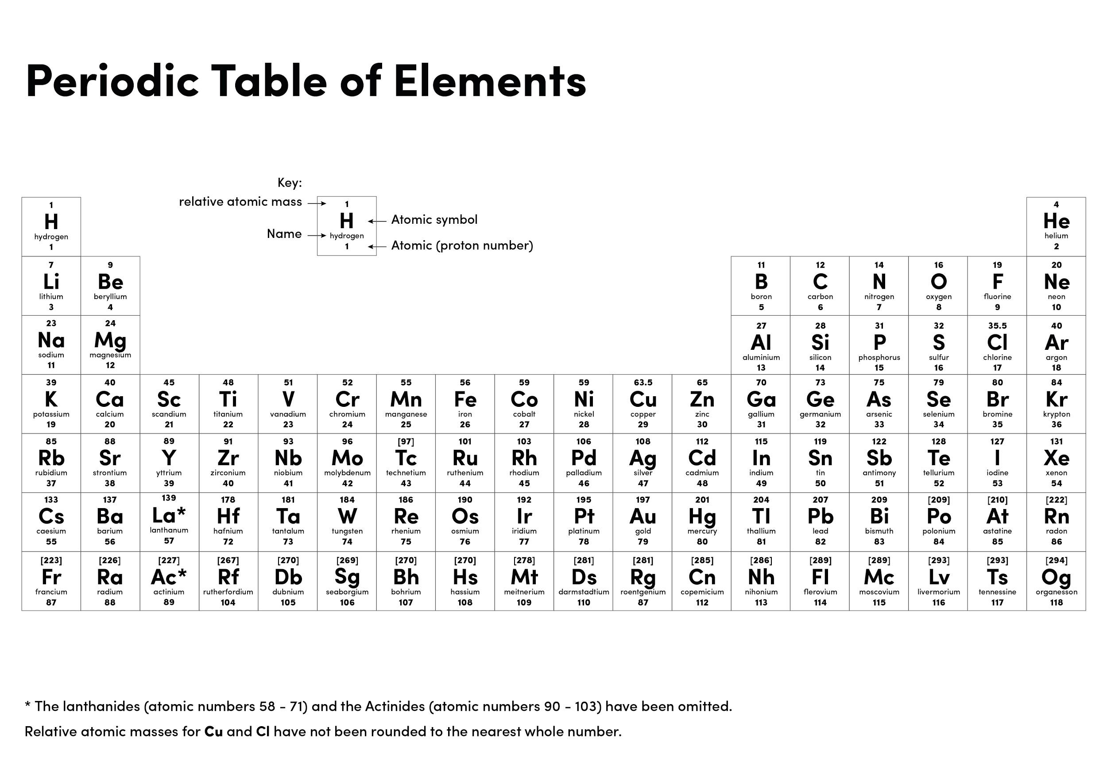

Slide 3
Independent task
Ion | Test | Positive result | Negative result
Lithium | Flame test | Crimson | Any other colour
 |  | Yellow
Potassium
 |  | Orange-red
Copper

Slide 4
Independent task
Ion | Test | Positive results | Negative result
Aluminium, calcium, magnesium ions
Copper (II)
Iron (II)
Iron (III)

Slide 5
Independent task
Ion | Test | Positive result | Negative result
Carbonate (CO₃²⁻)
Sulfates (SO₄²⁻)
Halides

