Slide 1
Comparing and ordering numbers within 50
Mathematics
Mrs Bramble and Miss Sidhu

Slide 2
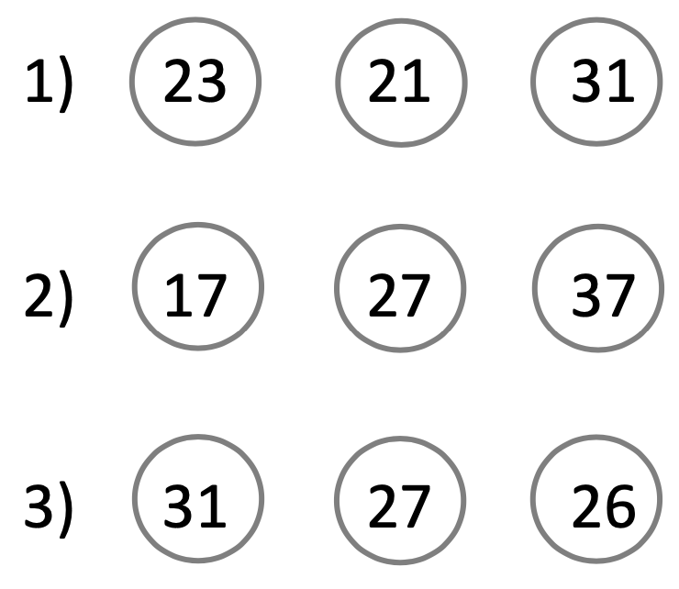
Order the numbers from the least to the greatest value.

