Slide 1
Lesson 5: Clean it up
Data science
Computing
Ben Garside
Materials from the Teach Computing Curriculum created by the National Centre for Computing Education

Slide 2
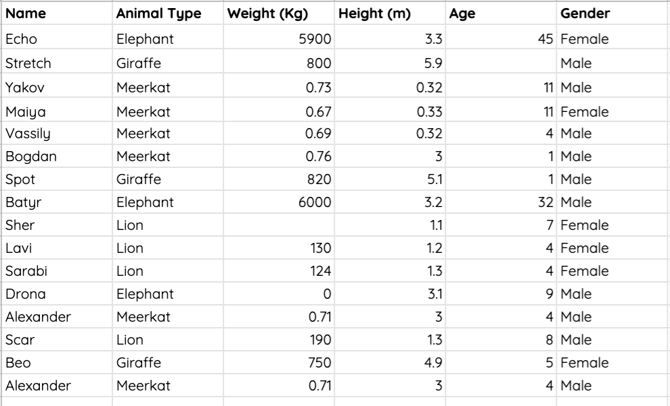
Task 1 - Clean it up
The following link takes you to a data set about zoo animals:
oaknat.uk/comp-A0-data-cleansing
Spend some time looking at the data and see whether it is ready for analysis.
Check to see if any data needs correcting. If so, how might you correct it?

Slide 3
Task 2 - Data upload
Save your spreadsheet as a CSV file
Open the CODAP website (oaknat.uk/comp-codap-concord)
Create a new document by selecting Try CODAP
Upload the CSV file
If you don’t have a data set to use, you can use the following data. This data set is a collection of data recorded about litter dropped in a school.
oaknat.uk/comp-L5-sample-data

Slide 4
Task 3 - Data analysis 1
Now that you have uploaded your data to CODAP, it’s time to analyse it and create a visualisation that helps you to answer one of the questions that you posed last lesson.
Write one of the questions that you posed last week into the table on the next slide
Insert an image of a visualisation that helps to answer the question
Write a few sentences to describe what you have learnt from the visualisation and whether it helps you to answer the question

Slide 5
Task 2 - Data analysis 1
Paste a screenshot of your visualisation in the box below
Question
Findings: write a few sentences describing what you have learnt from this visualisation

