Slide 1
How can you separate a mixture of sand, salt and water?
Downloadable Resource
Science
Miss Couves

Slide 2
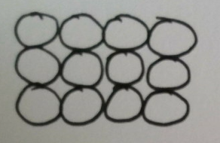
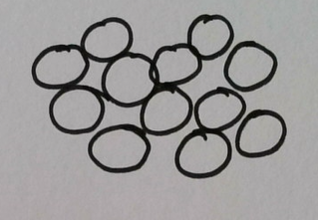
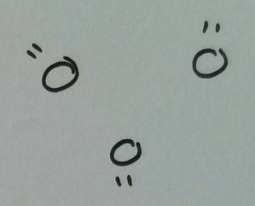
Which state of matter does each diagram represent?

Slide 3
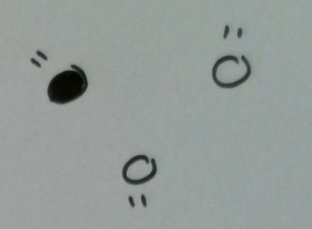
Which diagram shows a pure gas?

Slide 4
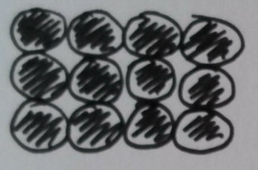
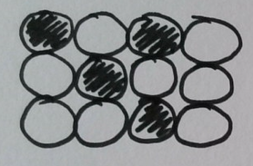
Pure metal or alloy?

Slide 5
Is this a formulation?
When making a cake you always use the same amount of sugar, butter, flour and eggs.

Slide 6
Salt dissolves in water, salt is called...
Option 1
Option 2
A solution
A solvent
Option 3
Option 3
Option 4
Option 4
A solute
A formulation

Slide 7
Salt dissolves in water, water is called...
Option 1
Option 1
Option 2
Option 2
A solution
A solvent
Option 3
Option 3
Option 3
Option 4
Option 4
Option 4
A solute
A formulation

Slide 8
Salt dissolves in water, the mixture produced is called...
Option 1
Option 1
Option 2
Option 2
A solution
A solvent
Option 3
Option 3
Option 3
Option 4
Option 4
Option 4
A solute
A formulation

Slide 9
Soluble or insoluble?
Sugar is soluble in water, will sugar dissolve in water?
Give two examples of insoluble solids.
How can a soluble solid be separated from a liquid?
How can an insoluble solid be separated from a liquid?

Slide 10
How can we separate sea water?
Which solid in the seawater mixture was insoluble?
How was the insoluble solid separated?
Draw a particle diagram to represent the pure sand that was separated.
Which solid in the seawater mixture was soluble?
How was the soluble solid separated?
Draw a particle diagram to represent the pure salt that was separated.

