Slide 1
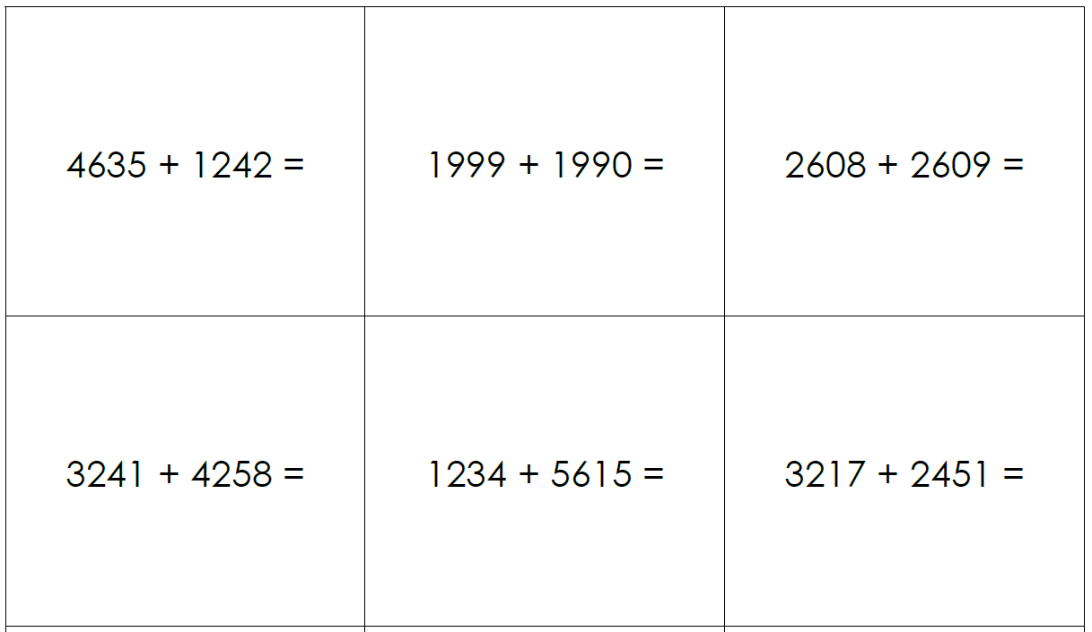
Independent Task
Questions
Solve the following equations using the most efficient method.
Challenge: Can you explain why you chose your method?
3805 + 3803 =
3217 + 2491 =

