Slide 1
Solve problems with repeated percentage change
Maths
Mr Clasper

Slide 2
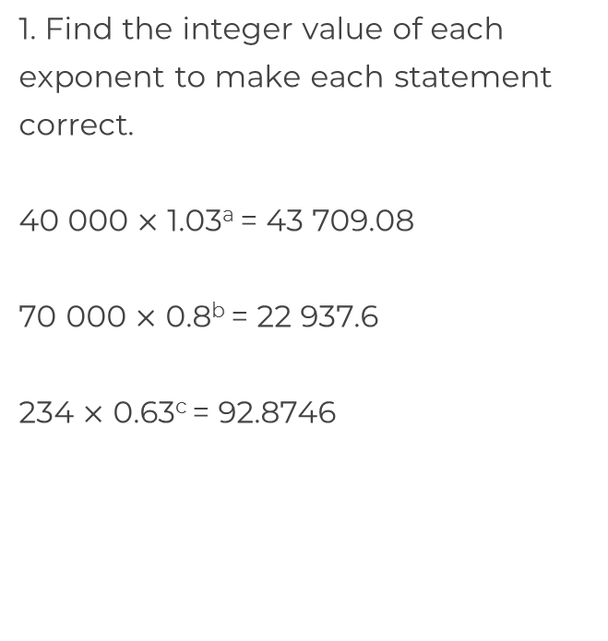
Solve problems with repeated percentage change
2. The population of Britain was approximately 66 000 000 in 2019. If the population increases at a rate of 1% per year, how many years would it take to reach a population of
67 999 866?

Slide 3
Solve problems with repeated percentage change
3. Alan has invested £5000 in a company which guarantees a profit of 5% every year. After how many years will it take Alan to make a profit of more than £500?
4. A car is valued at £4000 and depreciates in value by 11% every year. After how many years will the value of the car be less than half of the original value?
5. A college has 18 students who study maths and 20 students who study English.
The number of students studying maths increases by 15% each year.
The number of students studying English increases by 10% each year.
After how many years will the college have more students studying maths?

Slide 4
Answers

Slide 5
Solve problems with repeated percentage change
2. The population of Britain was approximately 66 000 000 in 2019. If the population increases at a rate of 1% per year, how many years would it take to reach a population of
67 999 866?
a = 3
b = 5
3 years
c = 2

Slide 6
Solve problems with repeated percentage change
3. Alan has invested £5000 in a company which guarantees a profit of 5% every year. After how many years will it take Alan to make a profit of more than £500?
4. A car is valued at £4000 and depreciates in value by 11% every year. After how many years will the value of the car be less than half of the original value?
5. A college has 18 students who study maths and 20 students who study English.
The number of students studying maths increases by 15% each year.
The number of students studying English increases by 10% each year.
After how many years will the college have more students studying maths?
2 years
3 years
Maths (after 3 years) – 27.375…
English (after 3 years) – 26.62
6 years

