Slide 1
Reading and Writing 7-Digit Numbers
Worksheet
Mathematics
Mrs Harris

Slide 2
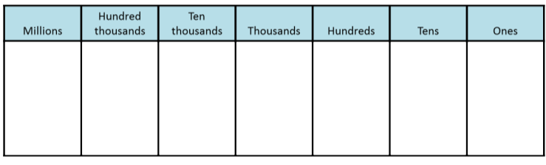

Slide 3
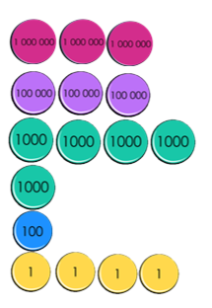
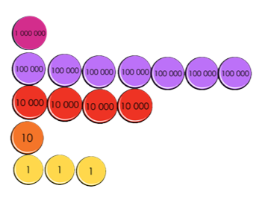
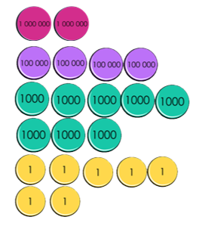
Independent Task
Match the different representations of the same number.
Record your own matching representations for numbers that don’t match.
1,740,013
Two million four hundred and eight thousand and seven
2 487 000
One million seven hundred thousand four hundred and thirty
Challenge: Can you create an incorrect pair of representations that shows a common mistake that you or a friend might make?

