Slide 1
Spanish
Assessment
Year 7 Spanish
Term 3 - Applying your knowledge test
Resources by NCELP/University of York. Content has had superficial branding changes from NCELP/University of York (CC BY-NC-SA)

Slide 2
Achievement Test - Year 7 Term 3 Spanish
Your name: ______________________ Your class / name of teacher: ______________________
The test is in four sections:
Section A: Listening (3.5 minutes)
Section B: Reading (10 minutes)
Section C: Writing (15 minutes)
Section D: Speaking (5 minutes)
This makes a total of 35 minutes to complete the entire test.
Remember – always just have a go! If you know some words, just write or say them!
Just do what you can!

Slide 3
SECTION A: Listening
On the next slide, You will hear a short story about Daniel and Lucia’s holidays.
Tick the box under the person or people that the statement is about.
You will hear the story twice. There will be a 20 second pause in between.
After hearing it twice, you have another minute to finish the grid.

Slide 4
Who? | Lucía | Daniel | Lucía y Daniel | The story doesn’t say
1. reads books | ☐ | ☐ | ☐ | ☐
2. rides a bike | ☐ | ☐ | ☐ | ☐
3. buys things | ☐ | ☐ | ☐ | ☐
4. enjoys the countryside | ☐ | ☐ | ☐ | ☐
5. is at home today | ☐ | ☐ | ☐ | ☐
6. can rest | ☐ | ☐ | ☐ | ☐
7. must study | ☐ | ☐ | ☐ | ☐
8. has plans | ☐ | ☐ | ☐ | ☐
9. wants to talk to a friend | ☐ | ☐ | ☐ | ☐
10. is well | ☐ | ☐ | ☐ | ☐

Slide 5
SECTION B: Reading Daniel is texting a friend. Translate what they say into English.
Write your answer in English. You have 10 minutes to complete this part of the test.
¿Qué haces los domingos? _____________________________________________________________________
Debo hacer tareas en casa...____________________________________________________________________
Normalmente saco la basura y hago los deberes.._______________________________________________________________________________________
¡Son actividades aburridas!_____________________________________________________________________
Diego limpia las ventanas. _____________________________________________________________________
A veces, lavamos el coche.______________________________________________________________________ Lucía no hace mucho.__________________________________________________________________________
Quiere estar con amigos._____________________________________________________________________

Slide 6
SECTION C: Writing Read the message below from Daniel. Translate what he says into Spanish.
Write your answer in Spanish. You have 15 minutes to complete this part of the test.
Hello! I’m in Madrid with Lucía._________________________________________________________________
It’s a beautiful city. _____________________________________________________________________________
It has some museums and parks. ______________________________________________________________
The museums are near the station._____________________________________________________________
Lucía is happy today!__________________._________________________________________________________
Tomorrow I want to spend time in the shops.
I can’t today...___________________________________________________________________________________
When can you travel to Madrid?______________________________________________________________

Slide 7
SECTION D: Speaking
You will need to record your speaking. Your teacher may have given you instructions already. If not, use the instructions below:
Before you start this section of the test, please go to this website: vocaroo.com. It will open in a new tab. Click the red record button, then come back to this test.
Take up to one minute to think about what to say each time, but don’t write your sentences down.
It doesn’t matter if you make a mistake - just have a go! It doesn’t matter if you speak slowly - just keep going!

Slide 8
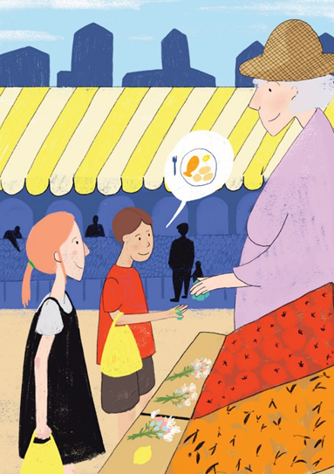
Look at the picture. Describe it to a friend by saying these sentences in Spanish:
1. Pablo and Sofia are in front of the market.
2. They have two yellow bags.
3. There is a fruit and some flowers on the table.
4. Pablo wants to eat something!
5. The woman gives money to Pablo.
To help you work out what to say, try to break each sentence into groups of words.
It doesn’t matter if you make a mistake - just have a go! It doesn’t matter if you speak slowly - just keep going!

Slide 9
Now go back to the Vocaroo window.
Click on the red button. Click on "Save & Share".
Copy & paste / write the URL for your Vocaroo recording here:
END OF ASSESSMENT

