Slide 1
Lesson 8 - Simple Titrations
Chemistry - Key Stage 3
Chemical Reactions
Mrs Walsh

Slide 2
Titration Method

Slide 3
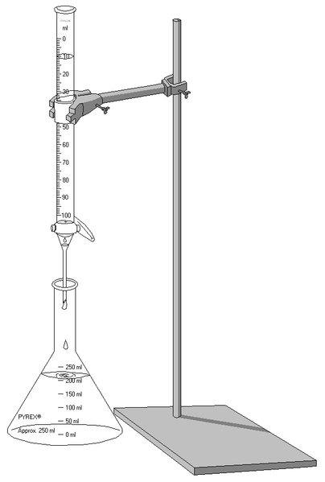
Titrations
Titration apparatus, Ivan Ikira, Wikimedia commons

Slide 4
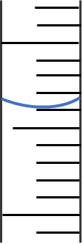
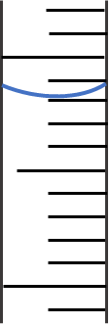
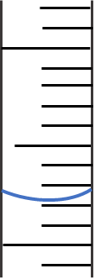
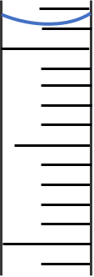
Reading measurements from scale
1.
2.
3.
4.
16 cm³
5 cm³
0.5 cm³
0.1 cm³
17cm³
10 cm³
1 cm³
0.2 cm³
Credit: Mrs Walsh

Slide 5
Titration method - obtaining a rough titre
Fill the burette with 1M hydrochloric acid to the 0 cm line - careful not to overfill. Run out any excess into a waste beaker.
Read the volume of acid used.
Measure out 10cm³ of sodium hydroxide (alkali) using a measuring cylinder and place into a conical flask. | 1
Allow the acid to run into the flask, swirling continuously, until the solution turns colourless.
Add a few drops of phenolphthalein. It should turn pink.
Place the conical flask under the burette and open the tap.
Notes:
#

Slide 6
Reproducible data

Slide 7
Results
Titration number | 1 | 2 | 3 | 4 | 5 | Mean
Volume of acid added (cm³) | 29.2 | 25.3 | 26.2 | 25.2 | 25.4
Identify the three concordant results
………..……………………………………………………………………………………………………………..………………………
2. Calculate the mean of these results.
………..……………………………………………………………………………………………………………..………………………
………..……………………………………………………………………………………………………………..………………………

Slide 8
Reproducible results?
Titration number | 1 | 2 | 3 | 4 | 5 | Mean
Volume of acid added (cm³) | 25.1 | 25.6 | 29.2 | 25.2 | 25.4
Are these reproducible results?
………..……………………………………………………………………………………………………………..………………………
Are these concordant results?
………..……………………………………………………………………………………………………………..………………………
Notes:
Are these results reproducible? YES - ⅘ of the results are as they are all roughly in the region of 25.0cm³

Slide 9
Using data to write a conclusion

Slide 10
Write a conclusion for the following hypothesis:
“We always get a neutral solution if we react equal volumes of acid and alkali”
Use the results obtained to support your conclusion and explain how confident you are that your results are valid.
The hypothesis that ………..……………………………………………………………………………………………………………..………………………………………………………………………is ………..……………………………………
I can see from my results that ………..……………………………………………………………………………………………………………..………………………………………………………………………………..……………………………………………………………………………………………………………..………………………………………………………………………
Which supports / does not support the hypothesis.
I know that my results are valid because……………………………………………………………………………………………………………..
……………………………………………………………………………………………………………..…………………………………………………………………………………
Therefore, I ………………………… confident in my conclusion.

