Slide 1
Exploring calculation strategies
Subtracting two 2-digit numbers, requiring regrouping, using the column method
Maths
Mrs Crane

Slide 2
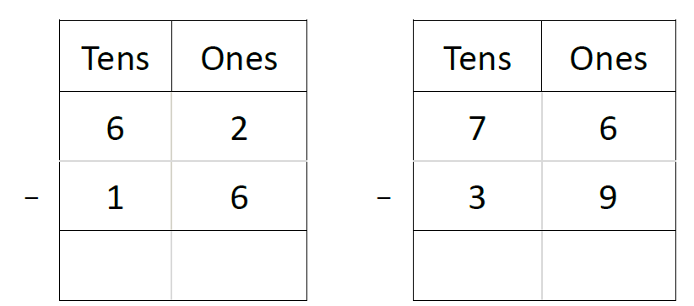
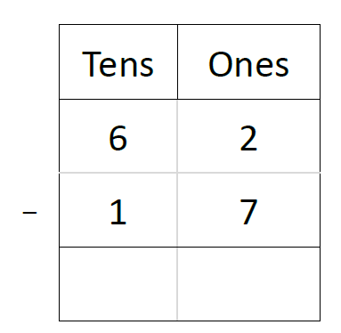
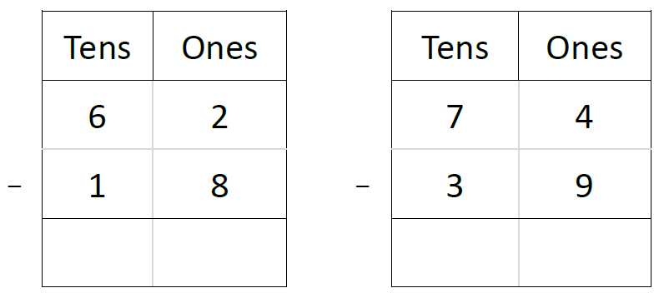
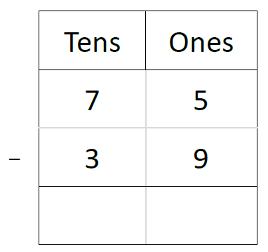
Independent Task
Solve the following equations using Dienes, pictures of Dienes or the column method.
Remember, start with the ones column!

