Slide 1
Lesson 4: It’s only Logical
Computer Systems
Computing
Kashif Ahmed
Materials from the Teach Computing Curriculum created by the National Centre for Computing Education

Slide 2
Task 1 - Boolean logic - part 1
A digital sensor returns a reading that is either true or false.
You have a digital light sensor and you name its reading light. This reading is true when the light level exceeds a certain threshold and false otherwise.
The table on the next slide contains the different possible values for the light sensor reading. For each of these values, fill in the table with the corresponding values for the logical expression not light.

Slide 3
Task 1 - Boolean logic - part 1
light | not light
false
true

Slide 4
Task 1 - Boolean logic - part 2
The logical variable fruit is true when a diet includes fruit and false otherwise. The logical variable veg is true when a diet includes vegetables and false otherwise.
The expression below is a simplistic indicator of a healthy diet:
fruit or veg
The table below contains different combinations of the possible values for fruit and veg. For each of these combinations, fill in the table with the corresponding values for the logical expression fruit or veg.

Slide 5
Task 1 - Boolean logic - part 2
fruit | veg | fruit or veg
false
false
false
true
true
false
false
true

Slide 6
Task 1 - Boolean logic - part 3
You come across a strange machine. It has a red button, a green button, and a blue light.
You try pressing different combinations of the two buttons and make a table indicating which combinations result in the blue light being turned on.

Slide 7
Task 1 - Boolean logic - part 3
red button pressed red | green button pressed green | blue light is on
true | true | true
true | false | false
false | true | false
false | false | false

Slide 8
Task 1 - Boolean logic - part 3
Write a logical expression that describes when the blue light is on. The expression should involve the red and green logical variables and it should be true when the blue light is on.
The logical expression is: red and green, because the light is on only when both the red and green buttons are pressed.

Slide 9
Task 2 - Logic circuits - part 1
Part 1: A circuit with the AND logic gate
For the tasks below, you will need to open a browser window and visit:
oaknat.uk/comp-simulator

Slide 10
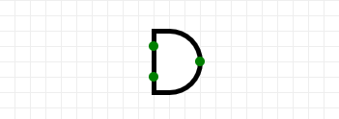
Task 2 - Logic circuits - part 1
The AND gate
Go to ‘Circuit elements’ on the left.
Click on Gates.
Click on the AND gate.
Place an AND gate on the canvas.

Slide 11
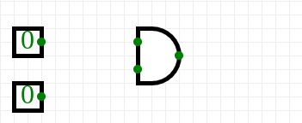
Task 2 - Logic circuits - part 1
The inputs to the AND gate
5. Go to ‘Circuit elements’ on the left.
6. Click on Input.
7. Click on the ‘Input’ box.
8. Place an input box on the canvas, to the left of the AND gate.
9. Repeat steps 7–8 to add a second input.

Slide 12
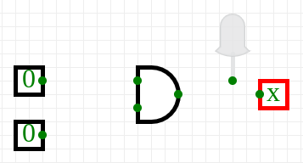
Task 2 - Logic circuits - part 1
The output of the AND gate
10. Go to ‘Circuit elements’ on the left.
11. Click on Output.
12. Click on the ‘Output’ box.
13. Place an output box on the canvas, to the right of the AND gate.
14. Click on the ‘Digital LED’.
15. Place an LED on the canvas, to the right of the AND gate.

Slide 13
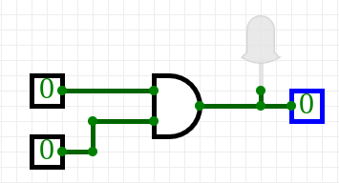
Task 2 - Logic circuits - part 1
The output of the AND gate
16. Go to ‘Circuit elements’ on the left.
17. Connect the first input box to one of the inputs of the AND gate (by click-dragging on the connectors, i.e. the little green circles).
18. Connect the second input box to the other input of the AND gate.
19. Connect the output of the AND gate to the output box.
20. Connect the output of the AND gate to the digital LED.
Connect the first input box to one of the inputs of the AND gate (by click-dragging on the connectors, i.e. the little green circles).
Connect the second input box to the other input of the AND gate.

Slide 14
Task 2 - Logic circuits - part 1
You can flip an input from false (0) to true (1) and vice versa by clicking on the input box.
Verify that the output is true (1) and the light is turned on only when both of the inputs are true (1). The table on the next slide contains all the input combinations that you should try.

Slide 15
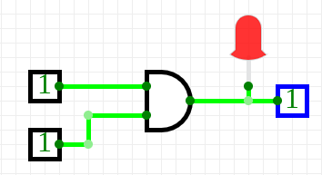
Task 2 - Logic circuits - part 1
jjb
First Input A | Second Input B | AND Output A and B
true | true | true
true | false | false
false | true | false
false | false | false

Slide 16
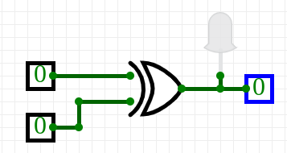
Task 2 - Logic circuits - part 2
Create the logic circuit below.
This is identical to the logic circuit that you created in the previous task, except that the AND logic gate has been replaced with an XOR logic gate. This is a new logic operation.
You can flip an input from false (0) to true (1) and vice versa by clicking on the input box.

Slide 17
Task 2 - Logic circuits - part 2
Try all the input combinations in the table below and fill in the table with the corresponding output.
First Input A | Second Input B | XOR Output A XOR B
true | true
true | false
false | true
false | false

Slide 18
Task 2 - Logic circuits - part 2
Before, we described how the result of the OR operator is true if at least one of its inputs is true. How would you describe the result of the XOR logic operator with words?
You can flip an input from false (0) to true (1) and vice versa by clicking on the input box.

Slide 19
Task 2 - Logic circuits - part 2
Before, we described how the result of the OR operator is true if at least one of its inputs is true. How would you describe the result of the XOR logic operator with words?

Slide 20
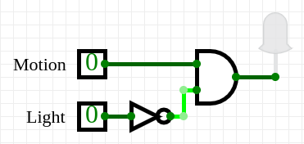
Task 2 - Logic circuits - part 3
Part 3: Security light
For the logic circuit below, there is a single combination of input values that will turn on the output LED.

Slide 21
Task 2 - Logic circuits - part 2
You can use logical reasoning to deduce what this combination will be, or you can create the circuit and try out the different combinations of input values. Write your answer in the table below, and provide a brief explanation for your answer.
input motion | input light | output
 |  | true

