Slide 1
What are the key parts of a healthy diet?
Downloadable Resource
Science- Lifestyle
Miss Hummel
Notes:
In this lesson, we will learn about what is important in a healthy diet. We will discuss the seven nutrients we need to know as well as their role in the body.

Slide 2
Complete this task:
Write down the seven major nutrients.
Notes:
Answer this thinking task:
Do all invertebrates have an exoskeleton?
You can resume once you are finished.
The answer is no! There are some animals, like Jellyfish, which are considered invertebrates but also do not have an exoskeleton. However, the majority of animals which are invertebrates also have an exoskeleton.

Slide 3
Complete this task:
Write down the definition of a balanced diet.
Notes:
Answer this thinking task:
Do all invertebrates have an exoskeleton?
You can resume once you are finished.
The answer is no! There are some animals, like Jellyfish, which are considered invertebrates but also do not have an exoskeleton. However, the majority of animals which are invertebrates also have an exoskeleton.

Slide 4
Answer these questions:
What is a diet?
What is a balanced diet?
What 7 nutrients do humans need to eat?
Notes:
Answer this thinking task:
Do all invertebrates have an exoskeleton?
You can resume once you are finished.
The answer is no! There are some animals, like Jellyfish, which are considered invertebrates but also do not have an exoskeleton. However, the majority of animals which are invertebrates also have an exoskeleton.

Slide 5
Answers:
Diet is the food and drink that a person consumes.
A balanced diet is eating the right types of food in the right amounts so that the body gets the nutrients it needs.
The seven essential nutrients are: carbohydrates, protein, fat, minerals, vitamins, fibre and water.
Notes:
Answer this thinking task:
Do all invertebrates have an exoskeleton?
You can resume once you are finished.
The answer is no! There are some animals, like Jellyfish, which are considered invertebrates but also do not have an exoskeleton. However, the majority of animals which are invertebrates also have an exoskeleton.

Slide 6
Copy this table into your notes in preparation for the rest of our lesson:
Nutrient | Found in | Role
Carbohydrate
Fibre
Protein
Fat
Minerals
Vitamins
Water

Slide 7
Answer these questions:
What is the role of protein in the body?
Why is some fat in the diet important?
Name a mineral and its role in your diet.
Notes:
Answer this thinking task:
Do all invertebrates have an exoskeleton?
You can resume once you are finished.
The answer is no! There are some animals, like Jellyfish, which are considered invertebrates but also do not have an exoskeleton. However, the majority of animals which are invertebrates also have an exoskeleton.

Slide 8
Answers:
Proteins are responsible for growth and repair.
Fat is important in our diet as it provides a store of energy, protects organs and keeps us warm.
An example of a mineral is calcium. Calcium is needed for the growth of healthy teeth and bones.
Notes:
Answer this thinking task:
Do all invertebrates have an exoskeleton?
You can resume once you are finished.
The answer is no! There are some animals, like Jellyfish, which are considered invertebrates but also do not have an exoskeleton. However, the majority of animals which are invertebrates also have an exoskeleton.

Slide 9
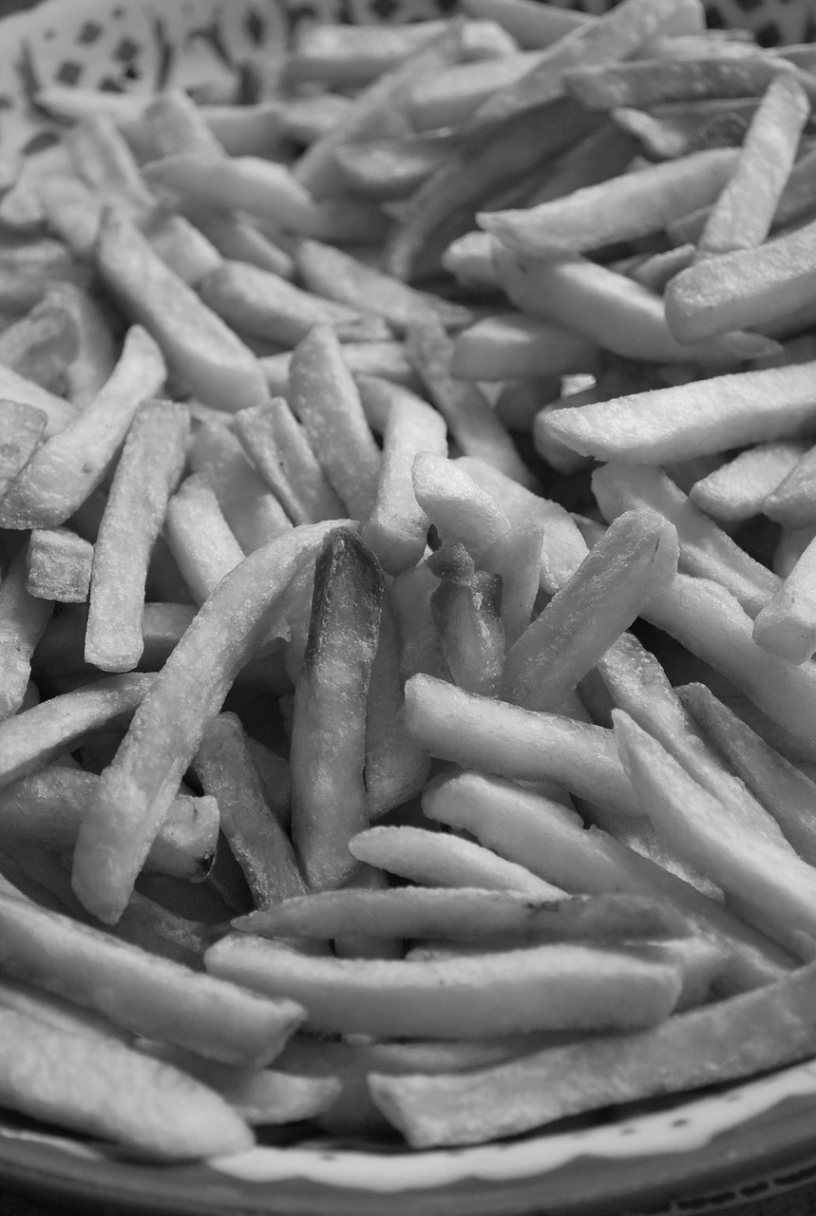
Balanced diet or not?
Notes:
Answer this thinking task:
Do all invertebrates have an exoskeleton?
You can resume once you are finished.
The answer is no! There are some animals, like Jellyfish, which are considered invertebrates but also do not have an exoskeleton. However, the majority of animals which are invertebrates also have an exoskeleton.

Slide 10
Balanced diet or not?
Notes:
Answer this thinking task:
Do all invertebrates have an exoskeleton?
You can resume once you are finished.
The answer is no! There are some animals, like Jellyfish, which are considered invertebrates but also do not have an exoskeleton. However, the majority of animals which are invertebrates also have an exoskeleton.

Slide 11
Activity:
Design a menu for yourself which you think would incorporate a nice mix of foods and would therefore fit the definition of a balanced diet.
Notes:
Answer this thinking task:
Do all invertebrates have an exoskeleton?
You can resume once you are finished.
The answer is no! There are some animals, like Jellyfish, which are considered invertebrates but also do not have an exoskeleton. However, the majority of animals which are invertebrates also have an exoskeleton.

