Slide 1
My Feelings and What Makes Me Happy
Lesson 10 of 14 on Emotional Regulation and Self Esteem
Speech and Language Therapy
Emma Jones

Slide 2
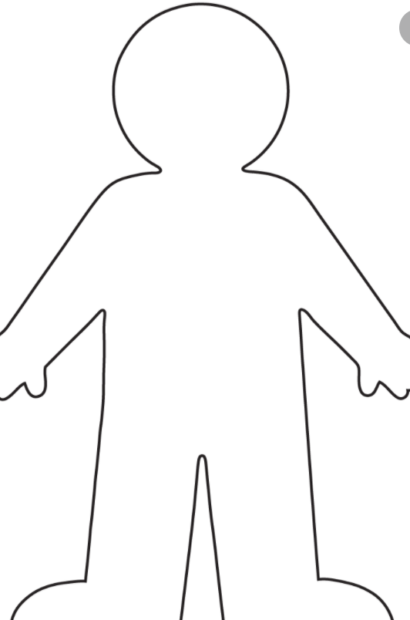
How does my body feel when I am happy …
My face
My voice
My body

Slide 3
What makes me feel happy?

Slide 4
References
Slide 2- Pixy.org images 2020

