Slide 1
German
Describing a school day [3 / 3]
Word order with adverbs (WO2)
Herr Jones

Slide 2
sch
schreiben
Steve Clarke / Rachel Hawkes

Slide 3
sch
falsch
schnell
[fast]
schreiben
schwarz
zwischen
Mensch
Rachel Hawkes

Slide 4
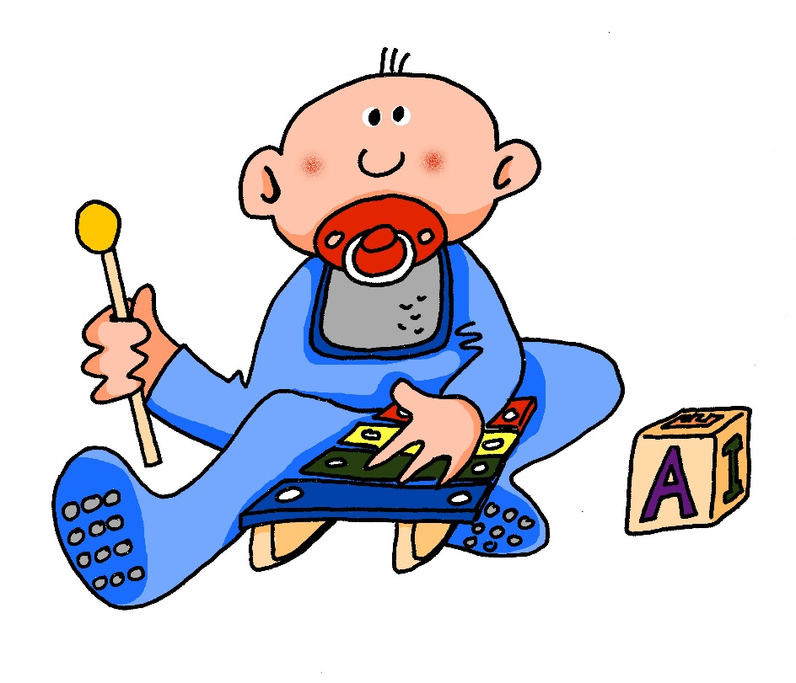
sp-
spielen
Steve Clarke / Rachel Hawkes

Slide 5
sp
Spaß
Sprache
[fun] (noun)
spielen
sprechen
Spiel
Sport
Rachel Hawkes

Slide 6
die Wahlfächer | optional subjects
Englisch | English
Deutsch | German
Sport | PE
Mathe | Maths
Biologie | Biology
Chemie | Chemistry
Physik | Physics
Erdkunde | Geography
Geschichte | history

Slide 7
Grammatik Word order with adverbs (WO2)
New blue unlocking icon

Slide 8
What is an adverb?
Describes a verb (think -ly in English).
schlecht
badly
schnell
quickly
How often or when you do something.
jeden Tag
every day
oft
often

Slide 9
Word order
Main verb is 2nd idea in the sentence.
The adverb usually comes immediately after the verb.
How does this differ from English?
Ich habe jeden Tag Sport.
I have PE every day.
The adverb can go at the start of the sentence.
But remember the main verb still has to come 2nd idea.
Jeden Tag habe ich Sport.
Every day I have PE.

Slide 10
Word order with adverbs:
An adverb describes a …………… or how ……………. you do something.
In German the main verb goes ……… idea in the sentence.
The adverb comes either immediately …………….. the verb or at the ……………. of the sentence.
verb
often
2nd
after
start

