Slide 1
Protecting the planet [1 / 3]
Modal verbs in the conditional
French
Madame Williams
Notes:
Bonjour et bienvenue. Je m’appelle Madame Williams. In our lesson today, we are going to continue to work on the final GCSE theme which looks at social and global issues. Today’s lesson is the first in a series of three lessons looking and what we could and should do to protect the planet. In our lesson today we will be using the modal verbs pouvoir and devoir in the conditional tense.

Slide 2
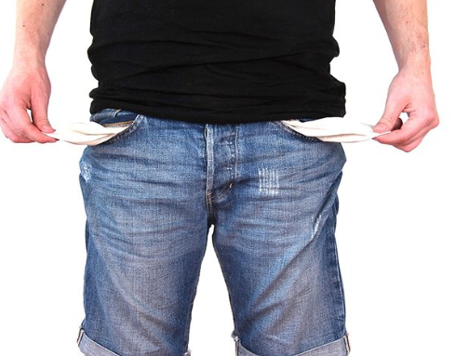
[ r ]
[ rr ]
rien
Notes:
Today’s phoneme is represented by the grapheme [r] or [rr]. The [r] or double [rr] makes a rrrr sound in French. Ecoute et répéte. Let’s consider a word which has this grapheme in it. What’s this person got in their pockets? This person has got nothing in their pockets. The French word for nothing contains the grapheme [r] Ecoute et répéte.
Now let’s look at some other words with this phoneme. I’ve chosen two words linked to our current topic area.

Slide 3
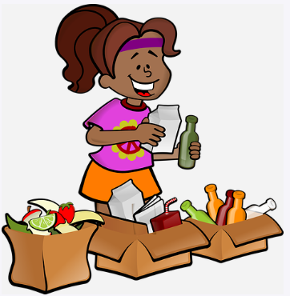
Spain
Logo
[r]
recyclage
recycler
Notes:
Let’s look at an example. How would you pronounce this word? Dis-moi! That’s right we would say dans. RETURN.

Slide 4
trier les déchets | to sort the rubbish
consommer moins d’énergie | to consume less energy
éteindre les appareils électriques | to turn off electrical appliances
faire des achats responsables | to shop responsibly
acheter des produits bios | to buy organic products
utiliser les transports en commun | to use public transport
éviter les sacs en plastique | to avoid plastic bags
économiser l’eau | to save water
installer des panneaux solaires | to install solar panels
The infinitive can also be translated by the gerund.
Trier les déchets to sort the rubbish AND sorting the rubbish.
Notes:
On the screen, you can see the new vocabulary together. Now, I’ll say the French again, but I will say the words out of order. You say the correct translation out loud. If you want to challenge yourself - close your eyes, focus on what I’m saying and say the correct translation out loud.
Then go through some of the words - you don’t need to go through all 10 words - start easy to build up confidence.
LE.g. les grands événements
E.g. les grands événements

Slide 5
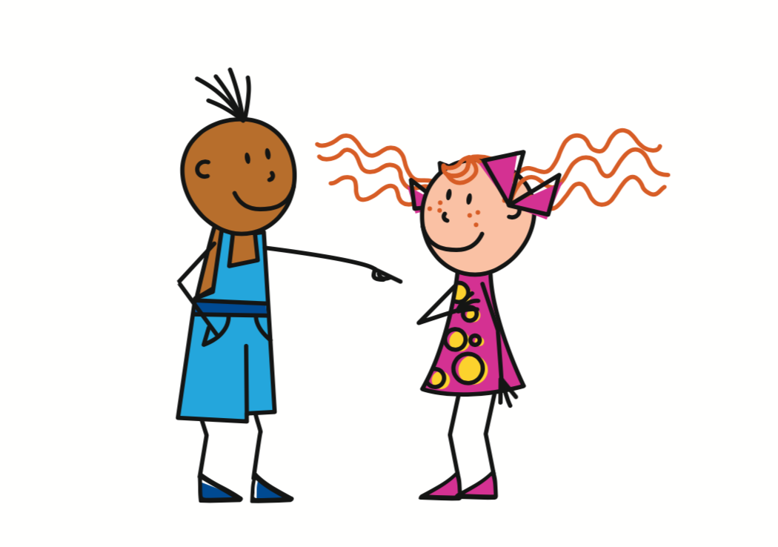
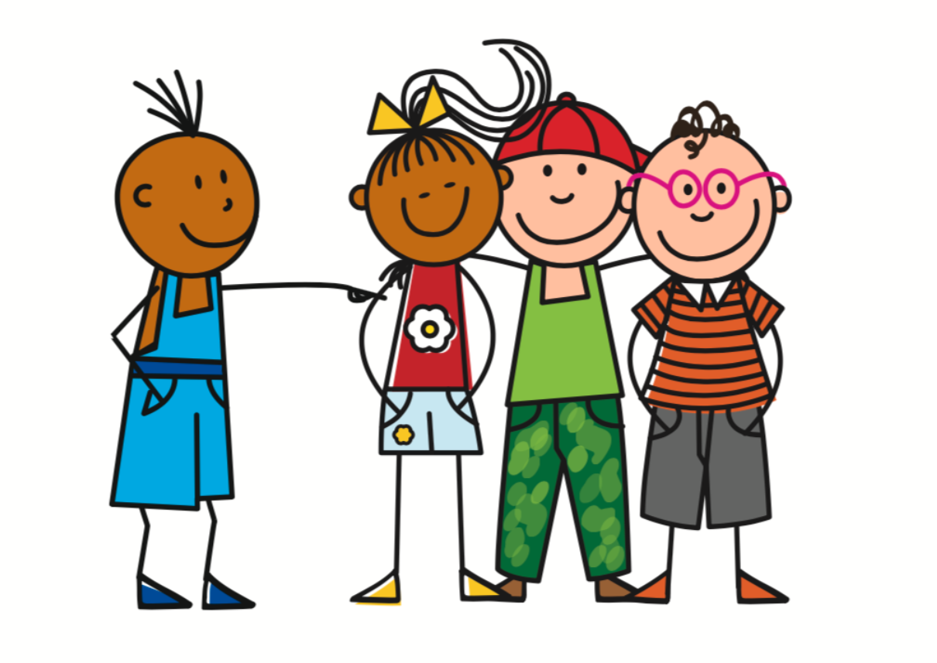
On
- You, we
= You
Tu
5
On
= You, we
4
3
To refer to one specific person
2
1
Vous
= You
To refer to a group of specific people
To refer to people in general
Notes:
First things, first. Let’s consider the pronoun - on. This pronoun is used really frequently in France and it has two distinct meanings.
Do you know what these meanings are? Dis moi! That’s right the pronoun ‘on’ means you or we. Return. We use it when we are talking about people in general.
There are two other words for you in French. The word ‘tu’ is used to refer to one specific person. Like you - the person watching this video. The word vous is used to refer to a group of specific people -let’s imagine your teacher is talking to everyone in the class. You all need to copy this down.
If this is something you were unfamiliar with or you had forgotten please make a note of it in your book now. Maintenant, mets la vidéo en pause.

Slide 6
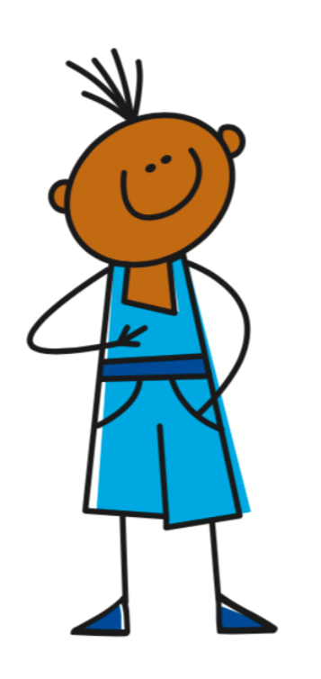
Using the modal verbs devoir and pouvoir
Je dois
= I must, have to
On doit
= You must, have to
Je peux
= I can
On peut
= You can
Notes:
“The verbs devoir and pouvoir are irregular verbs. This means that we have to learn the conjugation of these verbs by heart as they don’t follow the usual rules and patterns.
Can you remember how to say I must? Dis-moi! That’s right we say Je dois. The word dois ends in an ‘s’ when it is conjugated with je.
And what about you must? You have to when we are talking about a general group of people. That’s right we say on doit. On doit means you must, or you have to as well. We use on doit to refer to people in general. The word doit ends in a ‘t’ when it is conjugated with ‘on’”
And what about I can? Dis-moi! That’s right we say je peux - the verb peux ends in an ‘x’ when it is conjugated with je.
And finally You can? En francais? Dis-moi! That’s right we say on peut. The verb peut ends in a t when it is conjugated with on.

Slide 7
Using the modal verbs devoir and pouvoir in the conditional
5
On devrait
= You should
Je devrais
= I should
4
3
2
1
Je pourrais
= I could
On pourrait
= You could
Use devoir and pouvoir with an infinitive to say what someone
should or could do.
Notes:
Je devrais means I should. On devrait means - you should - when we are talking about a non specific group of people. Je pourrais means I could. How do you think we would say you could? Dis-moi? Did you say on pourrait? And what would the ending be? Ait - bravo!
The conditional ending in the je form of the verb, the first person is ais. The conditional ending in the on form of the verb, the third person is ait. Once again we use these conjugated verbs with a verb in the infinitive to say what we should or could do.
Please make a note of these structures in your book now. Maintenant, mets la vidéo en pause.

Slide 8
Protecting the Environment
The pronoun ‘on’ can mean ...
2. I should / You should =
3. I could / You could =
4. The second verb in a clause in a sentence must be in the ...
5. Infinitives can have two translations. What are they?
You / We
je devrais/on devrait
je pourrais/on pourrait
infinitive
To + action, action+ing
Notes:
Let’s go through the answers now.

