Slide 1
Long multiplication and area models
Worksheet
Mr Ward

Slide 2
Warm up - Doubling and halving
Use adapted bar model to help solve the following calculations.
25
50
100
100
50
100

Slide 3
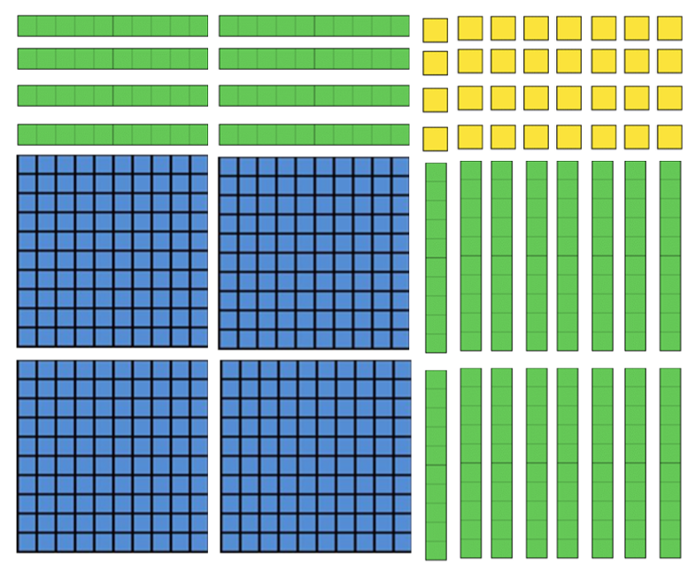
Area Model - Your turn!
Work out the calculation
Complete the area model

Slide 4
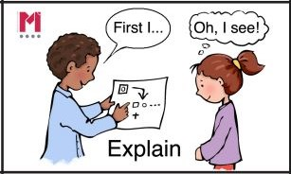
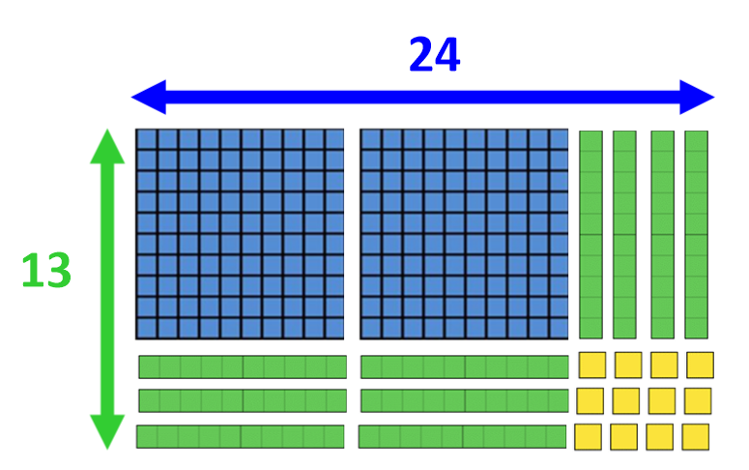
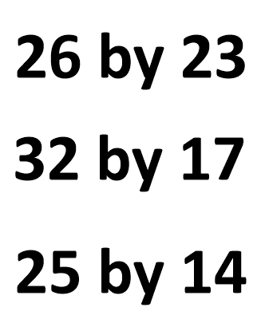
Talk Task - Sketching area models
Sketch the dienes to make an area model
Complete the area model
Work out the product for the calculation

Slide 5
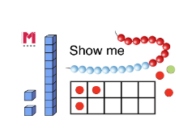
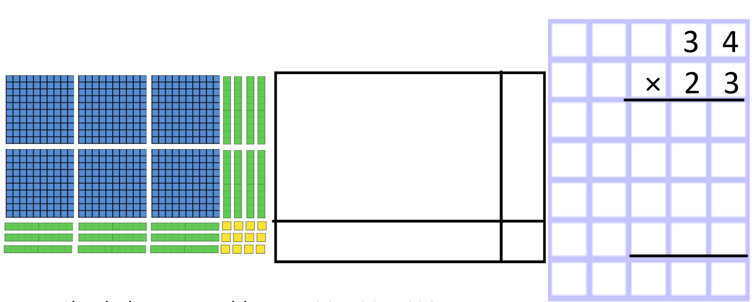
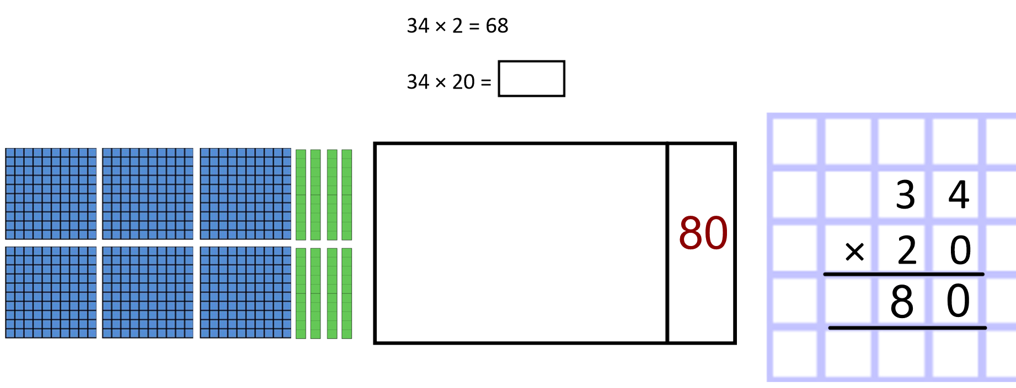
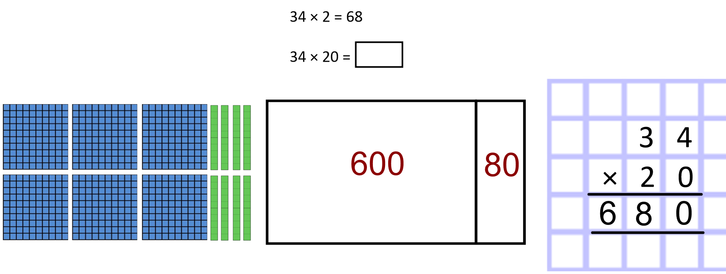
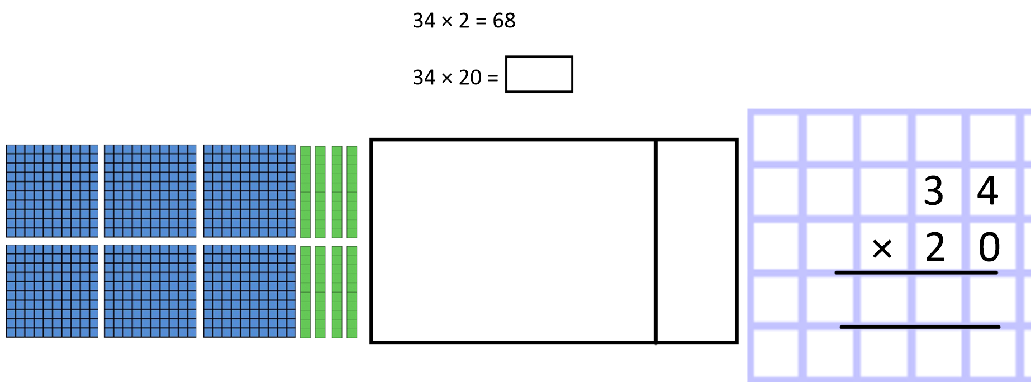
Formal Long multiplication
Concrete and pictorial representations
680

Slide 6
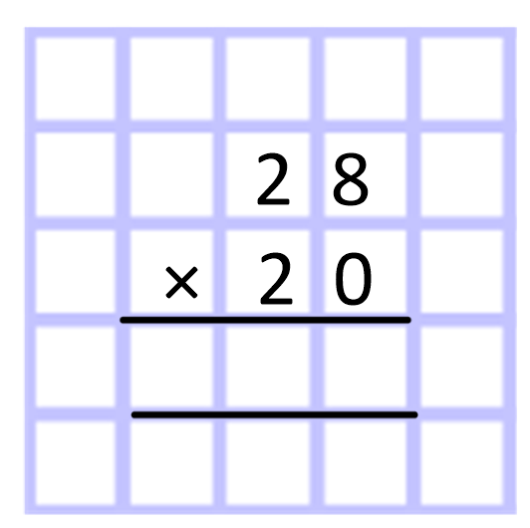
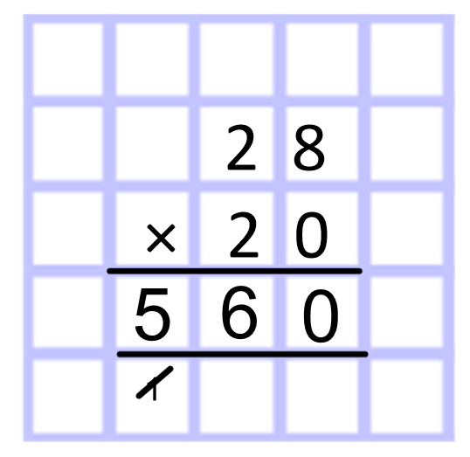
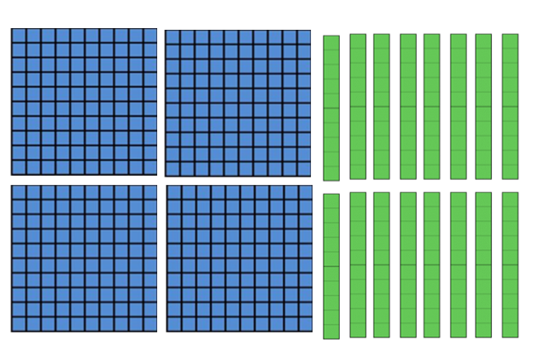
Formal Long multiplication
Concrete and pictorial representations
560
400
160

Slide 7
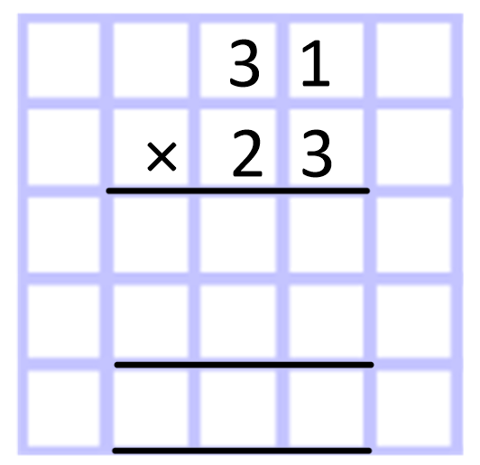
Use Long multiplication to solve these equations
Remember your derived facts and multiplying by multiples of 10
Sketching an area model is optional but recommended to help
1) 31 × 23
2) 43 × 29
3) 72 × 61
4) 64 × 25
5) 87 × 59

Slide 8
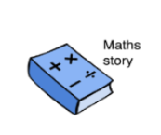
Challenge Slide
Multiplication Master
Create a maths story for each calculation
Can you think of three different ways to solve the equations?
E
B
A
D
64 x 25
33 x 14
46 x 21
Formal?
Informal?
Mental strategies?
How would you estimate first?

