Slide 1
Talk about doing and making things [2/ 2]
Faire: singular
French
Madame Sooden

Slide 2
[ u ]
[ ou ]
nous
tu

Slide 3
[ u ]
tu

Slide 4
[ u ]
amusant
utiliser
[to use]
sur
[on]

Slide 5
[ ou ]
nous

Slide 6
[ ou ]
trouver
toujours
jouer
[always; still]

Slide 7
Vocabulary list for this lesson:
En français
En anglais
la lessive | laundry
les courses | shopping
le lit | bed
le ménage | cleaning
la cuisine | cooking
la vaisselle | washing up
les devoirs | homework
5
4
3
2
1

Slide 8
Faire
to do / to make
French grammar
Il fait
= He does / makes
Je fais
= I do / make
To refer to a singular male
Elle fait
= She does / makes
To refer to yourself
To refer to a singular female

Slide 9
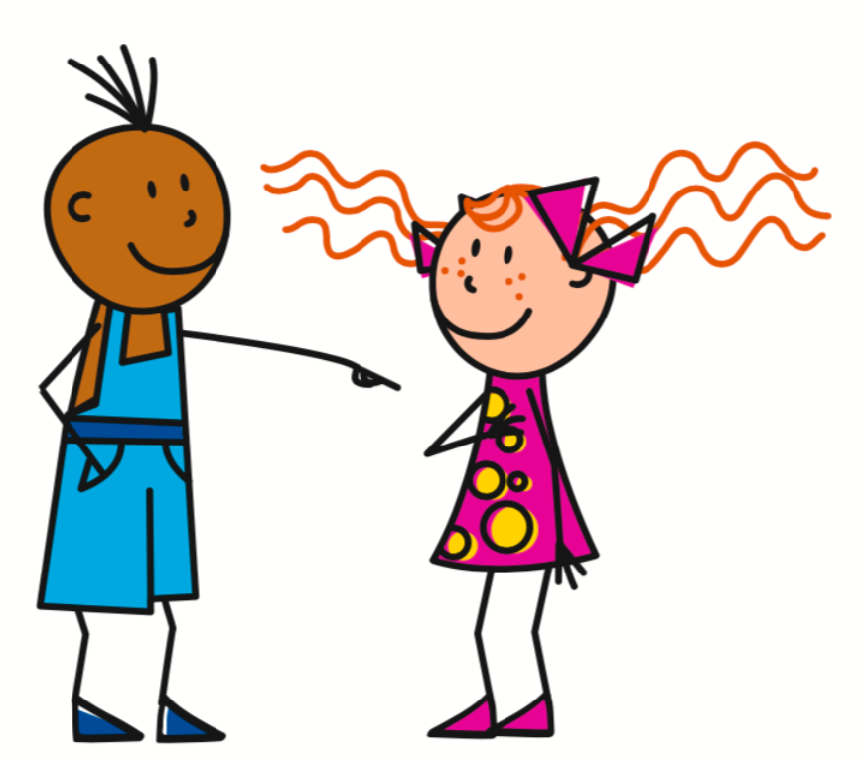
Faire
to do / to make
French grammar
Use faire to describe what you are doing or making.
Tu fais
= You do / make
On fait
= You do / make
To refer to one specific person
To refer to people in general

Slide 10
Faire
to do / to make
French grammar
Use faire to describe what you are doing or making.
Tu fais les courses
On fait les courses
You do the shopping
You do the shopping
To refer to one specific person
To refer to people in general

Slide 11
Writing Practice
Tu fais la cuisine?
Non, c’est ma mère.
1.
Elle fait la cuisine.
She does the cooking
Tu fais le lit?
Non, c’est mon père.
2.
2. Il fait le lit.
He does the bed
Tu fais la lessive?
Non, c’est mon père.
3. Il fait la lessive.
3.
He does the washing
Tu fais les courses?
Non, c’est ma mère.
4. Elle fait les courses.
4.
She does the shopping

Slide 12
Talk about doing and making things
1 | What does ‘to do’ mean in French?
2 | What is ‘you do’ in French?
3 | What is ‘he does’ in French?
4 | What is ‘cleaning’ in French?
5 | Do you use ‘le/la/les’ before ‘lit’?
6 | Do you use ‘le/la/les’ before ‘courses’?
faire
tu fais/on fait
il fait
le ménage
le
les

