Slide 1
To recognise equivalent fractions 2
Worksheet
Maths
Miss Brinkworth

Slide 2
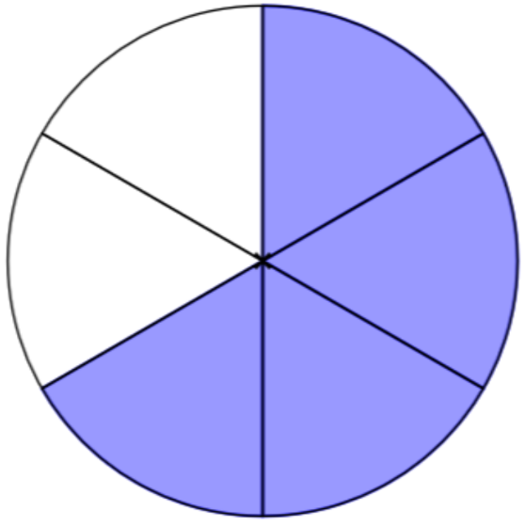
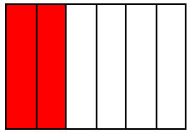
Part 1
Match each fraction with its equivalent
Can you draw other examples of equivalent fractions?
Notes:
Go through 1 together before children do independent task
I know that 1/1 = a whole and so does 4/4 so these match and are equivalent

Slide 3
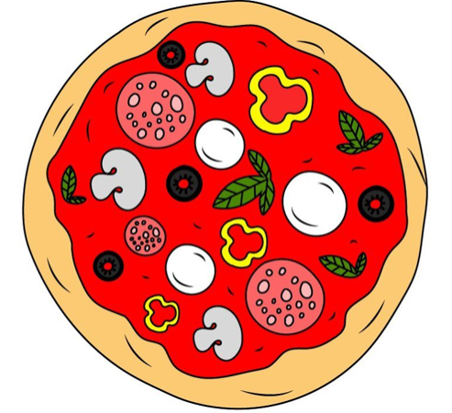
Part 2
Find 2 equivalent fractions below and think of different ways of representing them with pictures or objects.
B) Would you rather have or of a pizza? Why?
C) Complete the boxes to show equivalent fractions
= =
Use your fraction walls or diagrams to help you!
2
3
4
6
6
3

