Slide 1
Unit 10: Measure and Money Problems
Fruit
Independent Task
Mathematics
Lesson 12 of 15
Mr Whitehead

Slide 2
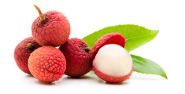
Fruit
A market stall is selling oranges and lychees.
Oranges cost £0.45 each and lychee fruit cost £0.25 each. Reena buys some oranges and lychees, which cost a total of £6.35.
How many oranges and lychees could she have bought?

Slide 3
Fruit
How many oranges? | Total | How many lychees? | Total | Total cost of both | Too much? Too little?
3 | £1.35 | 3 | £0.75 | £2.10 | Too little
10 | £4.50 | 10 | £2.50 | £7.00 | Too much

