Slide 1
Numbers within 10:
Using key vocabulary associated with ordinal numbers 1st to 10th
Mathematics
Lesson 10 of 10
Miss. Molnar

Slide 2
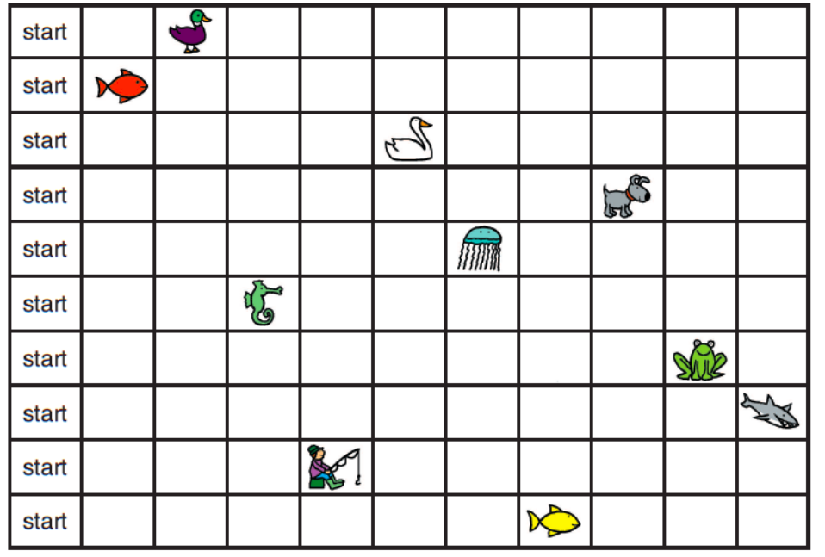
Can you you use ordinal language to describe the animals in the race?
The ______ is first/second/third. The ______ is behind the ______.
The ______ is last.

