Slide 1
What are the roles of different percussion instruments, and how can we best describe their sounds?
Music
Mr Chapman

Slide 2
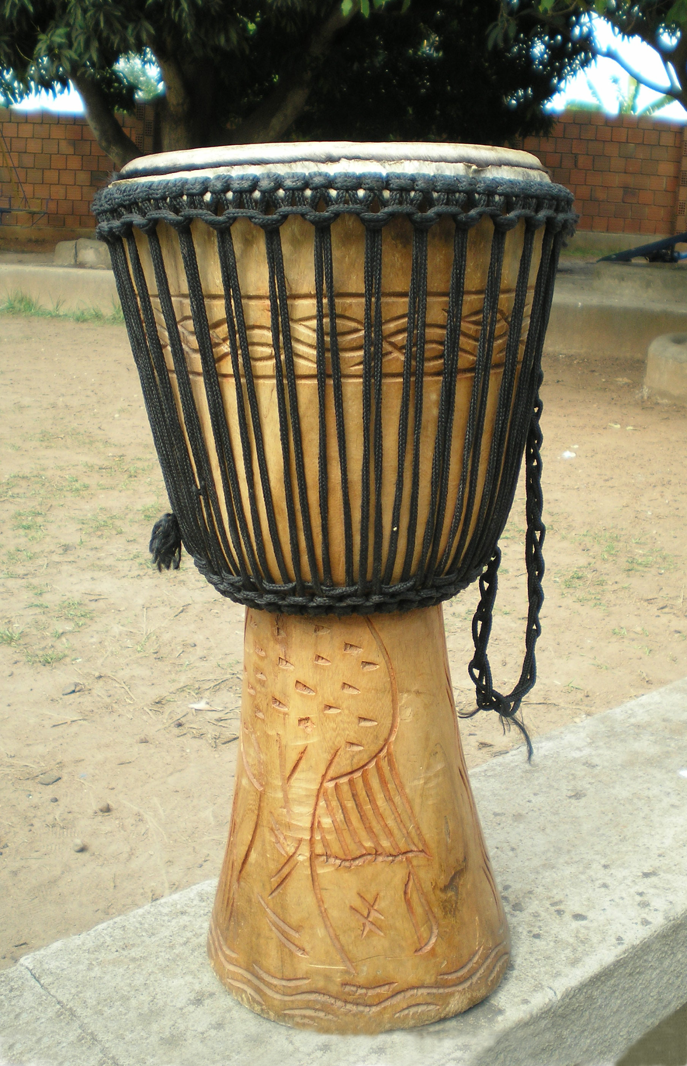
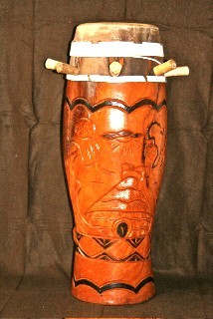
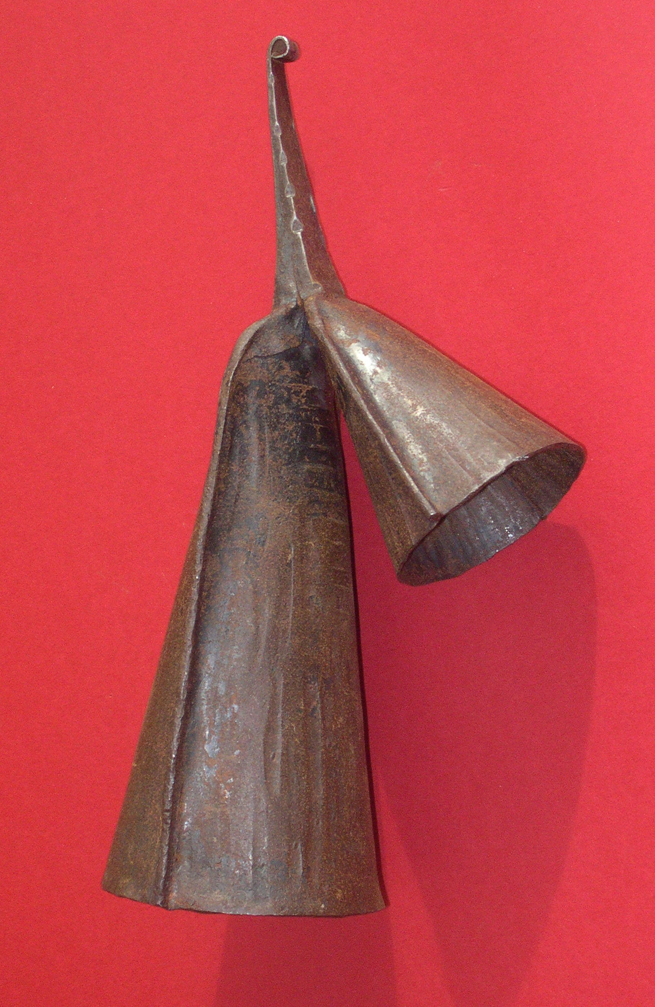
Percussion instruments in West Africa
Are the following instruments tuned or untuned? Why?
Djembe
Sabar
Gankogui

Slide 3
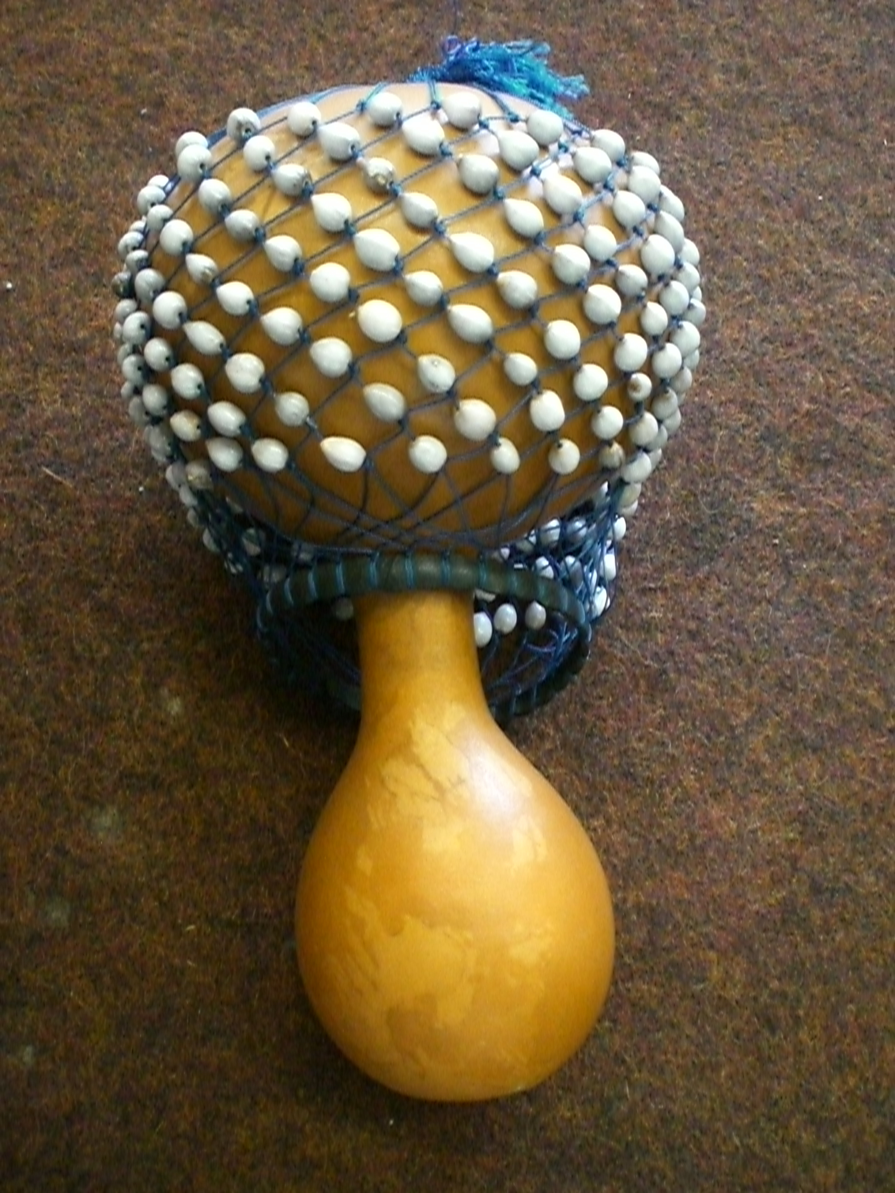
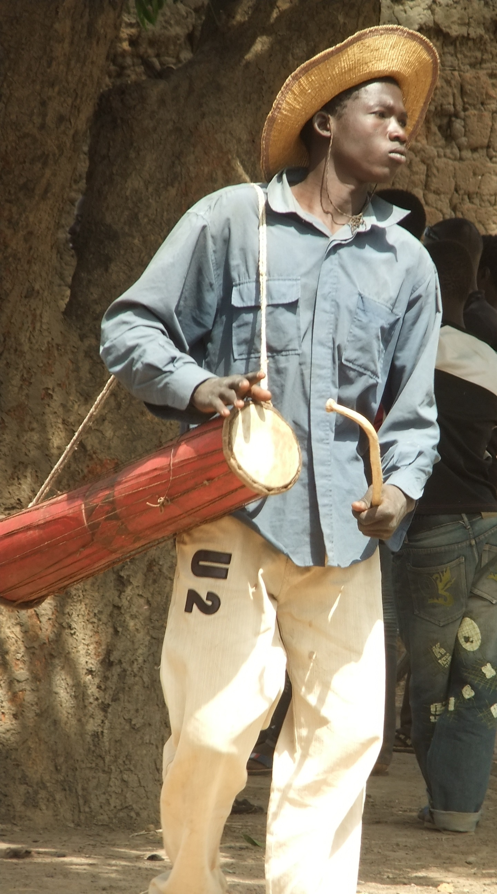
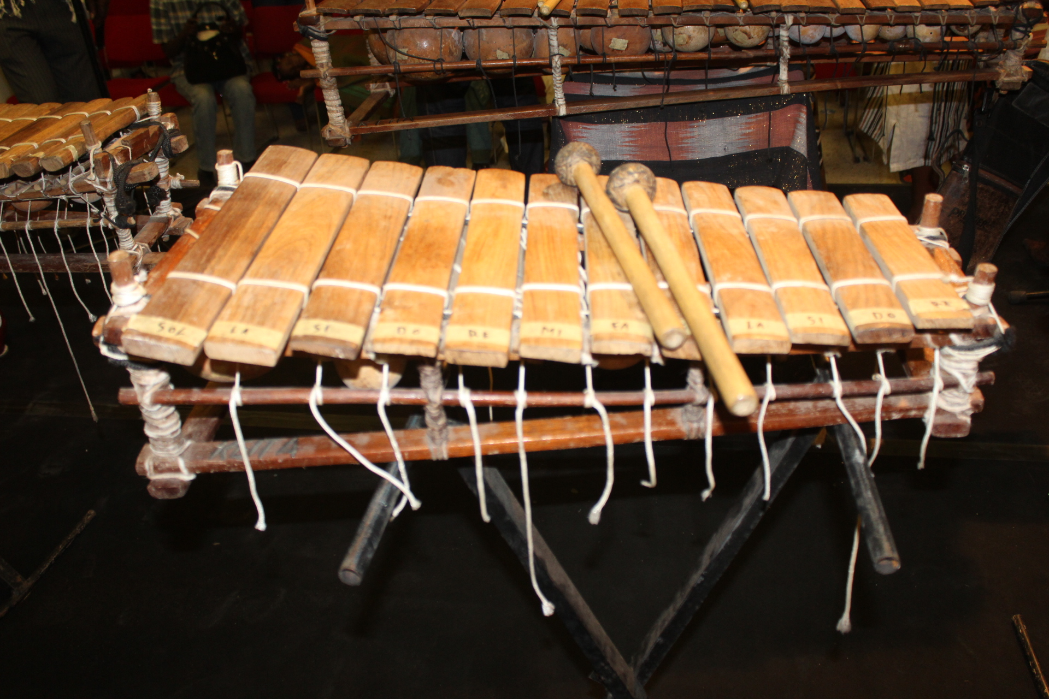
Percussion instruments in West Africa
Are the following instruments tuned or untuned? Why?
Axatse
Balafon
Gankogui
Tama

Slide 4
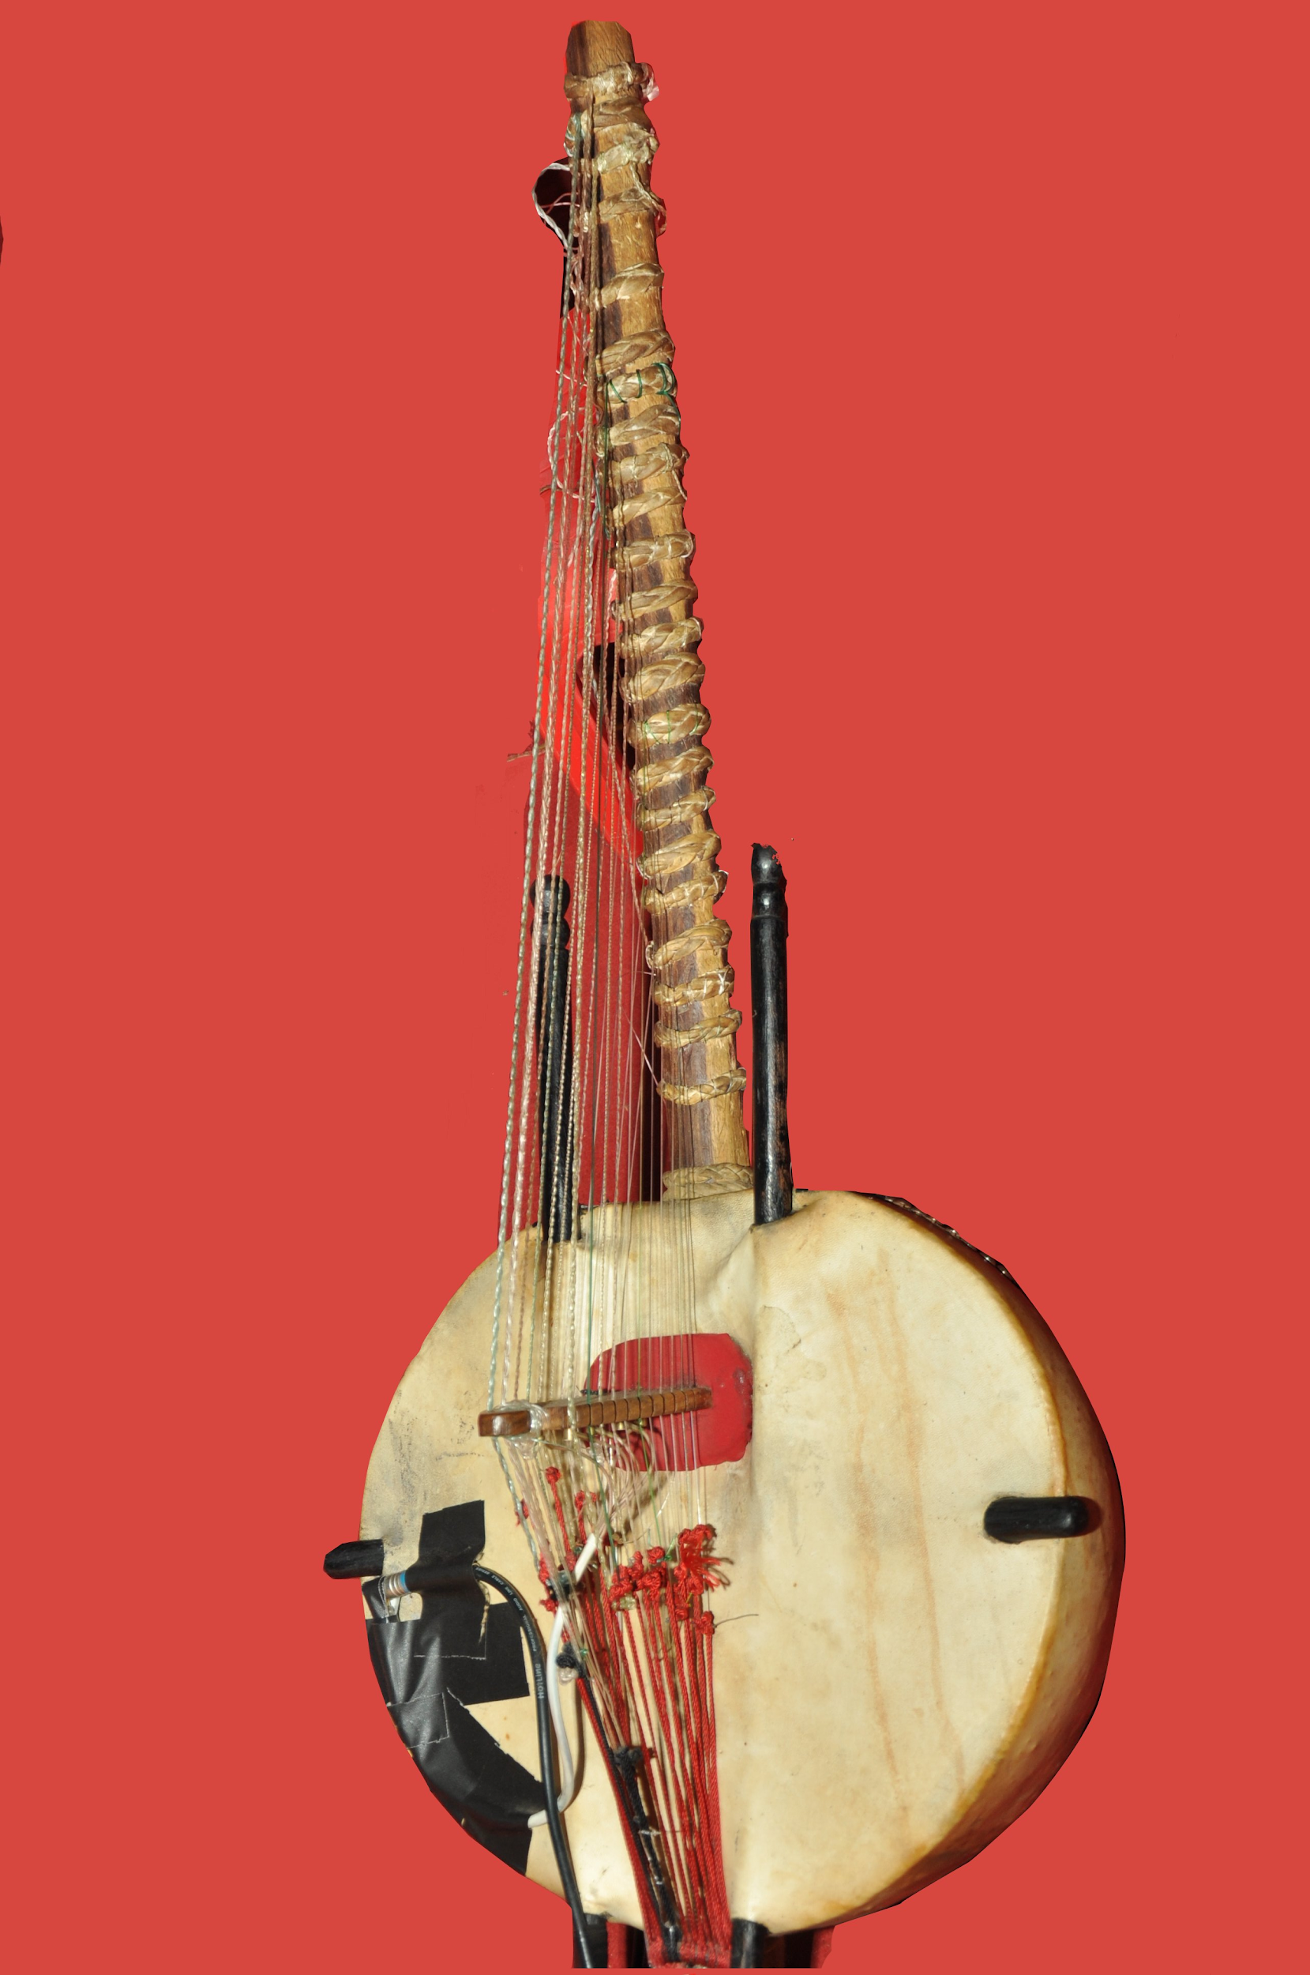
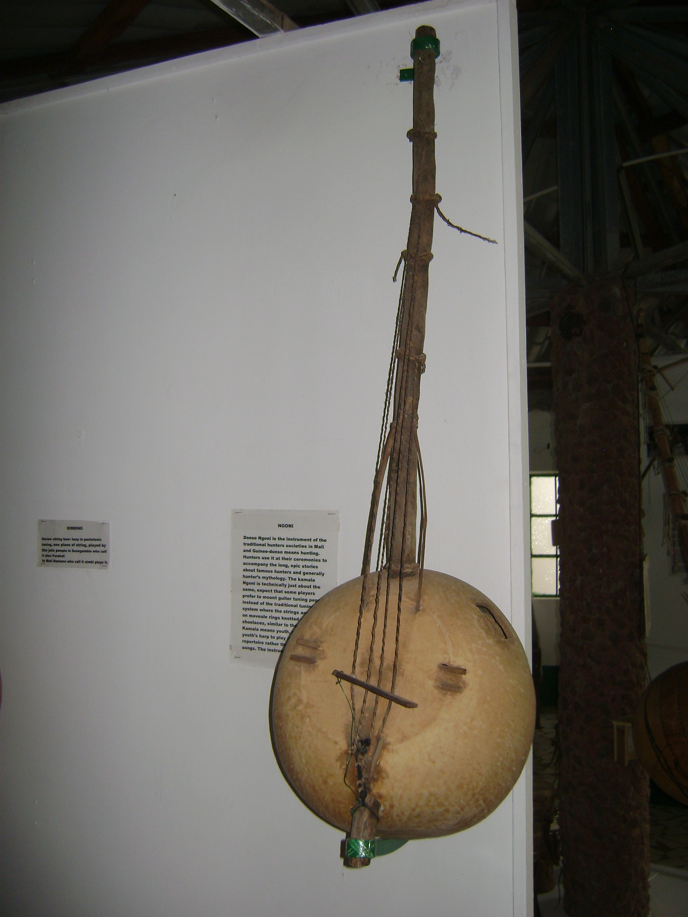
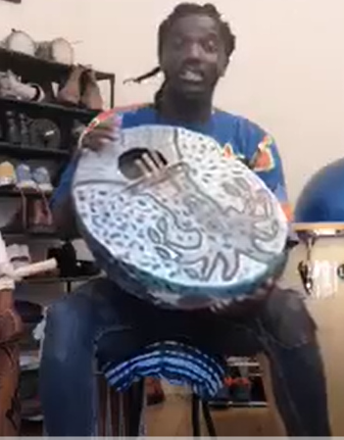
Non-percussion instruments in West Africa
Are the following instruments tuned or untuned? Why?
Kora
Ngoni
Senegalese bongo

Slide 5
Role of instruments
Instruments can have different roles and functions in an ensemble.
Melodic
Harmonic
Rhythmic
Provides the melody for the music
Tuned / pitched instruments
Usually high pitch
Can play an improvised melody
Accompanies the melody
Usually chords
Tuned / pitched instruments
Adds rhythmic interest
Untuned instruments
Establishes the tempo
Keeps players in time

Slide 6
Role of instruments
Resume once you’re finished
Melodic
Harmonic
Rhythmic
Balafon
Balafon
Do the same exercise with the instruments in a typical standard rock band or orchestra
Axatse
Gankogui
Ngoni
Kora
Sabar
Tama
Balafon

Slide 7
References
Slide 2 - Djembe, Ghana by ZSM - Wikimedia Commons [Attribution: ZSM / CC BY-SA]
Slide 2 - Sabar-Lamb by MichaelBr - Wikimedia Commons [Attribution: MichaelBr / CC BY-SA]
Slide 2 - African agogo, Wikimedia Commons [Public Domain)
Slide 3 - Talking drum (tama) Player by PGskot - Wikimedia Commons [Attribution: PGskot / CC BY-SA]
Slide 3 - Axatse Ghana by Take a Look in the Mirror - Wikimedia Commons [Public domain]
Slide 3 - Un Balafon 3 by Didierwiki - Wikimedia Commons [Attribution: Didierwiki / CC BY-SA]
Slide 4 - Kora DCS 0335 - Wikimedia Commons [Attribution: KannanShanmugamstudio,Main Road,Kollam / CC BY-SA]
Slide 4 - Ngoni 2011 by Lars Curfs - Wikimedia Commons [Attribution: Lars Curfs / CC BY-SA]

