Slide 1
Equivalent fractions
Mathematics
Mr Coward

Slide 2
Try this
There are many ways to write fractions that represent the same value.
1
Find other sets of fractions with the same value.

Slide 3
Connect
Complete the sets of equivalent fractions
=
=
=
=
=
=

Slide 4
Independent task
1. What fraction a a hexagon is shaded?

Slide 5
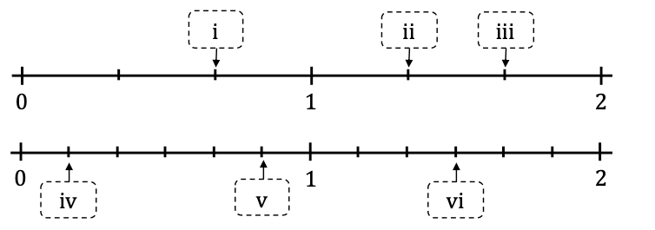
Independent task
2. a. Find the marked numbers:
2. b. Use the number line to convert i, ii and iii into sixths.
Why couldn’t you convert iv, v, and vi into thirds?

Slide 6
Independent task
3. Find the missing numbers:

Slide 7
Explore
How many different sets of equivalent fractions can you find by placing the digit cards in the frame?
1
2
3
4
6
8
9
12

