Slide 1
Exploring the concept of zero
Lesson 1 of 5
Mathematics
Miss. Molnar

Slide 2
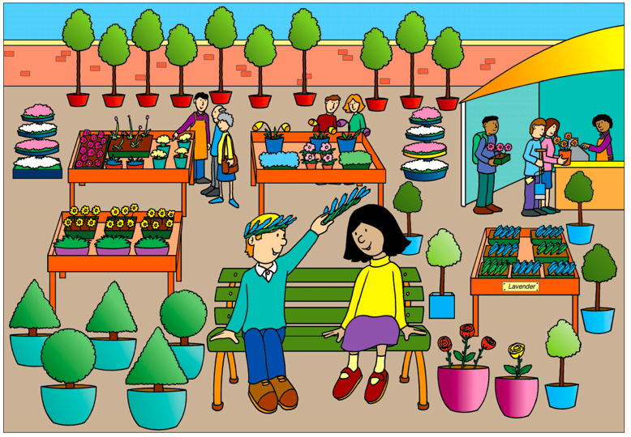
Can you think of questions where the answer will be zero?
Notes:
Model out loud some ideas for the pupils first. Then ask to pause the video and pupils can pause the video and go to the worksheet image and say something there are zero of.

Slide 3
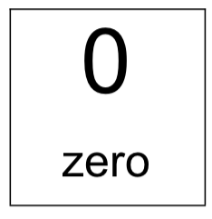
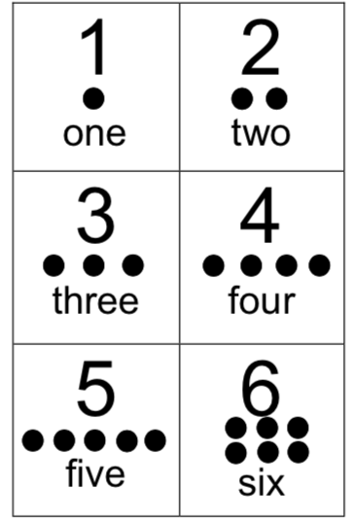
Can you build and match each of these numbers with your counting objects?

