Slide 1
Discussing film and TV [2 / 3]
Forming plurals of nouns
German
Frau Bolton

Slide 2
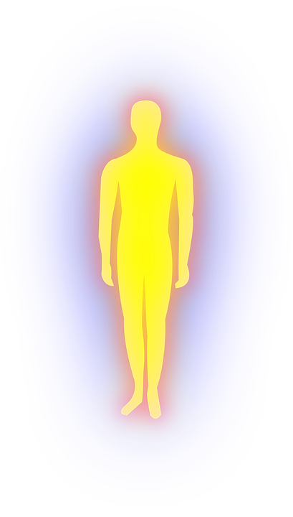
[ö]
mögen
[to like]
Lösung
[solution]
Körper
französisch
schön
möglich
[possible]

Slide 3
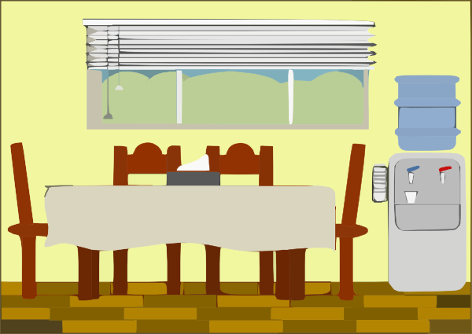
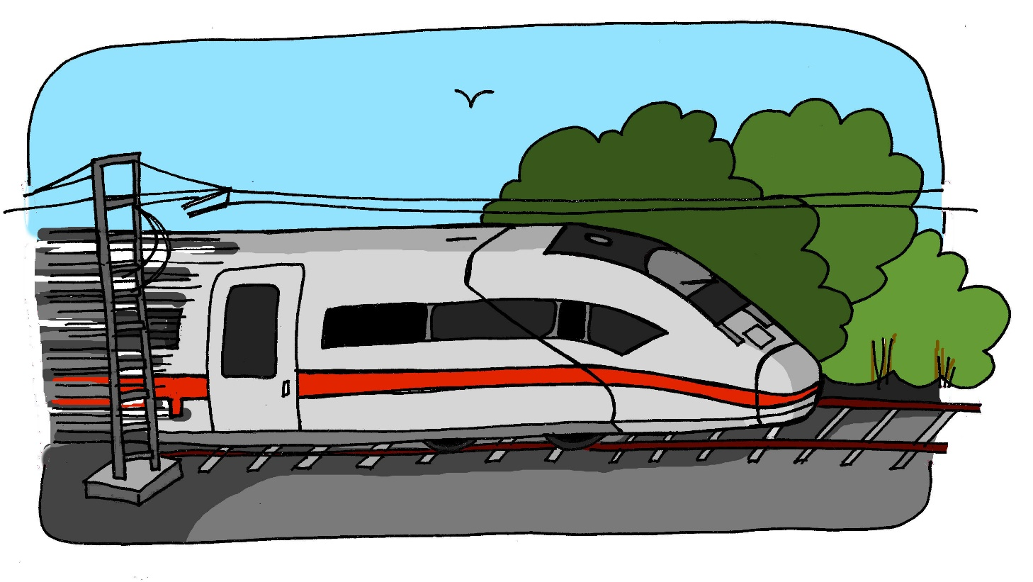
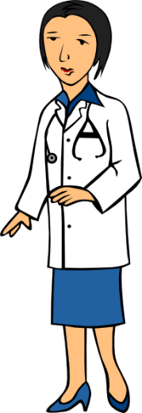
[z]
zehn
Zimmer
sitzen
Ärztin
Zug
Platz

Slide 4
die Sendung | programme
die Serie | series
der Actionfilm | action movie
der Krimi | detective/crime film
der Thriller | thriller
der Zeichentrickfilm | cartoon
der Fantasyfilm | fantasy film
der Horrorfilm | horror film
blöd | silly
beeindruckend | impressive

Slide 5
Forming plurals of nouns
In German there are several ways to make plural forms of nouns.
Most masculine and neuter words either:
add -e to the end
90% of masculine plurals work like this.

Slide 6
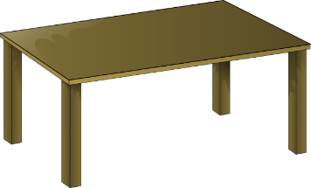
Forming plurals of nouns
der Tisch
die Tische

Slide 7
Forming plurals of nouns
or
2. add -e to the end + an umlaut on the vowel.

Slide 8
Forming plurals of nouns
der Zug
die Züge

Slide 9
Forming plurals of nouns
3. Some masculine and neuter nouns also add -er to the end + an umlaut on the vowel.
der Mann
die Männer
das Buch
die Bücher

Slide 10
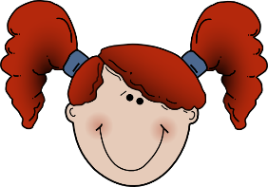
Forming plurals of nouns
Words ending in -el or -en or -er are often the same in the plural:
der Engel
der Lehrer
das Mädchen
die Engel
die Lehrer
die Mädchen

Slide 11
Forming plurals of nouns
Feminine nouns:
add –n or –en to the end

Slide 12
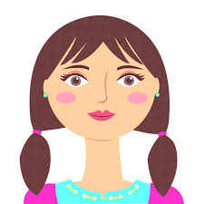
Forming plurals of nouns
die Gitarre
die Gitarren
die Frau
die Frauen

Slide 13
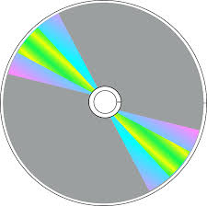
Forming plurals of nouns
Nouns borrowed from English or another language add an -s
die DVD die DVDs
Note that the word for ‘the’ is ‘die’ for ALL plural nouns!

Slide 14
Summary of our learning
Most masculine and neuter nouns add an -e to the end, eg. (action films) _______________ or add an -e and an umlaut on the vowel.
Some masculine and neuter nouns also add -er to the end + an umlaut on the vowel.
Words ending in -el or -en or -er are often the same in the plural, eg. (thrillers) _______________.
Feminine nouns add –n or –en to the end, eg. (series) _______________ and (programmes) _______________.
Nouns borrowed from English or another language add an -s, eg. (detective/crime films) _______________.

Slide 15
Summary of our learning
Most masculine and neuter nouns add an -e to the end, eg. (action films) Actionfilme or add an -e and an umlaut on the vowel.
Some masculine and neuter nouns also add -er to the end + an umlaut on the vowel.
Words ending in -el or -en or -er are often the same in the plural, eg. (thrillers) Thriller.
Feminine nouns add –n or –en to the end, eg. (series) Serien and (programmes) Sendungen.
Nouns borrowed from English or another language add an -s, eg. (detective/crime films) Krimis.

