Slide 1
Insulating material required practical part 2 (Physics only) - worksheet
Physics - Key stage 4 - Energy
Dr Fishwick

Slide 2
Exam style question
Thickness of cotton wool / mm | Start temperature / ºC | End temperature / ºC | Temperature change / ºC
0 | 90 | 65 | 25
2 | 90 | 45 | 45
4 | 90 | 69 | 21
6 | 88 | 69
8 | 88 | 71 | 17
10 | 90 | 74 | 16
A student investigates how the thickness of insulation affects the rate of cooling of water.
Calculate the temperature difference for 6 mm of cotton wool. (2)
The reading for 2 mm cotton wool is anomalous. Explain how it can be seen that this is anomalous. (1)
Thermometer
Lid
200 cm³ water
Cotton wool insulation

Slide 3
Exam style question
Thermometer
c) The student had access to a datalogger capable of taking 5 readings every second and a temperature probe able to read to 1 decimal place. The thermometer was an analogue thermometer as shown to the right.
Explain why the student chose just to use the thermometer for this experiment. (1)
Datalogger
21. 5 ºC

Slide 4
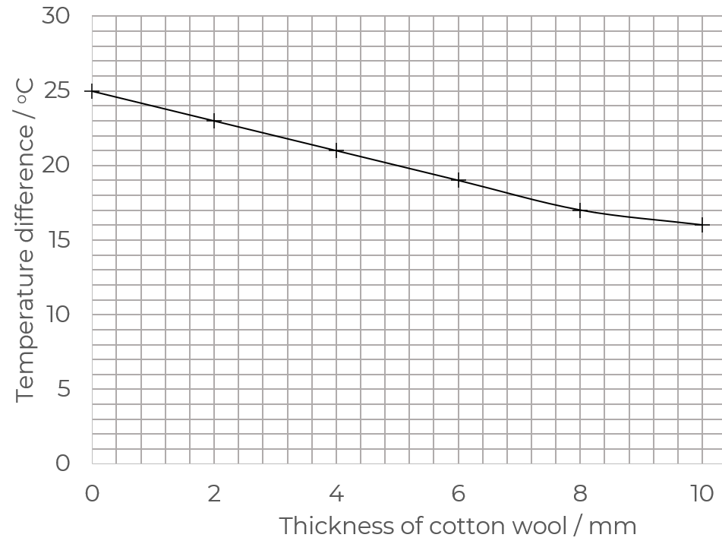
Exam style question
d) Describe the relationship between thickness of insulation and temperature change and the effect of thickness on rate of cooling. (2)

Slide 5
Exam style question
The student followed this method:
Wrap insulation around beaker
Measure temperature at the start
Measure temperature at end, calculate difference
Repeat with different thicknesses of cotton wool
e) Suggest two improvements to the method that the student could perform. (2)

Slide 6
Answers

Slide 7
88 - 69 = 19 ºC 1
The temperature difference for 2 mm is larger than for no insulation. 1
Or, the result does not fit the pattern of decreasing temperature difference.
The readings do not need to be taken as often as every second as only need start and end readings of temperature. 1
As the thickness increases, the temperature change decreases. 1
The rate of cooling decreases with increasing thickness 1
Any two from
Stir the water, use a more precise instrument, have the same starting temperature of water, take repeats and calculate a mean 2

Slide 8
In lesson questions

Slide 9
Independent practice
What is the biggest source of error in this practical?
The biggest error is due to ….
Explain why it is the biggest error.
What can be done to improve this method? (4)

Slide 10
Review
What is the biggest source of error in this practical?
The biggest error is due to not filling the space between the beakers the same.
Explain why it is the biggest error. Because with different air gaps, we will have different insulating properties than each material actually has.
What can be done to improve this method? (4)
Ensure all space is filled with insulation completely
Ensure exact same covering sizes are used for each beaker
Choose a larger range of materials
Compare the thickness of the material against its insulating properties

