Slide 1
Lesson 2: Computer Databases
Flat-file Databases
Computing
Andy Bush
Materials from the Teach Computing Curriculum created by the National Centre for Computing Education

Slide 2
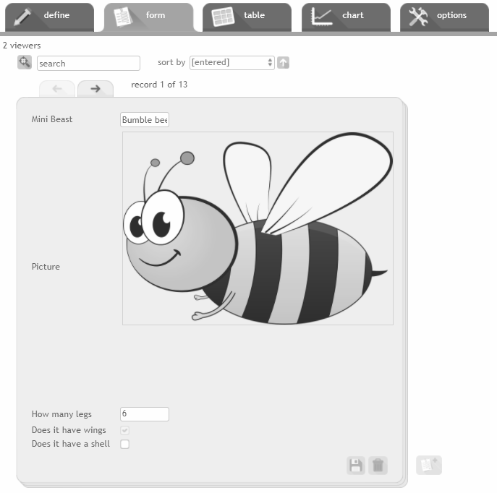
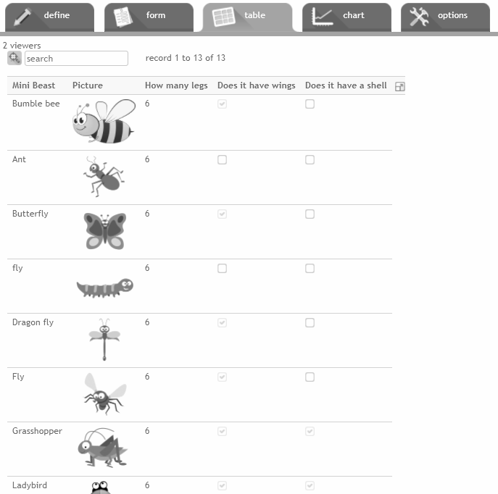
Task 1 - Sorting to answer questions
Open the mini beasts database from: oaknat.uk/comp-d52-1
Click in the table tab
Click on the column headings to sort the data from highest to lowest. Click a heading again to sort the data from lowest to highest.
Sort the data to help you answer the questions on the next page.
Source: J2E

Slide 3
Task 1 - Sorting to answer questions
Which mini beast has the most legs?
Which mini beasts have the fewest legs?
Which mini beast is at the beginning of the alphabet?
Which mini beast is at the end of the alphabet?
Source: J2E

Slide 4
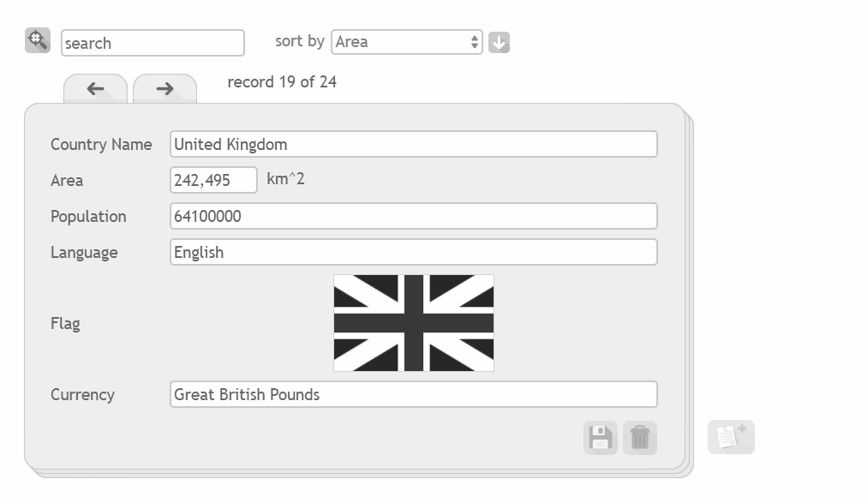
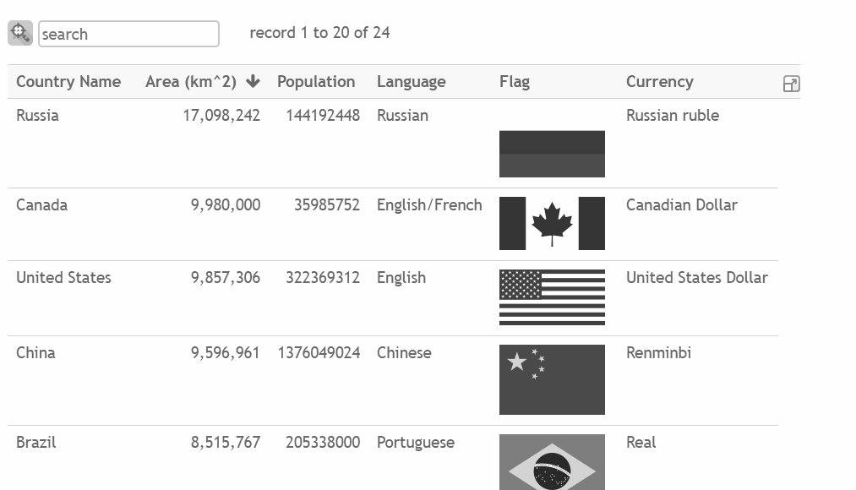
Task 2 - Sorting in different views
Open the countries database:
oaknat.uk/comp-d52-2
Choose a view and sort the data to answer the questions on the next page.
Think of two more questions you could answer by sorting the data.
Source: J2E

Slide 5
Task 2 - Sorting in different views
Write down answers to the questions below. Also note which field you used to answer each question.
Which country has the smallest population?
Which country covers the largest land area?
Which currency is last alphabetically?
Think of two more questions you could answer by sorting the data.
Source: J2E

Slide 6
Task 3 - Records and fields
Look at these two database views and identify which parts are records and which parts are fields.
Can you think of another field that could be added to this database?
Source: J2E

Slide 7
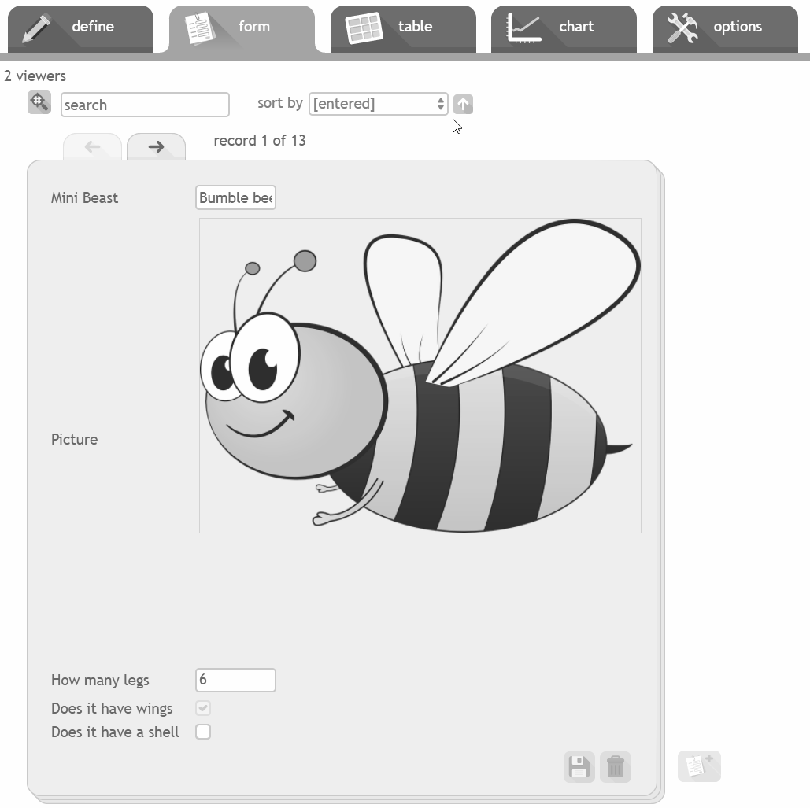
Task 4 - Compare paper vs computer
Think of advantages and limitations.
✓
✓
Can fly
Has six legs
Name:
Bee
Lives in large groups
Is more than one colour
Source: J2E
✓
✓

