Slide 1
Materials and the Earth
Lesson 7: Review 1
Science
Chemistry - Key Stage 3
Miss Willett

Slide 2
What have you learnt already?
What is a hydrocarbon?
Which is the hottest layer of the earth?
Which is the thickest layer of the earth?

Slide 3
Rock properties
Which am I?! How do you know?
Rock one is a ……………………………… rock, because ……………………
Rock two is a ……………………………… rock, because ………………………
Rock three is a ……………………………… rock, because …………………..
Rock four is a ……………………………… rock, because ………………………
Rock five is a ……………………………… rock, because ………………………

Slide 4
Properties of rock
Strata, crystals, irregular layers, hard (x2!), porous, shiny, fossils, colourful
Organise the following into the table:
Igneous | Sedimentary | Metamorphic

Slide 5
The rock cycle

Slide 6
The rock cycle
Tell the story of how magma can become metamorphic rock:
Magma starts in..
Then, after………... , it cools to form....
Weathering…
The sediments…
Over millions of years..
Sedimentary rock can either..
If it is pushed deeper…
This turns it into...
STRETCH: Include how volcanic eruption happens, which type of igneous rock you form (intrusive / extrusive), and how fossils may be involved

Slide 7
The rock cycle
Answer space:

Slide 8
Fossils
Match up the sentences
Preserves evidence of activity
Whole body cast
Imprint cast
Preserves soft tissue
Organism trapped in sediment layers
Amber

Slide 9
Crude oil
Fill in the gap!
Fossils undergo heat and ____________ to turn into oil
The process takes ____________ of years
Hydrocarbons are made of carbon and ___________ only

Slide 10
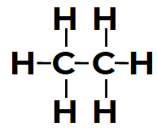
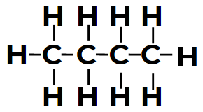
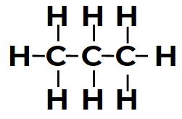
Hydrocarbons
What’s the name?
Credit: Miss Willett

Slide 11
Crude oil:
Answer the following questions:
Describe how fossils form. (3 marks)
State two conditions that are needed to turn fossils into oil.
What is a non-renewable resource?
What is crude oil made of?
Draw a diagram of pentane.
How could drilling for oil affect the environment?
Suggest one advantage of using crude oil.
Pause the video to complete your task
HINT: ‘pent’ = 5

Slide 12
Crude oil:
Answer space:

Slide 13
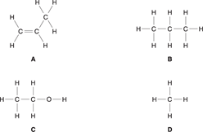
Exam paper application:
1. | This question is about carbon compounds. Look at the displayed formulas below. Which compound is not a hydrocarbon? Explain your answer. [2]
Source: OCR, June 2016; B711/01

Slide 14
Exam paper application:
2. Crude oil is often transported in large ships called oil tankers.
These oil tankers sometimes spill crude oil.
Crude oil spills cause environmental problems.
Write about two of these problems.
[2]
Source: OCR, June 2016; B711/01

Slide 15
Exam paper application:
3. Crude oil is a non-renewable fuel.
What is meant by a non-renewable fuel?
[2]
Source: Jan OCR, 2013; B711/01

