Slide 1
Lesson 6: Get Designing
Vector Drawing
Computing
Jordan Bickel
Materials from the Teach Computing Curriculum created by the National Centre for Computing Education

Slide 2
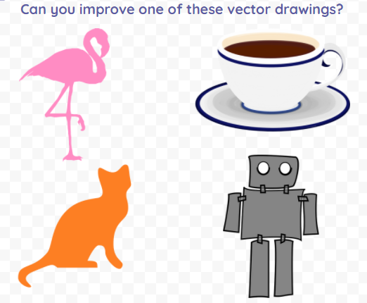
Task 1: Improve a vector drawing
In this task, you will choose one of the four drawings to improve.
Remember to use all of the skills we have learned throughout the unit!
Click the link to open your own copy of the activity in Google Drawings: oaknat.uk/comp-improving-vector
Credit: Pixabay

Slide 3
Task 2: What can you create?
Think of an object in the classroom or at home that could be labelled.
Think about what shapes you will need to use to draw it.
Create a vector illustration that could be added to a label around the classroom or your home
Remember the tools you have learned:
Copy and paste
Select and zoom
Shapes and fill colours
Line colours and styles
Layering
Grouping

