Slide 1
How can we develop ideas in fusion music?
Music
Ms Friar
Notes:
Introduction hello big welcome - exciting opportunity to decide what fusion style you like and want to develop!
Activity - can you spot what I have done with a rhythm or melody? - repetition, played it lower or higher, missing notes.

Slide 2
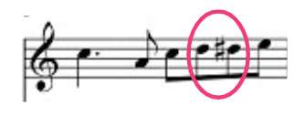
Choose one melodic idea.
Practise playing or singing it.
How could you develop this? How can this become a longer part in a piece of music?
Rag scale - Indian classical
Aeolian scale - afro celt
Melodic call - afrobeat
Chromatic melody - tango
Option 4

Slide 3
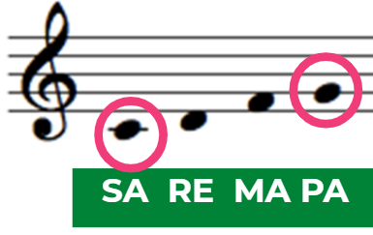
Choose one harmonic idea.
Practise playing or singing it.
How could you develop this? How can this become a longer part in a piece of music?
Drone - Indian classical
Synth pad - afro celt
Chords - electrotango
7th chords - afrobeat
A | Em | Em | A | Em
E | B | B | E | B
C | G | G | C | G
A | E | E | A | E
G7 | Em7 | F#m7 | F#m | Em
F# | D | E
D | B | C# | C# | B
B | G | A | A | G
G | E | F# | F# | E

