Slide 1
Identify Prime Numbers
Mr Lund
Maths
‹#›

Slide 2
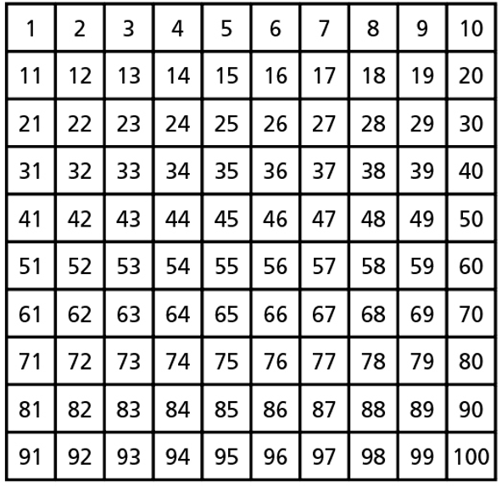
Identify Prime Numbers
1. a) List the factors of 2
b) List the factors of 47
c) How does this tell you that 2 and 47
are prime?
2. List the prime numbers to 10
3. Explain why 1 is not prime.
4. Gary has highlighted the primes up to 100, but he has missed 4 primes.
Which 4 has he missed?
‹#›

Slide 3
Identify Prime Numbers
5. Is the statement true or false?
Explain your answer.
6. Fill in the blanks to write 20 and 16 as the sum of two primes.
3 + 17 = 20
3 + 17 = 16
7. Sort the numbers into the Venn diagram.
1, 2, 3, 5, 17, 18, 23, 33
All prime numbers are odd.
Multiples of 3
Prime numbers
‹#›

Slide 4
Answers
‹#›

Slide 5
Identify Prime Numbers
1. a) List the factors of 2
b) List the factors of 47
c) How does this tell you that 2 and 47
are prime?
2. List the prime numbers to 10
3. Explain why 1 is not prime.
4. Gary has highlighted the primes up to 100, but he has missed 4 primes.
Which 4 has he missed?
1, 2
1, 47
Prime numbers have exactly 2 factors.
2, 3, 5, 7
Primes have exactly two factors and 1 only has one factor.
2, 7, 13, 23
‹#›

Slide 6
Identify Prime Numbers
5. Is the statement true or false?
Explain your answer.
6. Fill in the blanks to write 20 and 16 as the sum of two primes.
3 + 17 = 20
3 + 13 = 16
7. Sort the numbers into the Venn diagram.
1, 2, 3, 5, 17, 18, 23, 33
All prime numbers are odd.
Multiples of 3
Prime numbers
False, 2 is the only even prime.
2
18
3
17
33
5
23
e.g
1
‹#›

