Slide 1
Planning how to make a savoury salad
Design and technology - Cooking and nutrition: preparing fruit and vegetables
Mrs L Mee

Slide 2
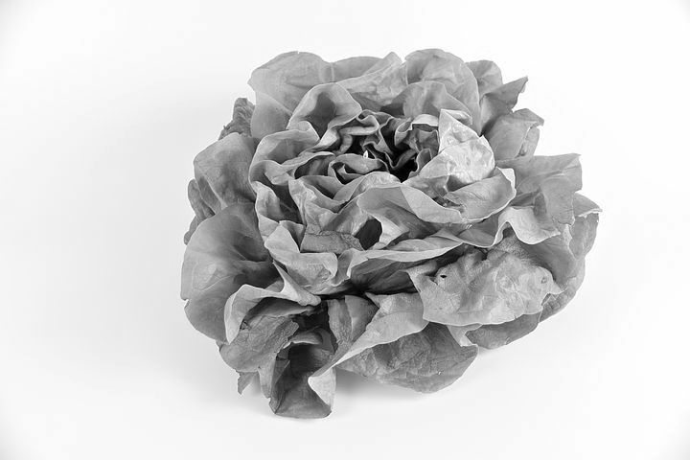
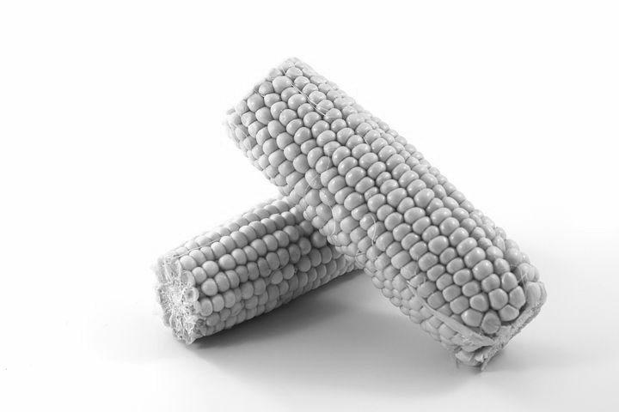
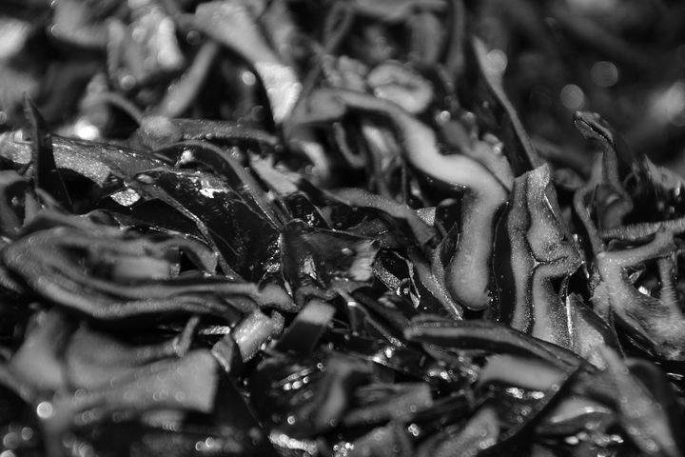
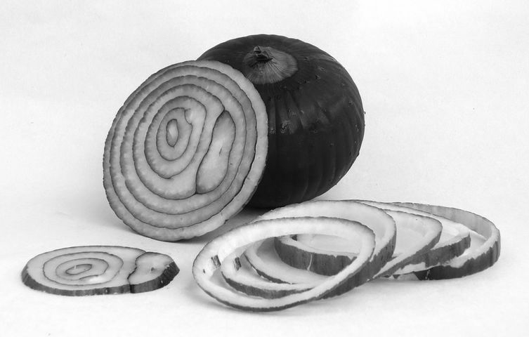
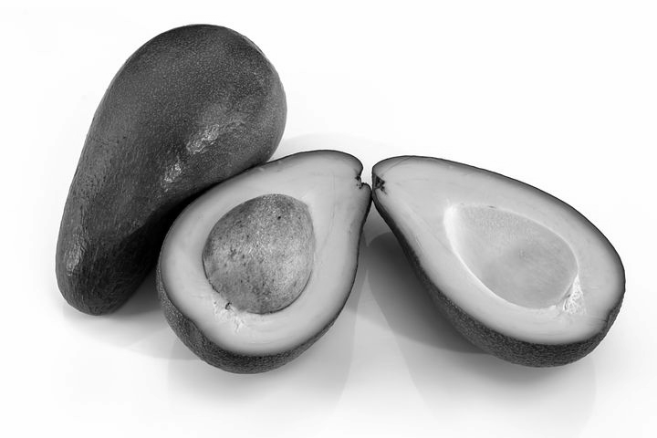
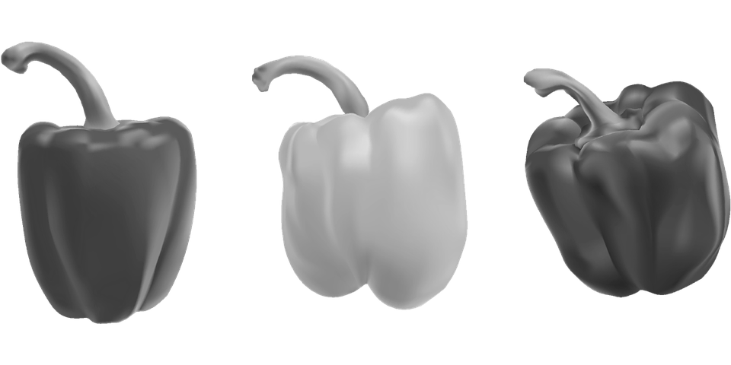
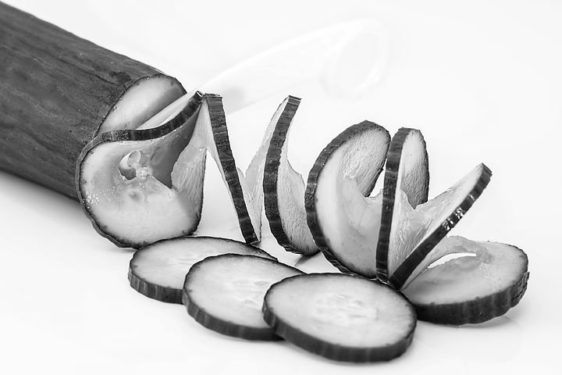
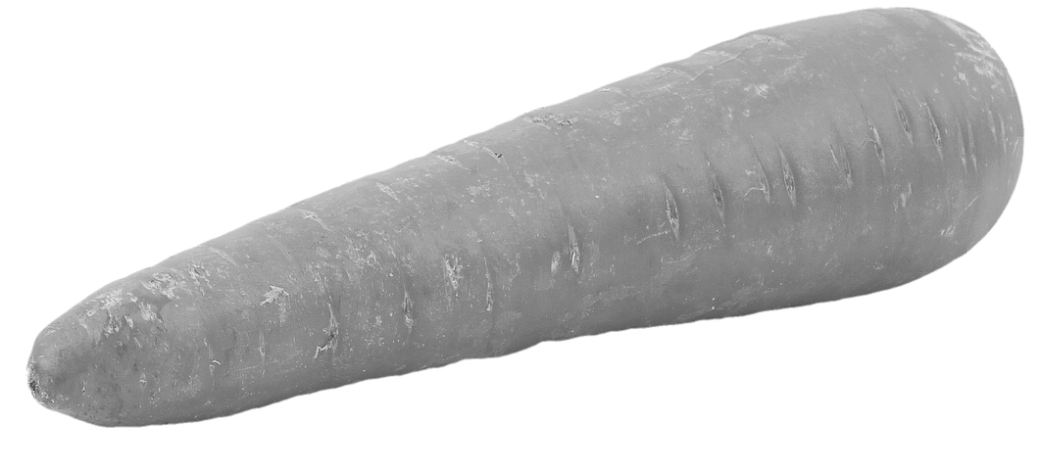
Selecting ingredients and equipment
Images of ingredients.

Slide 3
Selecting ingredients and equipment
Images of equipment.
Credit: Flacticons © 2010-2020 Freepick Company S.L All rights reserved, pixabay

Slide 4
Selecting ingredients and equipment
Add your ingredients and equipment to your plan of making.
Plan to make savoury salad
Ingredients | Equipment | Method

