Slide 1
Exploring multiplication strategies
Mathematics
Miss Thomas

Slide 2
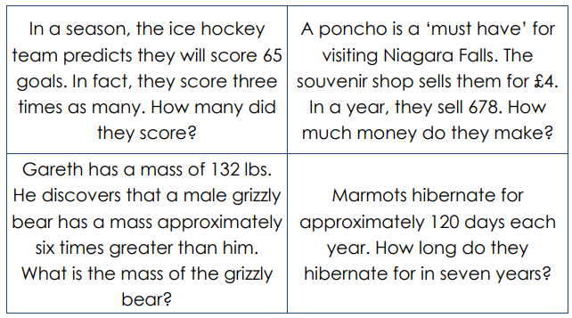
Question 1
Identify the problem and choose an efficient strategy to solve it.

Slide 3
Question 1 Answers
Identify the problem and choose an efficient strategy to solve it.
195
2712
792
840

