Slide 1
Calculate probabilities of dependent events
Mr Chan
Maths

Slide 2
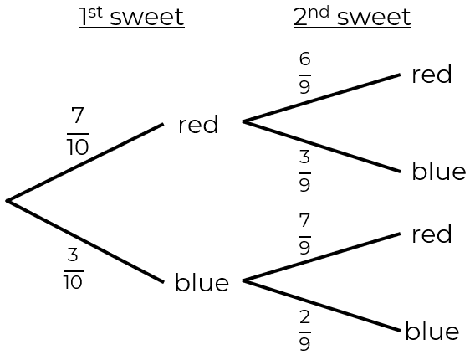
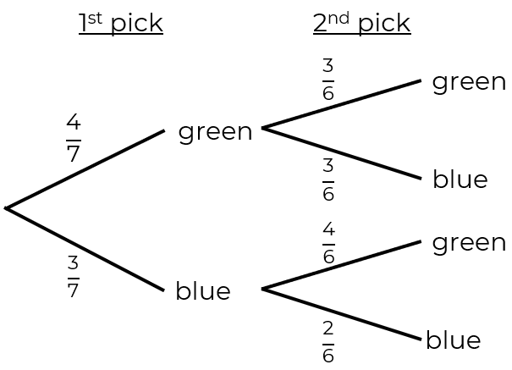
Calculate probabilities of dependent events
1. Jack takes two sweets from his bag. Here is a probability tree with all outcomes shown.
Calculate the probability that Jack takes two red sweets from his bag.
2. Amir is takes 2 counters from a bag.
Here is a probability tree with all outcomes shown.
Calculate the probability that Amir takes two counters that are different colours.

Slide 3
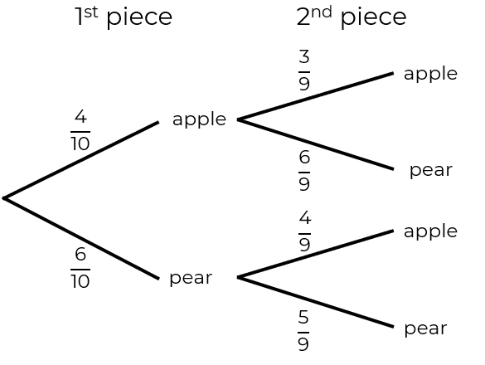
Calculate probabilities of dependent events
3. Rosie is eating fruit from her
lunch bag. The outcomes for
her first two pieces of fruit are shown:
Calculate the probability that Rosie eats at least one piece of apple.
4. Jim is giving away some marbles he has in a box.
The table shows the probabilities of taking different coloured marbles.
Jim has 24 blue marbles.
a) Calculate how many green marbles there are.
b) Calculate the probability that Jim gives away two blue marbles.
Blue | Green
0.2 | 0.8

Slide 4
Answers

Slide 5
Calculate probabilities of dependent events
1. Jack takes two sweets from his bag. Here is a probability tree with all outcomes shown.
Calculate the probability that Jack takes two red sweets from his bag.
2. Amir is takes 2 counters from a bag.
Here is a probability tree with all outcomes shown.
Calculate the probability that Amir takes two counters that are different colours.

Slide 6
Calculate probabilities of dependent events
3. Rosie is eating fruit from her
lunch bag. The outcomes for
her first two pieces of fruit are shown:
Calculate the probability that Rosie eats at least one piece of apple.
4. Jim is giving away some marbles he has in a box.
The table shows the probabilities of taking different coloured marbles.
Jim has 24 blue marbles.
a) Calculate how many green marbles there are.
b) Calculate the probability that Jim gives away two blue marbles.
Blue | Green
0.2 | 0.8
96

