Slide 1
Integer Addition and Subtraction: Adding using the column method
Mathematics
Ms Jeremy

Slide 2
Pause the video to complete your task
Resume once you’re finished
63 198 + 25 764 =

Slide 3
Pause the video to complete your task
Resume once you’re finished
Estimate the answer to the calculation using rounding.
Calculate the answer using the column method.
437 029 + 158 772 =
632 901 + 45 891 =

Slide 4
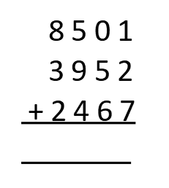
Pause the video to complete your task
Resume once you’re finished
8501 + 3952 + 2467 =
Calculation:
Estimation:

Slide 5
Pause the video to complete your task
Resume once you’re finished
Independent Task
For each of the equations below, provide a suitable estimate before calculating using the column method:
236 712 + 441 823 =
210 462 + 549 882 =
712 013 + 56 225 =
4510 + 2683 + 1195 =
12 013 + 4432 + 1549 =

