Slide 1
Composition: Weather Forecast
Communication and Language: Seasons - Building Understanding
Rae
Notes:
Lesson 1 starting screen. Add the Unit title, Lesson title and stage (Early Development, Building Understanding or Applying Learning)
Text sharing
Poetry reading & writing
Rhythm & rhyme
2 word level understanding
Instructional text
This is language comprehension (listening to and understanding text)
Pupils who are emerging into the Building Understanding level should be given opportunities to:
· follow single key word instructions eg, ‘stand up’
· indicate correctly pictures of familiar characters and known objects in response to ‘Where is …?’in a familiar story read by an adult. Responses may be sign/ symbol/ single word or combination.
· show anticipation about what is going to happen e.g. by turning page
· join in with some actions or repeat some familiar words, rhymes and phrases when prompted
· Communicate ‘yes’ and ‘no’
Pupils who are established at the Building Understanding level should be given opportunities to:
· demonstrate single word understanding of familiar rhyme or story read by an adult by answering ‘Who?’, ‘Where?’, ’What?’ questions
· join in with predictable phrases or refrains
· follow simple 2 key word instructions eg give the spoon to Bob
· differentiate by colour
· respond to questions about immediate events eg. ‘Where’s the dog?’ (with dog nearby)

Slide 2
Intro
This lesson aims to develop understanding of key weather words and encourages the child to use key vocab to report on the weather (verbally, with symbols or signs).
Notes:
Full screen video introducing yourself and the lesson

Slide 3
Aims
Develop association with and anticipation of sensory experience related to weather
Show understanding of key weather words and use them receptively and expressively
Notes:
Full screen video introducing yourself and the lesson

Slide 4
Structure
Play game in which symbol represents the sensory experience associated with weather
Explore the current weather outside and name it
Encourage the child to share their knowledge and experience
Notes:
Full screen video introducing yourself and the lesson

Slide 5
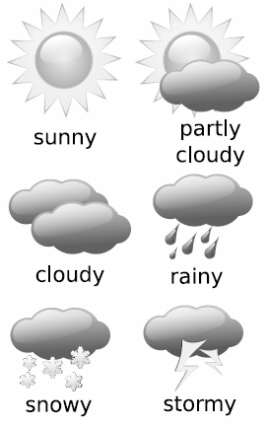
For this lesson you will need
Recommended, but not required:
Relevant symbols & signs or images supplied in the downloadable content for this lesson
Some ‘weather’ props - wellies, umbrella, ice, spray bottle, suncream, hat etc
Notes:
Voice over - slide full screen, add the resources needed for the lesson on the left and widgit symbols on the left (copyright Widgit)

Slide 6
Getting ready
Reduce distractions within the room (turn off anything that creates light or sound)
Prepare your child to be ‘ready for learning’ - this may require a run around outside first, a snack, or an opportunity to re-position and settle into a comfy chair
Create interest by sharing and exploring props / resources
Show them you’re excited for the lesson! Build curiosity and anticipation!
.
Notes:
Add here how to get the room ready for learning

Slide 7
Part one - Game!
Explore the key words and symbols first...
Notes:
Full screen video introducing yourself and the lesson

Slide 8
sun
Notes:
Full screen video introducing yourself and the lesson

Slide 9
cloud
Notes:
Full screen video introducing yourself and the lesson

Slide 10
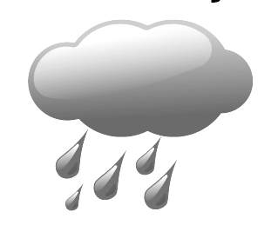
rain
Notes:
Full screen video introducing yourself and the lesson

Slide 11
snow
Notes:
Full screen video introducing yourself and the lesson

Slide 12
storm
Notes:
Full screen video introducing yourself and the lesson

Slide 13
Part one - Game!
Develop a reciprocal game in which you or the child a weather symbol from a choice of two, four or six (whichever is most appropriate) and the other person finds the associated item.
Don’t forget to clearly articulate the weather word indicated by the symbol.
Swap roles.
Notes:
Full screen video introducing yourself and the lesson

Slide 14
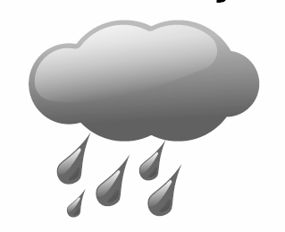
Part one - Game!
= sunglasses / suncream on
= ice cube on hand
= spray bottle squirts
Notes:
Full screen video introducing yourself and the lesson

Slide 15
Part two - weather forecast
Make it real. Go outside and look at the sky, discuss what you will need to wear, use the symbols to decide what the weather is doing.
Create a weather chart on the wall, so each day you can look at the weather and compare it to the previous day.
Notes:
Full screen video introducing yourself and the lesson

Slide 16
Weather Chart
Monday | Tuesday | Wednesday | Thursday | Friday
Notes:
Full screen video introducing yourself and the lesson

Slide 17
Example Weather Chart
Monday | Tuesday | Wednesday | Thursday | Friday
Notes:
Full screen video introducing yourself and the lesson

Slide 18
Part three - share
To secure understanding and to develop communication and interaction around this subject, encourage your child to show others the weather chart and report daily on the status! This will enable regular repetition of the topic words and secure understanding and language over time.
Notes:
Full screen video introducing yourself and the lesson

Slide 19
Communication and Language Seasons Unit 8: Lesson 3
Composition: Weather Forecast
Make it easier
Make it harder
More ideas
Repetition, repetition, repetition.
Drama!
Focus on one key word at a time. Identify only when it’s sunny, for example.
Limit choices to two.
Prompt “what weather?” without providing choices, as an open question.
Encourage the child to articulate the word or use the sign as well as using the symbol.
Explore books and songs about the weather together. Make paintings of the different weather symbols or use weather-related items to create prints and marks (wellies to make footsteps or fill suncream bottle with paint to shake out).
Slides 5, 8 to 12, 14, 17 - All weather icons sourced from Free SVG j4p4n weather chart 2014
Notes:
Final slide of the lesson. Suggest adaptations for teachers/parents. Voice over - slide to be full screen

