Slide 1
German
Discussing reading habits [3 / 3]
Forming plurals of nouns
Frau Bolton

Slide 2
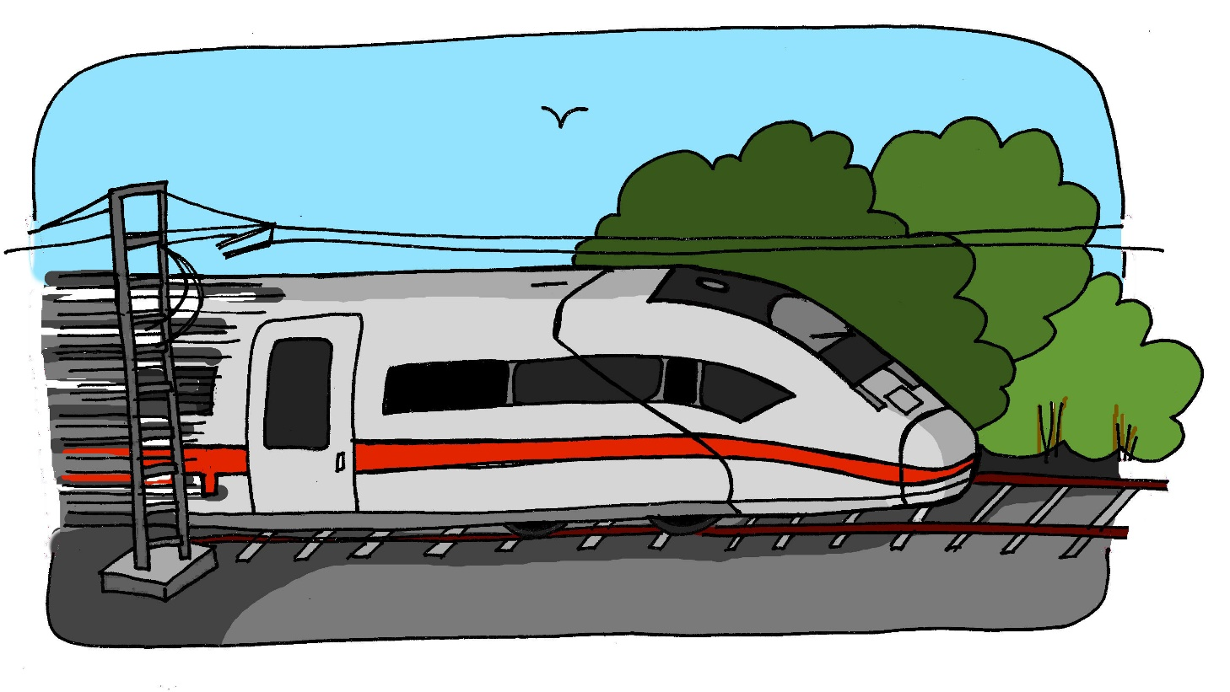
[z]
Zug
Notes:
Phonics slides
Wiederhole! Z Z Zug

Slide 3
[z]
Notes:
Wiederhole! z.

Slide 4
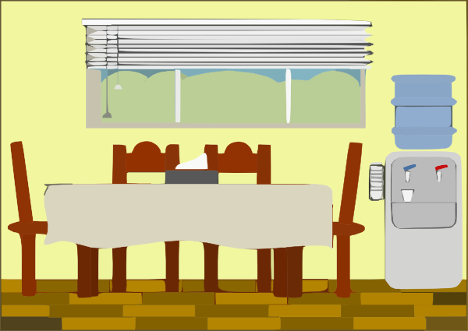
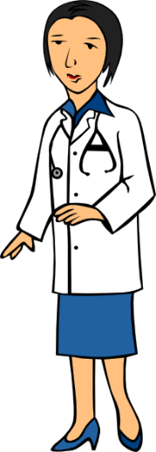
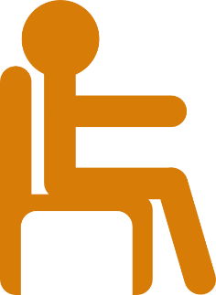
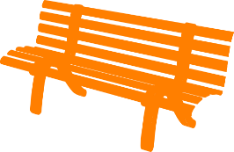
[z]
zehn
Zimmer
sitzen
Ärztin
Zug
Platz
Notes:
Wiederhole! Schnell ... schwarz …..

Slide 5
Comics | comics
Illustrierten | glossy magazines
Zeitschriften | magazines
Krimis | detective/crime stories
Thriller | thrillers
Taschenbücher | paperback books
Blogs | blogs
Zeitungen | newspapers
Magazine | magazines
E-books | e-books
Notes:
On the screen, you can see the new vocabulary together. Now, I’ll say the German again, but I will say the words out of order. You say the correct translation out loud. If you want to challenge yourself - close your eyes, focus on what I’m saying and say the correct translation out loud.
Taschenbücher E-books Krimis Comics Thriller Zeitungen Magazine Blogs Illustrierten Zeitschriften
Did you get most of the English meanings right? Sehr gut!
LE.g. les grands événements
E.g. les grands événements

Slide 6
Forming plurals of nouns
In German there are several ways to make plural forms of nouns.
Most masculine and neuter words either:
add -e to the end
90% of masculine plurals work like this.
Notes:
In German, there are several ways to make plural forms of nouns. Most masc and neuter word either add -e to the end

Slide 7
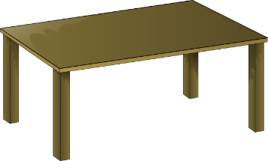
Forming plurals of nouns
der Tisch
die Tische
Notes:
Eg. der Tisch the table die Tische the tables

Slide 8
Forming plurals of nouns
or
2. add -e to the end + an umlaut on the vowel.
Notes:
Or they add -e to the end and an umlaut on the vowel

Slide 9
Forming plurals of nouns
der Zug
die Züge
Notes:
Eg. der Zug the train die Zuege the trains

Slide 10
Forming plurals of nouns
3. Some masculine and neuter nouns also add -er to the end + an umlaut on the vowel.
der Mann
die Männer
das Buch
die Bücher
Notes:
Some masc and neuter nouns also add -er to the end and an umlaut on the vowel, eg,
der Mann (the man), die Maenner (the men)
And das Buch (the book) die Buecher (the books)

Slide 11
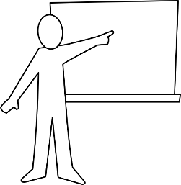
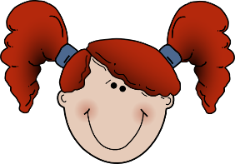
Forming plurals of nouns
Words ending in -el or -en or -er are often the same in the plural:
der Engel
der Lehrer
das Mädchen
die Engel
die Lehrer
die Mädchen
Notes:
Words ending in -el or -en or -er are often the same in the plural:
Eg. der Engel means the angel and die Engel means the angels
Similarly, der Lehrer means the teacher and die Lehrer means the teachers
And das Maedchen is the girl while die Maedchen is the girls

Slide 12
Forming plurals of nouns
Feminine nouns:
add –n or –en to the end
Notes:
Feminine nouns add -n or -en to the end

Slide 13
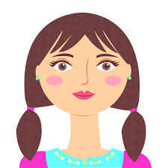
Forming plurals of nouns
die Gitarre
die Gitarren
die Frau
die Frauen
Notes:
Eg. die Gitarre (the guitar) in the plural becomes die Gitarren and die Frau (the woman) becomes die Frauen

Slide 14
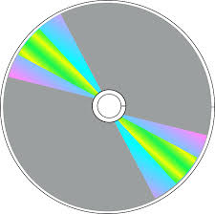
Forming plurals of nouns
Nouns borrowed from English or another language add an -s
die DVD die DVDs
Note that the word for ‘the’ is ‘die’ for ALL plural nouns!
Notes:
Finally, nouns borrowed from English or another language add an -s to the end, so die DVD becomes die DVDs - easy to remember!

Slide 15
Summary of our learning
Most masculine and neuter nouns add an -e to the end, eg. (magazines) _______________ or add an -e and an umlaut on the vowel.
Some masculine and neuter nouns also add -er to the end + an umlaut on the vowel, eg. _______________ .
Words ending in -el or -en or -er are often the same in the plural, eg. (thrillers) _______________.
Feminine nouns add –n or –en to the end, eg. (glossy magazines) _______________.
Nouns borrowed from English or another language add an -s, eg. (blogs) _______________.
Notes:
Really well done! You’ve learned and practised some really useful phonics, vocabulary and grammar today!
Now see if you can summarise what you’ve learned by filling in the gaps in this slide.
Take your time and see if you can score full marks. Stopp das Video!

Slide 16
Summary of our learning
Most masculine and neuter nouns add an -e to the end, eg. (magazines) Magazine or add an -e and an umlaut on the vowel.
Some masculine and neuter nouns also add -er to the end + an umlaut on the vowel, eg. (paperback books) Taschenbücher.
Words ending in -el or -en or -er are often the same in the plural, eg. (thrillers) Thriller.
Feminine nouns add –n or –en to the end, eg. (glossy magazines) Illustrierten.
Nouns borrowed from English or another language add an -s, eg. (blogs) Blogs.
Notes:
Hier sind die Antworten! (READ IT THROUGH)

