Slide 1
Fission and Fusion
Physics - Key stage 4 - Atomic Structure
Mr van Hoek

Slide 2
Fission and fusion
Copy and complete the sentences using some of these keywords.
large small join split smaller larger energy neutron(s)
Fission involves the ______________ of ___________ nuclei to produce _____________ nuclei, two or three ____________ and a large amount of ____________.
Fusion involves the _____________ of ___________ nuclei to produce ______________ nuclei, one additional _____________ and a ____________ amount of energy.

Slide 3
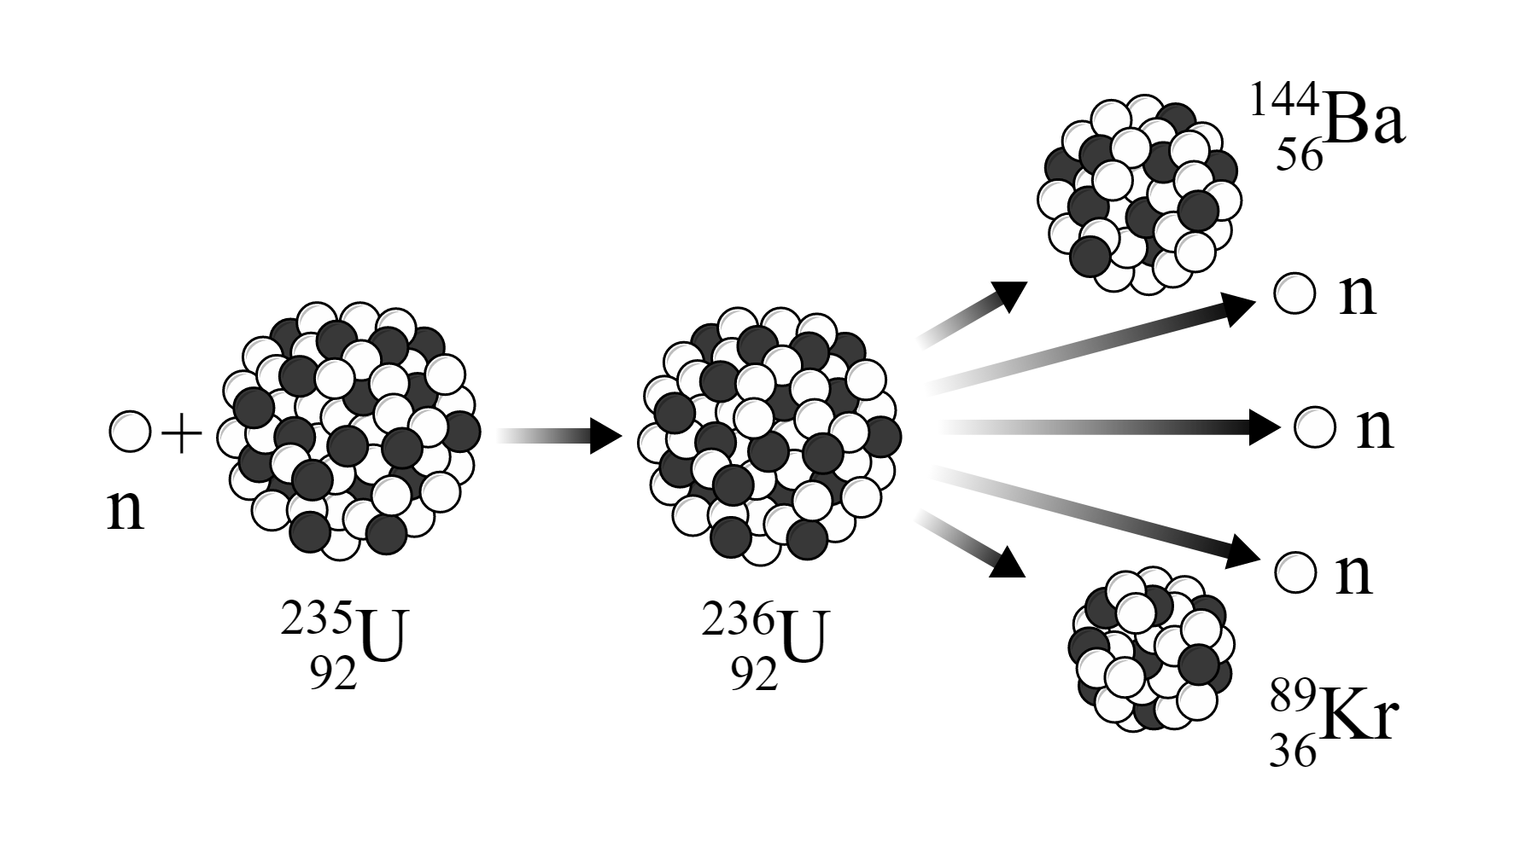
Fission
Credit : wikimedia, MikeRun, Illustration of a typical nuclear fission reaction

Slide 4
Sort the statements into the correct order
1 | A uranium-235 nucleus absorbs a neutron.
 | 2 or 3 neutrons, gamma rays and...
 | Control rods will absorb some of neutrons to control the chain reaction.
 | This nucleus undergoes fission and produces 2 smaller smaller nuclei.
 | ...energy is released and given to the particles as kinetic energy.
 | This creates uranium-236 - a very unstable nucleus.

Slide 5
Independent writing
Describe and explain how the process of nuclear fission releases energy from Uranium-235 nuclei, and how the chain reaction is control.
Credit : wikimedia, MikeRun, Illustration of a typical nuclear fission reaction

Slide 6
Exam Question
Which statement describes nuclear fusion?
Two hydrogen nuclei join to form a helium nucleus.
A helium nucleus joins with a hydrogen nucleus to form an alpha particle.
Uranium nuclei split and produce high energy neutrons causing a chain reaction.
Two helium nuclei join to form a hydrogen nucleus.
OCR, Specimen, J249/04

Slide 7
Exam Question
Nuclear power stations are used to generate electricity.
Nuclear scientists must make sure that nuclear reactions do not go out of control.
They can place control rods in the reactor.
Explain what the control rods do and why they cannot remain in the reactor all the time.
OCR, June 2016, B752/02

Slide 8
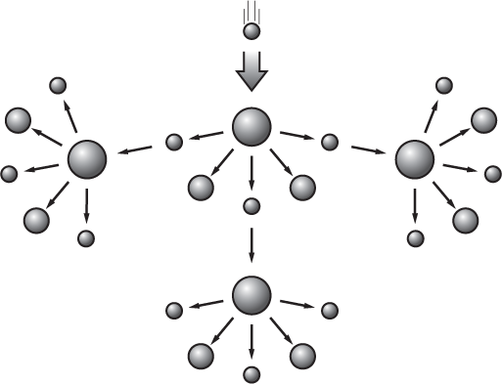
Exam Question
Carlos draws a diagram to show what happens in a chain reaction.
Label the diagram and use it to explain what happens in a chain reaction.
Describe the differences between a chain reaction in a nuclear reactor and in a nuclear bomb. [6]
OCR, June 2017, B752/02

