Slide 1
Independent Living Daily Living Skills
Lesson 6 - Daily meals
Oak Specialist
Building Understanding

Slide 2
Unit 3- Daily Living Skills
Lesson 1- Creating a visual schedule
Lesson 2- Getting dressed
Breaking down the steps of the sequence and creating opportunities for independence.
How to make and follow a visual schedule for daily activities.
Lesson 3- Recycling
Lesson 4- Using equipment in the kitchen
Sorting recycling items into different categories.
Labelling kitchen equipment and learning what food to use them with.
Lesson 5- Following a simple recipe
Lesson 6- Daily meals
Following simple steps to make a cheese sandwich.
Choosing food items and matching them to a meal time.
‹#›
Notes:
Depending on how many lessons for each unit, there could be a 2nd page for lesson 5…etc

Slide 3
Teacher notes- Daily meals
Learning Intention: To identify what food items are eaten at different times of the day.
Introduction to three daily meals and the times of day that we eat them at.
What food do we eat at breakfast? Choose images from a grid and create a breakfast plate.
What food do we eat at lunchtime? Choose images from a grid and create a lunch plate. Talk about the different food items and size.
What food do we eat at dinnertime? Choose images from a grid and create a dinner plate. Do you eat dessert too? Talk about portion size.
-Resources: pen and paper.
Notes:
This is the equivalent to a loose lesson plan/overview for teachers before starting the lesson.

Slide 4
Lesson Activity Stages
Mealtimes
Choosing food items at breakfast
Choose food items at lunch
Choose food items at dinner
Create your own plates of food
Notes:
Lesson 1 breakdown of the lesson. Repeat for each lesson.

Slide 5
Meal times
We eat meals at three different times of the day.
morning
lunchtime
evening
Notes:
We eat three main meals a day.

Slide 6
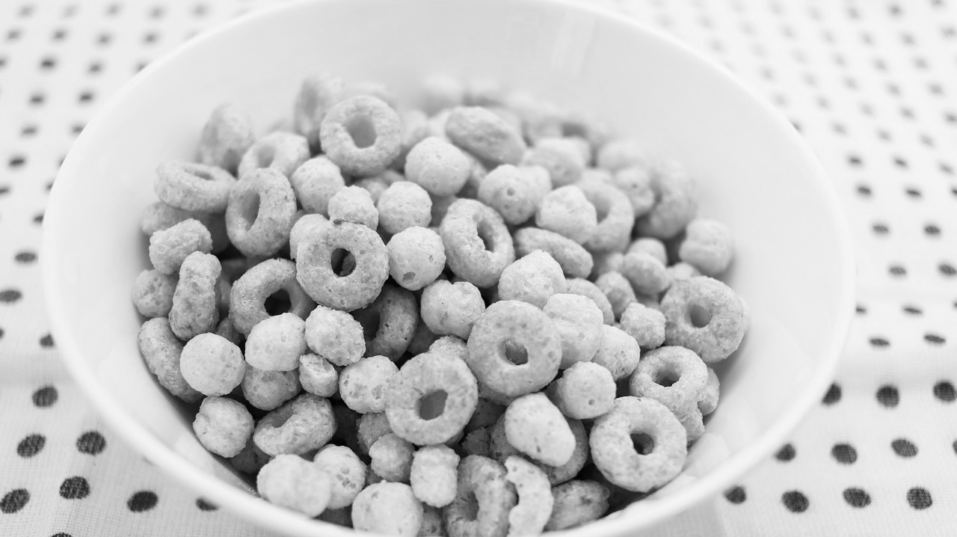
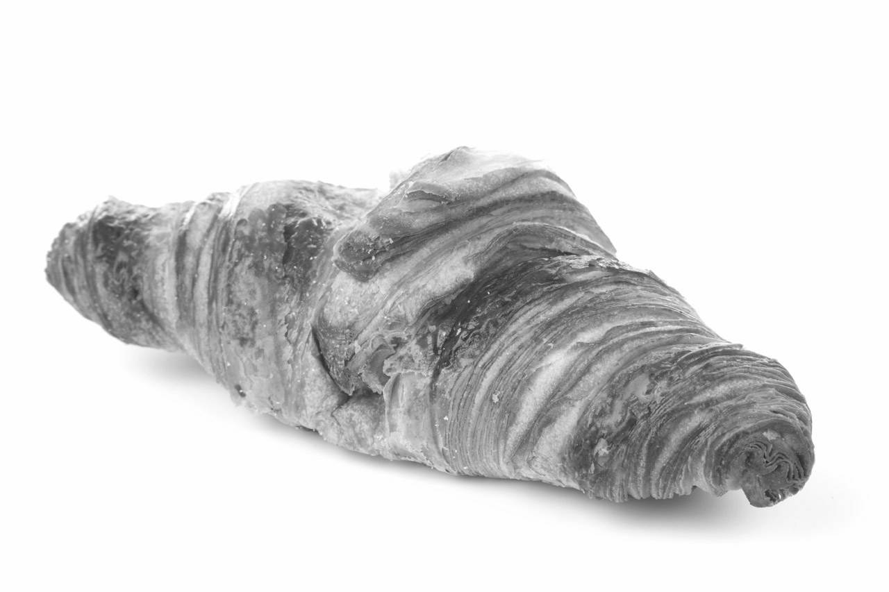
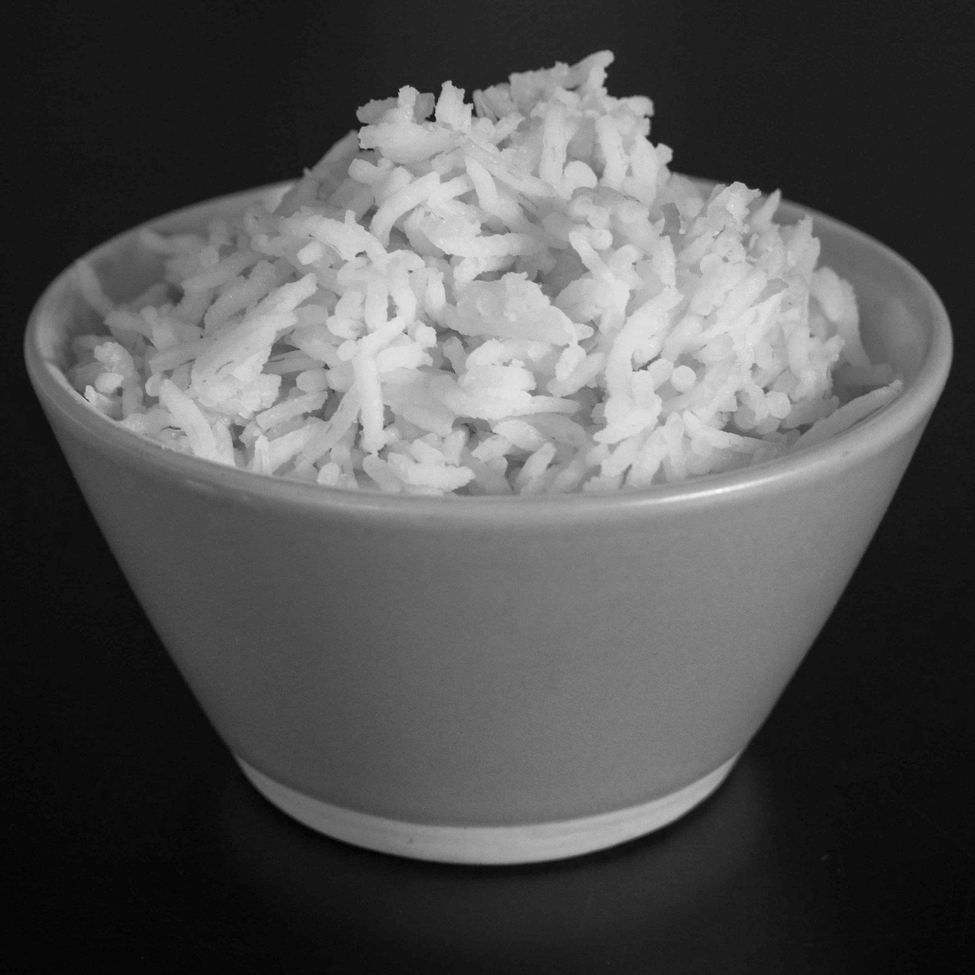
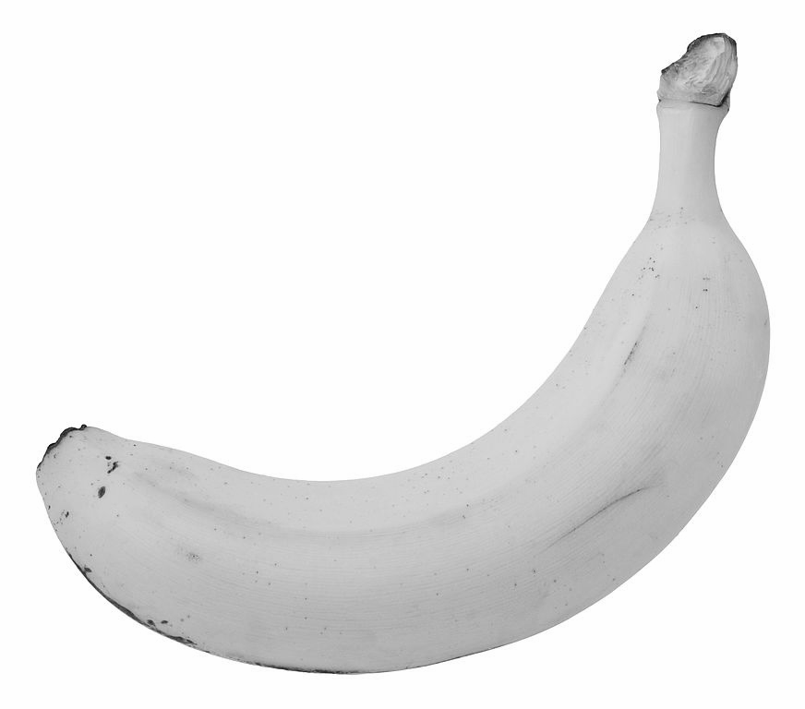
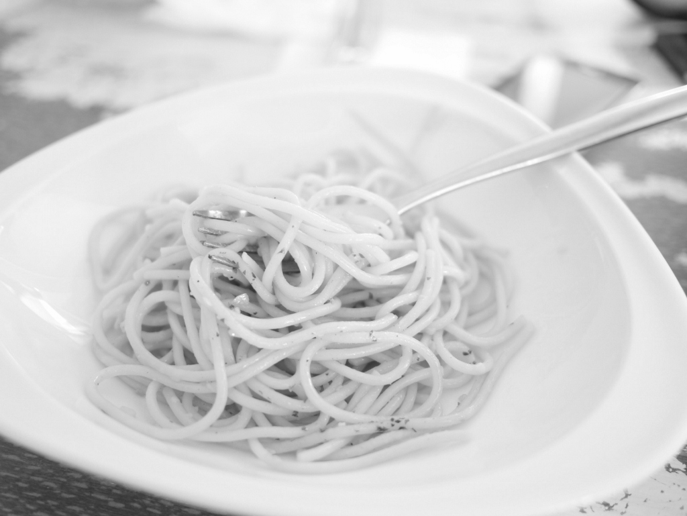
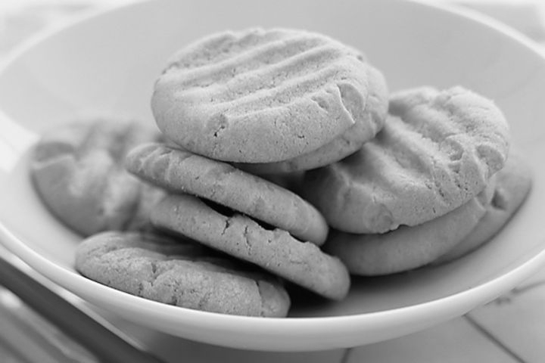
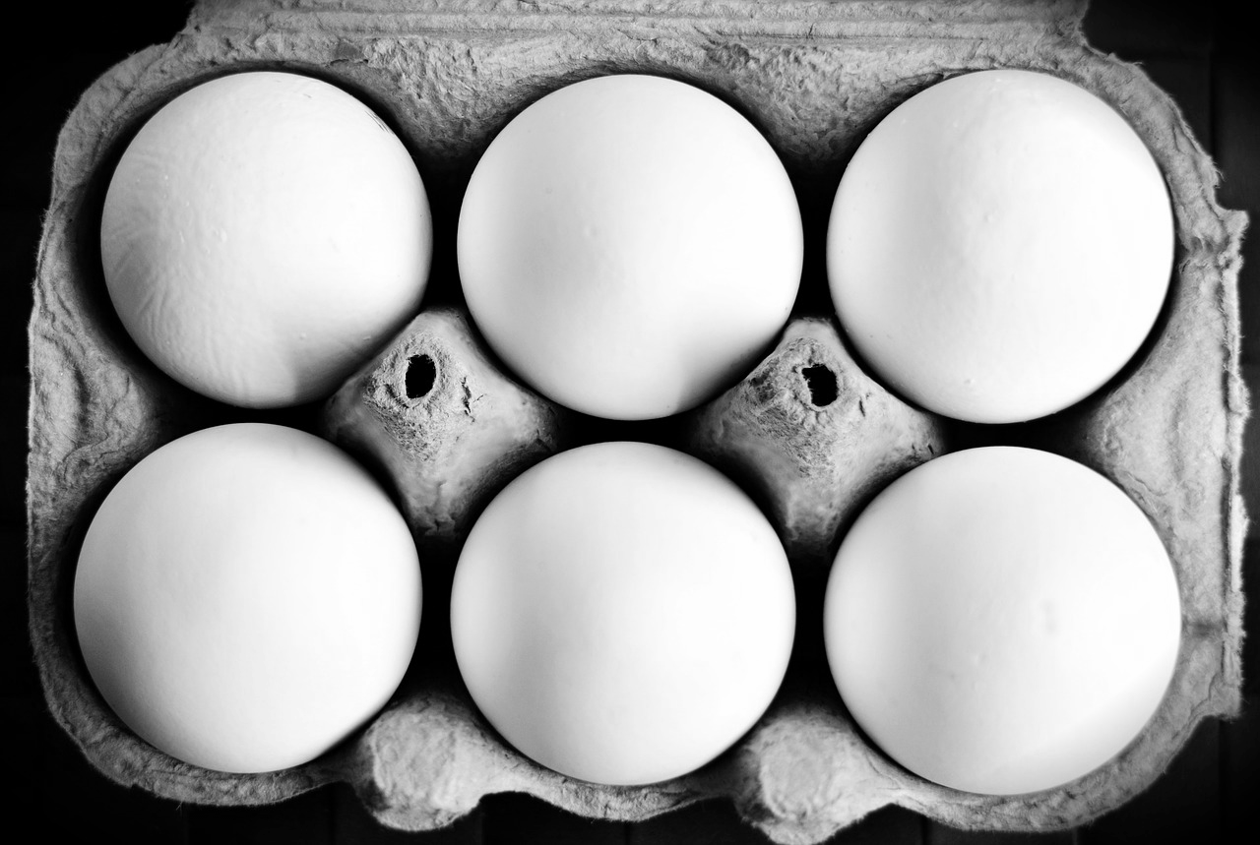
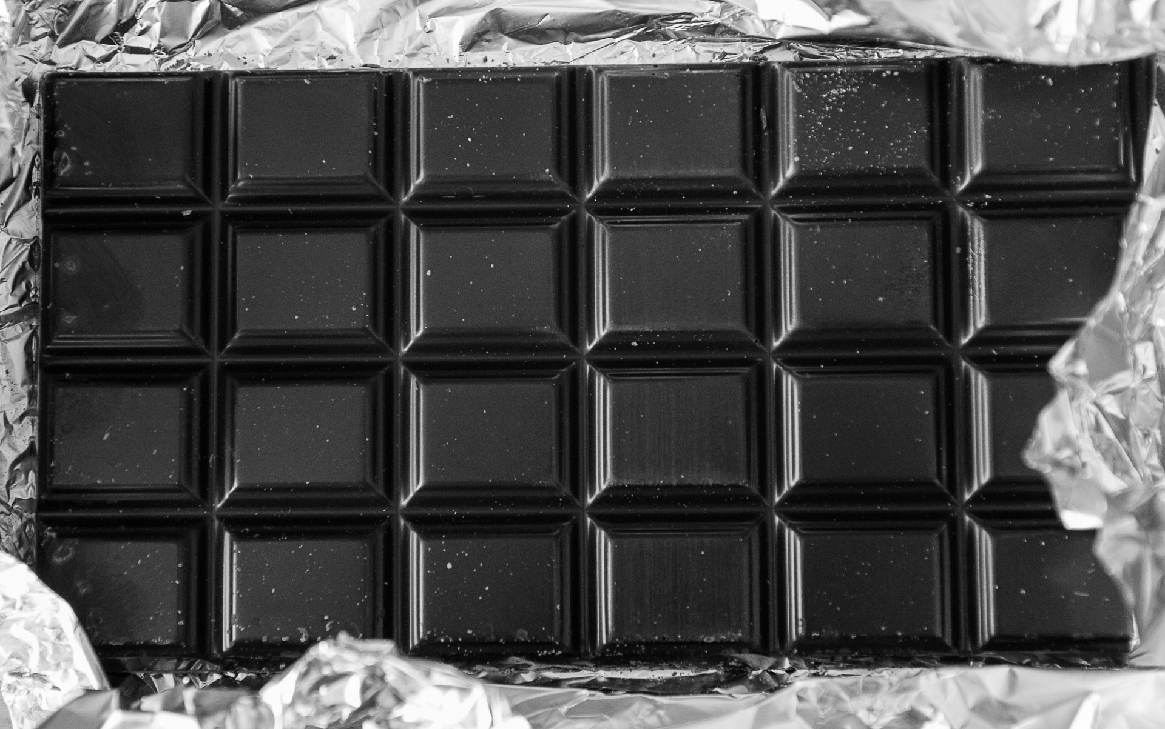
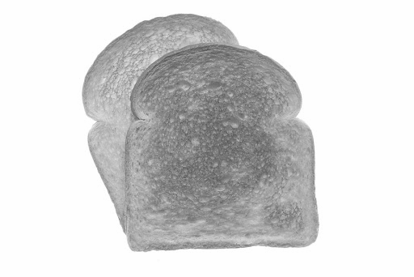
Breakfast
In the morning we eat breakfast.
What food items do you eat at breakfast time?
Point to the food items that you eat in the morning for breakfast. Discuss foods that you shouldn’t eat at breakfast e.g. chocolate.
Notes:
What food do you eat at breakfast time? Ask your learner to point to the food items that you eat in the morning for breakfast. Discuss foods that you shouldn’t eat at breakfast e.g. chocolate.

Slide 7
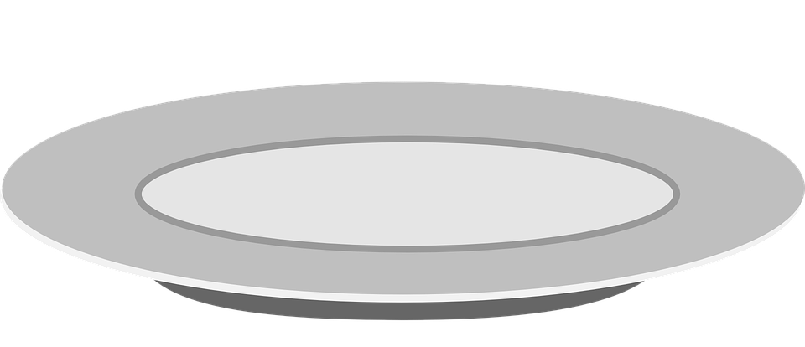
Breakfast
It is important to eat healthy food in the morning. Healthy food helps get our brains ready for learning.
Draw or cut out what you would choose for breakfast.
Notes:
Discuss with your learner the importance of eating healthy food for breakfast and foods that give us energy. Use the previous slide to choose breakfast items to cut out or draw onto a blank plate. What drink would you choose at breakfast time?

Slide 8
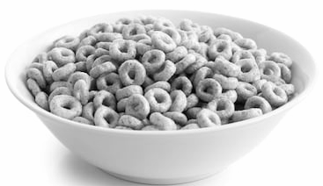
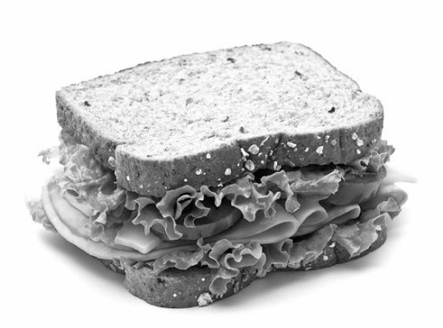
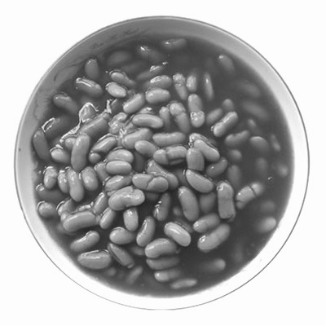
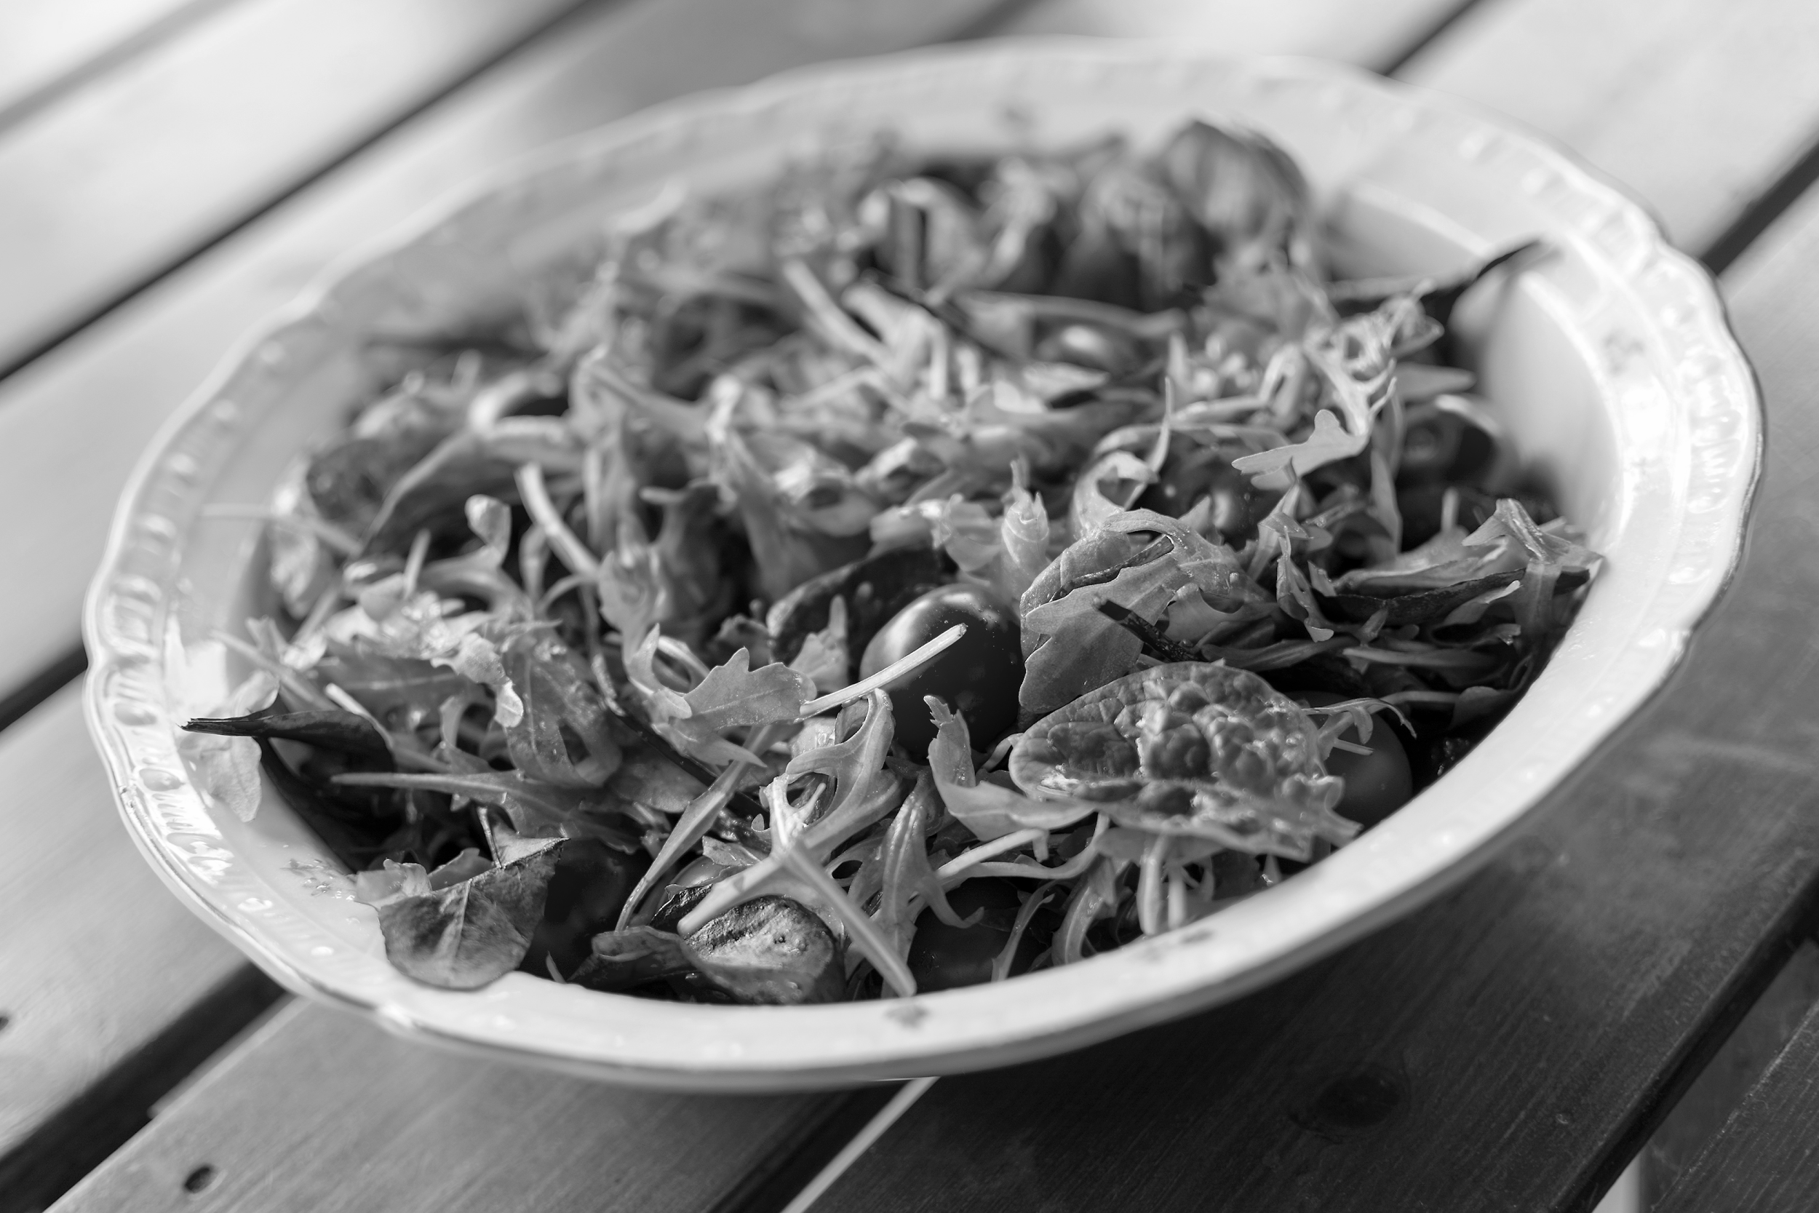
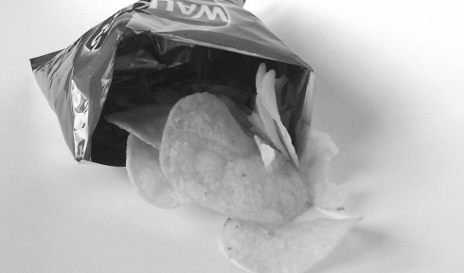
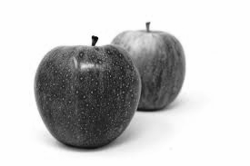
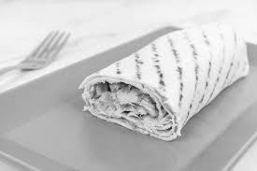
Lunch
At lunchtime we eat lunch.
What food items do you eat at lunch time?
Point to the food items that you eat at lunchtime. Discuss portion size and what food items could go in a lunch box.
Notes:
What food do you eat at lunchtime? Ask your learner to point to the food items that you eat at lunchtime. Discuss portion size and what food items could go in a lunch box.

Slide 9
Lunch
Lunch is usually a smaller meal.
Draw or cut out what you would choose for lunch.
Notes:
Use the previous slide to choose lunch items to cut out or draw onto a blank plate. What drink would you choose at lunchtime?

Slide 10
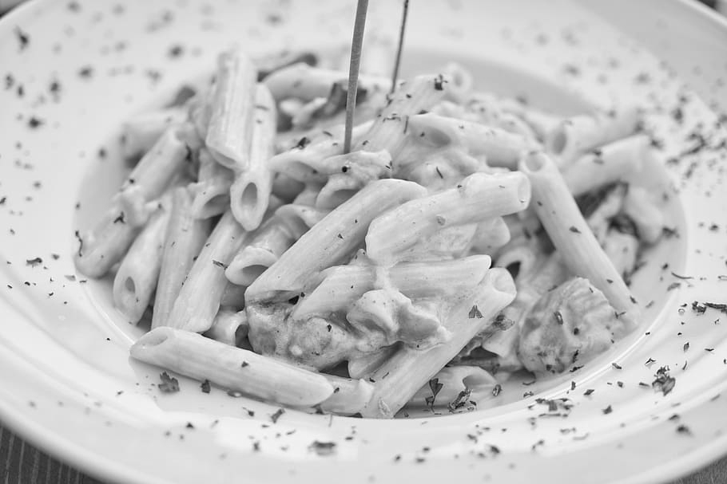
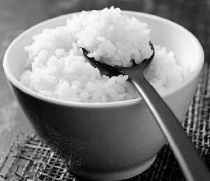
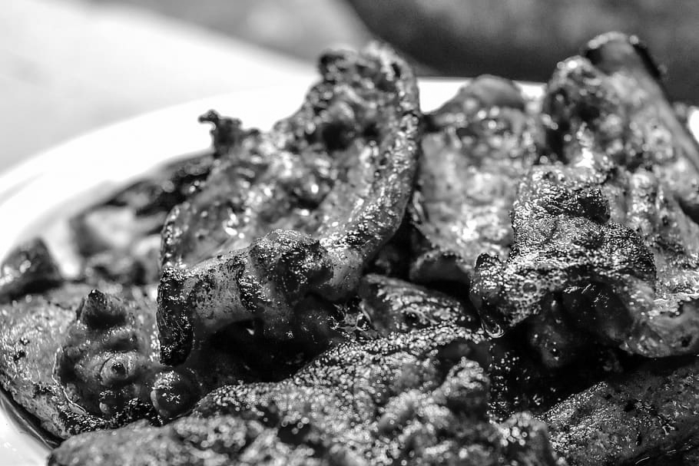
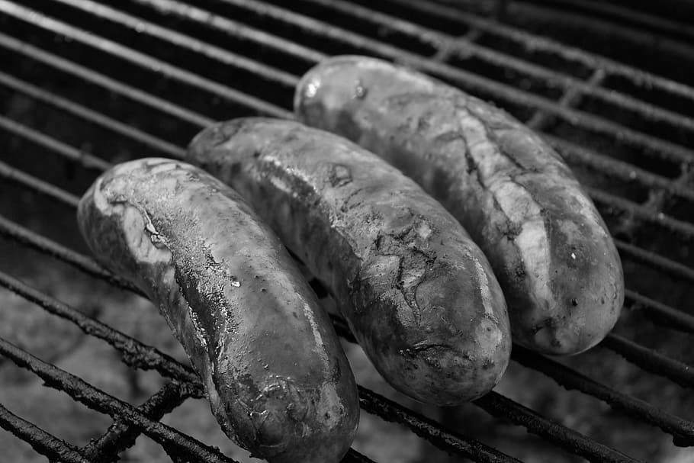
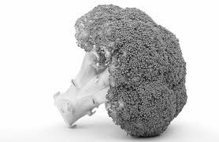
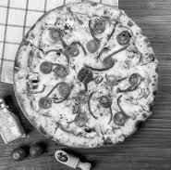
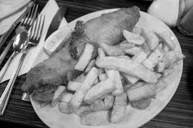
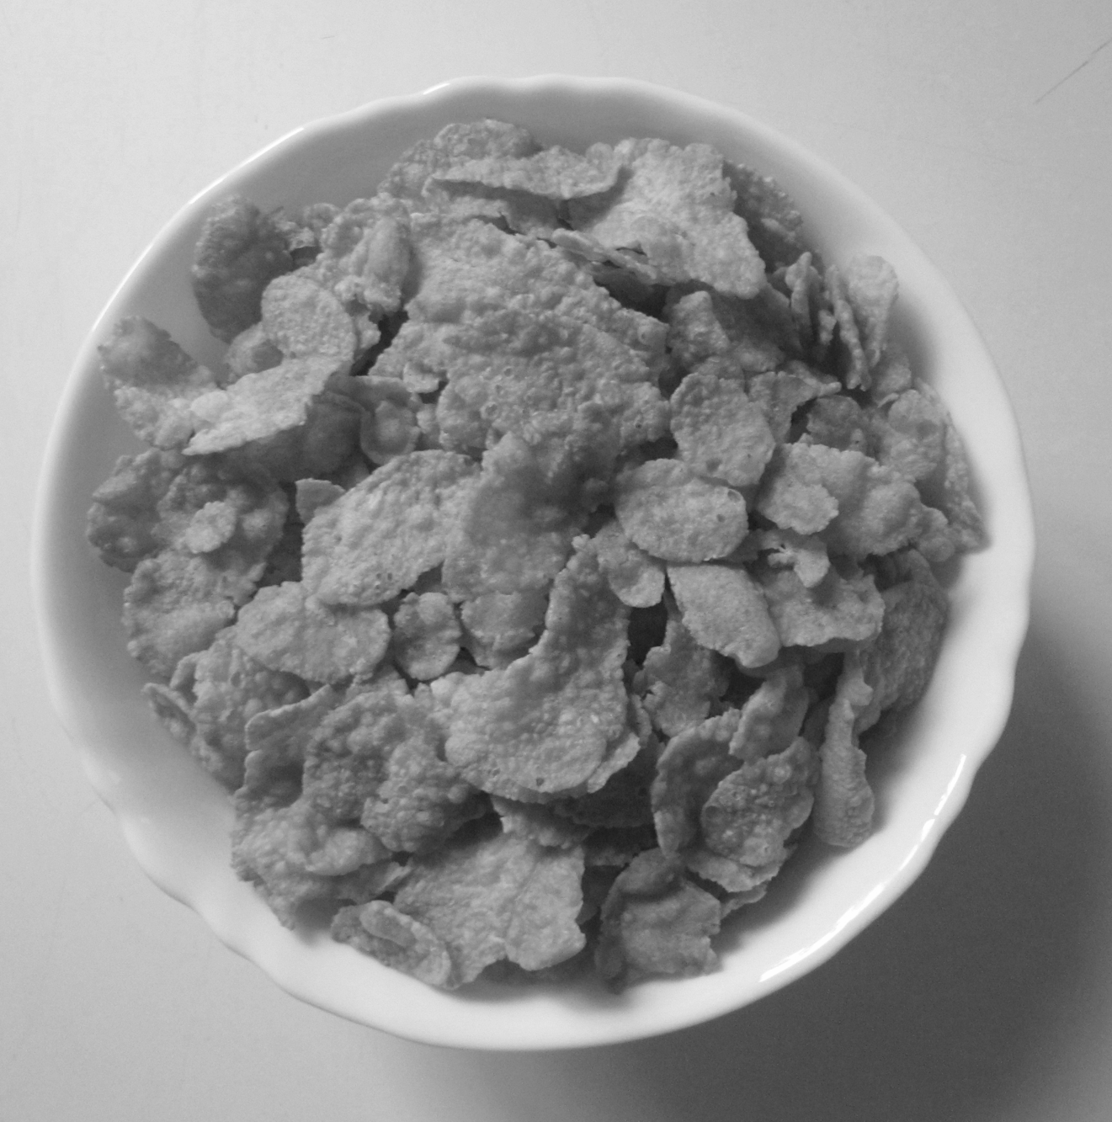
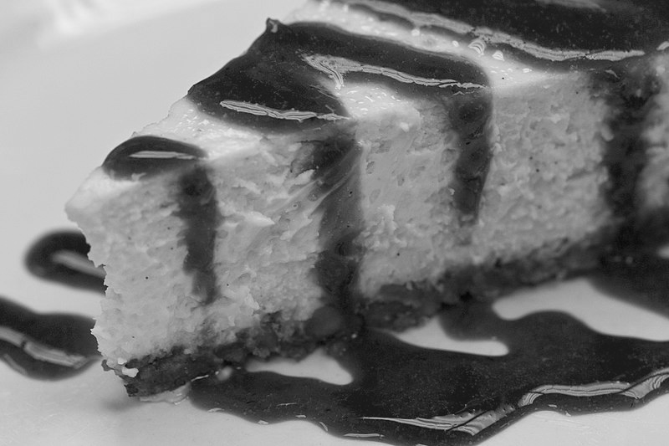
Dinner
In the evening we eat dinner.
What food items do you eat at dinner time?
Notes:
What food do you eat at dinner time? Ask your learner to point to the food items that you eat at dinner time. Discuss portion size and possible desserts. Can you think of any more food that you can eat for dinner?

Slide 11
Dinner
Usually our evening meal is larger and we might eat dessert afterwards.
Draw or cut out what you would choose for dinner and dessert.
Notes:
Use the previous slide to choose dinner items to cut out or draw onto a blank plate. What dessert would you choose?

Slide 12
Independent Living: Daily Living Skills
Daily meals: Suggested adaptations for teachers/parents/carers.
Make it easier
Make it harder
More ideas
Make a choice board for one of the meal times and ask your learner to choose their food.
Make a food diary for a week, writing what food items you eat at each time of the day.
-Discuss healthy choices and enjoying these in moderation.
-Write a food diary including snacks eaten throughout the day. Are you eating a balanced diet?
-Help your learner research different cultures and foods eaten at breakfast.
Notes:
Final slide of the lesson. Suggest adaptations for teachers/parents/carers.

Slide 13
Further Learning with Oak National
Independent Living:
Building Understanding- Daily meals for different times (Unit 3)
Applying Learning- Daily recommendations (Unit 2)
Applying Learning- Daily meals for different times of the day (Unit 3)
Applying Learning- Preparing a simple meal (Unit 3)
Applying Learning- Balanced plate of food (Unit 2)
Notes:
Insert info for subject/lesson name/stage (if appropriate)

Slide 14
References
Slide 6- Chocolate, Jean Beaufort, Publicdomainpictures / Yohgurt, Public domain files / Rice bowl, FriFran / Banana, Evan-Amos, Wikimedia commons / Croissant, Petr Kratochvil, Publicdomainpictures / Toast, Public domain, Free stock photos / Cereal, Needpix / Pasta, Seika, Flickr / Eggs in carton, Congerdesign, Needpix
/ Biscuits, Taste
Slide 7- Plate, Pixabay / Drinking Glass, Pixabay
Slide 8 Red Apples, Alexas_Fotos, Pixabay / Tortilla, Flickr / Canned Baked Beans, made-in-china / Salad, Public domain licence, Libreshot / Sandwich, MAXIMILIAN MEYER, Unisci24 / Cheerios, Shutterstock, DLPNG / Crisps, Arps, Wikipedia / Toast, Public domain, Free stock photos
Slide 10- Rice bowl, Tri Food / Broccoli, Shutterbug75, Pixabay / Sausage on bbq, Piqsels / Cooked meat, Pxfuel / Pasta, Wallpaper flare / Fish and chips, Memm, Wikimedia commons / Pizza, Pxhere / Cornflakes, Geotrinity, Wikimedia commons / Cheese cake, Vortbot, Wikimedia commons
Slide 11- Bowl, Vadim_P, Pixabay

