Slide 1
Lesson 2 - Representing Forces
Physics - KS3
Forces and Motion
Mrs Wolstenholme

Slide 2
Reminder
1: Forward push of an object moving on a solid surface
2: Attraction (pull towards) or repulsion (push away) of magnets and magnetic materials
3: Attraction between two objects with mass (Gravity)
4: Upward push of water on an object
5: Force which slows objects moving along a solid surface
6: Upward push of a solid surface on an object
7: Force which slows objects moving through water
8: Force which slows objects moving through air
A: Magnetism
B: Upthrust
C: Weight
D: Air resistance
E: Water resistance
F: Friction
G: Normal contact
H: Thrust
Notes:
Video of me pushing an object and pulling an object

Slide 3
Name the Force
?
Credit: no attribution required

Slide 4
Name the Force
?
Credit: no attribution required
Notes:
We know force is measured in Newtons.

Slide 5
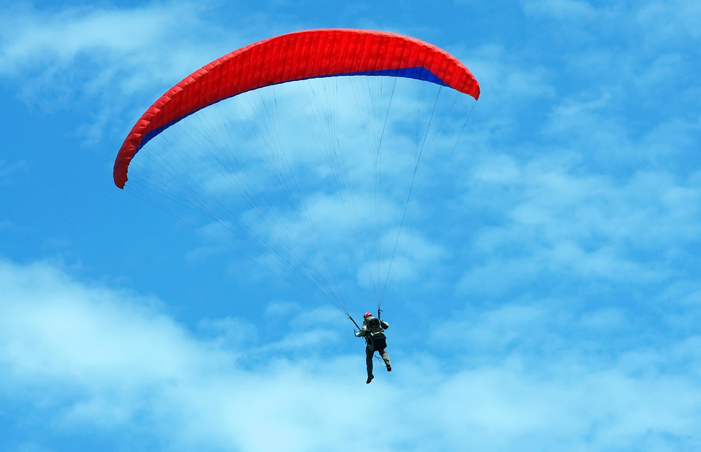
Balanced and Unbalanced Forces
If one of the forces is larger than the other, the forces are unbalanced.
If forces in opposite directions are equal, the forces are balanced.
Air Resistance = 350 N
Air Resistance = 200 N
Weight = 350 N
Weight = 350 N
Credit: no attribution required
Notes:
Unbalanced

Slide 6
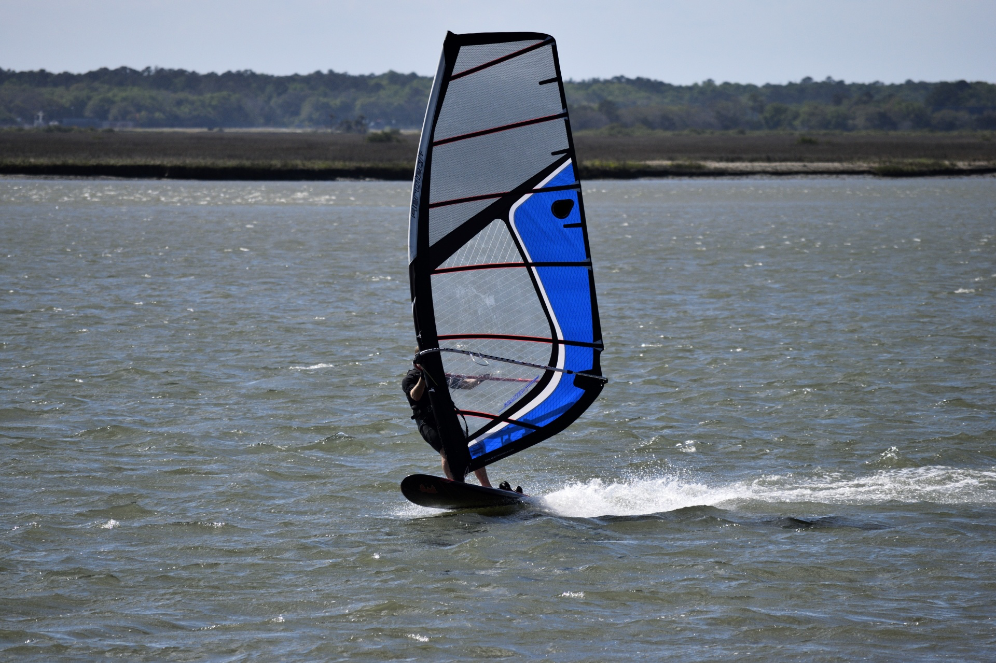
Balanced or Unbalanced?
Upthrust= 350 N
Weight = 500 N
Credit: no attribution required
Notes:
Unbalanced

Slide 7
Balanced or Unbalanced?
Upthrust= 500 N
Weight = 500 N
Credit: no attribution required
Notes:
Unbalanced

Slide 8
Balanced or Unbalanced?
Lift = 30,000 N
Air resistance = 25,000 N
Thrust = 25,000 N
Weight = 30,000 N
Credit: no attribution required
Notes:
We know force is measured in Newtons.

Slide 9
Balanced or Unbalanced?
Lift = 20,000 N
Air resistance = 25,000 N
Thrust = 25,000 N
Weight = 30,000 N
Credit: no attribution required
Notes:
We know force is measured in Newtons.

Slide 10
Balanced or Unbalanced?
Lift = 30,000 N
Air resistance = 25,000 N
Thrust = 40,000 N
Weight = 30,000 N
Credit: no attribution required
Notes:
We know force is measured in Newtons.

Slide 11
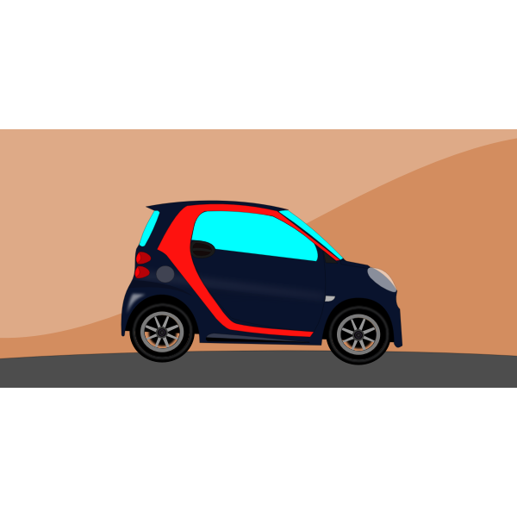
Representing Forces
Normal Contact
Normal Contact
Air resistance
Air resistance
Thrust
Thrust
Weight
Weight
Credit: no attribution required
Notes:
Now the car is moving. We need to add the other forces

Slide 12
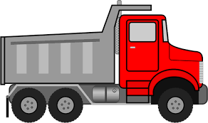
Representing Forces
Normal Contact
Credit: no attribution required
Thrust
Draw a diagram representing the forces on this truck. The thrust is larger than the air resistance.
Air resistance
Weight

Slide 13
Representing Forces
Lift
Credit: no attribution required
Thrust
Draw a diagram representing the forces on this plane. The lift is larger than the weight. The thrust and air resistance are balanced.
Air resistance
Weight

Slide 14
Representing Forces
Normal Contact
Credit: no attribution required
Your Turn: Draw a diagram representing the forces on this car. The thrust and air resistance are balanced.
Weight

Slide 15
Representing Forces
Credit: no attribution required
Your Turn: Draw a diagram representing the forces on this car. The thrust is larger than the air resistance.

Slide 16
Representing Forces
Credit: no attribution required
Your Turn: Draw a diagram representing the forces on this car. The thrust is smaller than the air resistance.

Slide 17
Representing Forces
Normal Contact
Credit: public domain
A motorcycle has a thrust of 500 N. The air resistance is 100 N. The weight and the normal contact force are 300 N.
Air resistance
Thrust
Weight

Slide 18
Representing Forces
Normal Contact
Credit: public domain
Air resistance
Thrust
Is the motorcycle balanced?
Weight

Slide 19
Representing Forces
Credit: public domain
Your Turn: There is a weight of 500 N and an air resistance of 300 N on the parachutist. Are the forces balanced?

Slide 20
Representing Forces
Credit: no attribution required
Your Turn: The trolley is pushed with a force of 70 N. There is a frictional force of 30 N. The weight and normal contact force are 50 N. Is the trolley balanced?

Slide 21
Well Done!

