Slide 1
Saying What You Do and Did on Holiday [4/4]
The Perfect Tense with Être and Reflexive Verbs
French
Mademoiselle Franklin

Slide 2
[ é ]
[-er]
[-et]
écrire

Slide 3
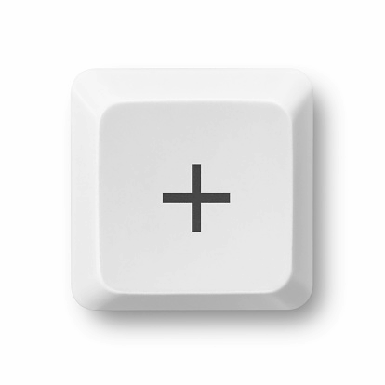
[ é / er / et ]
bébé
aller
et

Slide 4
[ SFC ]
dans
X

Slide 5
[ SFC ]
c r f l
Be c a r e f u l with these!

Slide 6
[ SFC ]
petit
grand
mot

Slide 7
l’année dernière | last year
l’été dernier | last summer
il y a X ans / mois | X years/months ago
souvent | often
se baigner dans la mer | to bathe/bathing in the sea
se promener à la campagne | to walk/walking in the countryside
se reposer sur la plage | to relax/relaxing on the beach
aller aux musées | to go/going to the museums
rester chez moi | to stay/staying at home
arriver à l’hôtel | to arrive/arriving at the hotel

Slide 8
Meanings of the perfect tense
The perfect tense is used to talk about completed actions in the past
2. Verbs conjugated in the perfect tense in French have two meanings in English. J’ai mangé = I ate and I have eaten.
3. Most verbs use the conjugated form of ‘avoir’ as their auxiliary verb - J’ai mangé.
4. Certain verbs use the conjugated form of ‘être’ as their auxiliary verb.
5. Most of these verbs concern movement : going, arriving, staying
6. All reflexive verbs use ‘être’ as their auxiliary verb

Slide 9
The perfect tense with être
Some verbs use the conjugated form of ‘être’ as the auxiliary (second part) of the past tense
Most of these verbs concern movement: going, arriving, staying
All reflexive verbs use ‘être’ as the auxiliary verb
When using the perfect tense with être, the past participle must agree in gender and number with the pronoun
Je (I) | suis (have) | allé(e)(s) (went) arrivé(e)(s) (arrived) resté(e)(s) (stayed)
On (We) | est (have)
Je (I) | me | suis (have) | baigné(e)(s) (bathed) reposé(e)(s) (relaxed) promené(e)(s) (walked)
On (We) | s’ | est (have)

Slide 10
Saying what you do and did on holiday
Verbs that take être usually involve ___
When the subject of the sentence is feminine, we add ___ onto the past participle.
When using the pronoun ‘on’, we add ___ onto the past participle.
I walked = Je me ___ promené
We bathed = On s’___ baignés
movement
[e]
[s]
suis
est

