Slide 1
French
Please print this resource if you are able to and use it to record your answers. The audio for the listening section of the test is available in the online worksheet.
Assessment
Year 8 French
Term 3 Applying Your Knowledge Test
Resources by NCELP/University of York. Content has had superficial branding changes from NCELP/University of York (CC BY-NC-SA)

Slide 2
This test is in five sections:
Section A: Listening (10 minutes)
Section B: Reading comprehension (20 minutes)
Section C: Writing (20 minutes)
Section D: Speaking (5-10 minutes)
Section E: Reading aloud (5-10 minutes)
This makes a total of 55-65 minutes to complete the entire test.
Remember – always have a go! If you know some words, just do what you can!

Slide 3
SECTION A - LISTENING

Slide 4
Listening
PART A
On the next slide, you will hear Amir talk about language learning in his family.
There is a word bank of activities he mentions (plus some that he does not mention!). You have 20 seconds to read the activities.
Write one activity into each space in the grid. You must decide who does the activity, and when.
You will hear the story twice, with a 20 second gap in between. After hearing it twice, you will have another minute to finish the grid.

Slide 5
Word Bank
write down new words go to Italy study German
have conversations with local people translate
pass English exam speak a bit of German watch English films
^{when?} _{who?} | in the past | in general | in the future
Amir | 1. ____________________ | 1. read novels 2. ____________________ | 1. ____________________
Léa | 1. ____________________ | 1. ____________________
Amir and Léa | 1. go on a trip | 1. like language learning 2. learn English | 1. ____________________

Slide 6
Listening
PART B
Now listen for a third time. You then have two minutes to answer the questions in English.
 |  | Write as many details as you can (2 marks per question)
a) | Where did Amir and Léa visit last year, and when?
b) | What did Amir buy?
c) | What does Amir say about Italian?
d) | Who speaks better English, Amir or Léa? What example does Amir give to show this?

Slide 7
SECTION B - READING COMPREHENSION

Slide 8
Reading comprehension
PART A
You are spending your summer holiday in Saint-Clair-des-Monts, a mountain town in France. You are given a map and an information leaflet about summer time in the town.
The map isn’t very clear! On the next slide, read the text and write the English for the words in bold in the right places on the map.

Slide 9
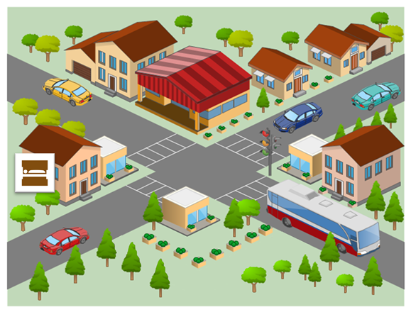
Si vous sortez de l’hôtel et traversez la rue, vous allez trouver un café avec une belle vue du parc. Le parc est en bas de la carte. À gauche, il y a une petite place. À droite on trouve le jardin anglais.
Près du parc il y a le musée local de Saint-Clair-des-Monts. C’est un lieu populaire³, et il y a toujours⁴ un grand bus devant le bâtiment. À côté du musée, vous trouvez l’école.
En haut de la carte il y a un grand magasin. Le magasin est entre deux autres bâtiments, la banque et la poste. Le bâtiment qui est moins petit est la poste.
¹bienvenue = welcome ² le plan = map ³populaire = popular ⁴toujours = always
hotel

Slide 10
Now read the general information about the town, and answer the questions that follow.
Reading comprehension
Read the general information about the town, and answer the questions that follow on the next two slides.
Voici des informations pour mieux organiser les vacances.
Le café est excellent. Ici, on prépare des repas pour les événements
nationaux. Ce mois, on a mangé de bons sandwichs pendant la Fête
du pain, et on va très bientôt célébrer la Fête du fromage !
Dans le parc, il y avait un restaurant, mais aujourd’hui vous trouvez des
tables pour manger dehors. Il y a un cinéma aussi, mais notre théâtre a fermé
l’année dernière.
Il n’y a pas de neige à Saint-Clair-des-Monts en été, mais on peut faire des promenades sur les pistes. En hiver, on va organiser une compétition internationale de ski.
Il y a un lycée pour les élèves locaux, mais on doit aller à Chambéry (une autre ville près d’ici) pour aller à l’université.

Slide 11
Reading comprehension
PART B
Put a tick next to the things that can be found in Saint-Clair-des-Monts at the moment.
a restaurant |  |  | snow
picnic tables |  |  | ski runs
a cinema |  |  | a high school
a theatre |  |  | a university

Slide 12
Reading comprehension
PART C
Number these events in the order they happen. Write the numbers 1-4 in the boxes on the right (1= happened first, 4 = will happen last).
the closure of the theatre
the bread festival
the cheese festival
the international ski competition

Slide 13
SECTION C - WRITING

Slide 14
Writing
PART A
On the next slide, look at the picture and complete the missing words in the text.
The number of gaps tells you how many letters are missing.

Slide 15
Léa ne v_ pas à l’école aujourd’hui parce qu’elle est m_ _ _ _ _ . Elle l_ _ un peu de son livre, mais elle doit d_ _ _ _ _.
La f_ _ _ _ _ _ de Léa habite dans un petit a__ _ _ _ _ _ _ _ _ à Paris. Par la grande
f _ _ _ _ _ _, on peut regarder les oiseaux dans l’a_ _ _ _.
La mère de Léa p _ _ _ _ une chemise
n_ _ _ _. Elle apporte un t _ _ pour Léa, mais Léa ne v_ _ _ pas boire en ce moment.

Slide 16
Writing
PART B
What happened last week? What will happen next week?
On the next slide, write between one and three sentences in French for each picture. Write your sentences in the blank box on the right. Use all of the French words under the boxes.
Try to show that you know what the words mean by writing full, interesting, and varied sentences that make sense. You can use your imagination if you like!

Slide 17
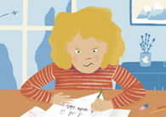
1. Last week
 | travailler / l’examen / dur / note
2. Next week
 | jeudi / l’hôpital / rester / son OR sa OR ses

Slide 18
SECTION D - SPEAKING

Slide 19
Before you start this section of the test, please go to this website: vocaroo.com.
It will open in a new tab. Click the red record button, then come back to this test.

Slide 20
Speaking
On the next slide, look at the photo and answer the questions in French. For each idea you say, you will get 2 marks for expressing the meaning, and 1 mark for speaking accurately. In total (parts A & B combined), you will get 2 marks for speaking fluently.
You have 2 minutes to prepare all of your answers before you speak. It doesn’t matter if you make mistakes! Just try to keep going and say something that you know how to say.

Slide 21
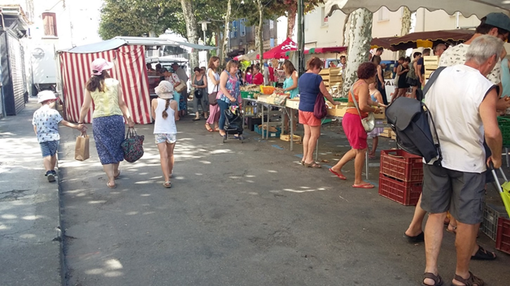
Speaking
PART A What can you see in this photo? Try to say at least 4 different things in French. (12 marks)
Here are some ideas about what you could say. You can say different things if you wish!
Say something about the weather
Say what there is in the town (you can use your imagination)
Describe any of the three people on the left (you can use your imagination)
Say what one of the people in the picture is doing

Slide 22
Speaking
PART B
Ask the man on the right 2 different questions in French. (6 marks)

Slide 23
SECTION E - READING ALOUD AND COMPREHENSION

Slide 24
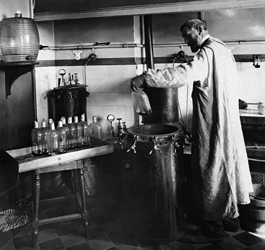
Reading Aloud And Comprehension
PART A
Read the following text aloud. You won’t know some of the words – don’t worry! Just do your best to read them aloud as you think they should sound in French.
You will get marks for understandable and fluent pronunciation.
Louis Pasteur est un scientifique français très important dans l'histoire.
Il trouve une solution pour conserver des produits périssables.
Comme résultat, on achète le lait ‘pasteurisé’ au magasin aujourd’hui.
Il crée aussi le premier vaccin contre une maladie dangereuse.
C'est pourquoi on dit qu'il est ‘le père de la médecine moderne’
Louis Pasteur (1822-1895) dans son laboratoire

Slide 25
Reading Aloud And Comprehension
PART B
Now say, in English, any 4 facts mentioned in the text about Louis Pasteur. You will get half a mark for each fact.
Louis Pasteur est un scientifique français très important dans l'histoire.
Il trouve une solution pour conserver des produits périssables.
Comme résultat, on achète le lait ‘pasteurisé’ au magasin aujourd’hui.
Il crée aussi le premier vaccin contre une maladie dangereuse.
C'est pourquoi on dit qu'il est ‘le père de la médecine moderne’
Louis Pasteur (1822-1895) dans son laboratoire

Slide 26
When you have finished, go back to the Vocaroo window.
Click on the red button. Click on "Save & Share".
Copy & paste / write the URL for your Vocaroo recording here:
END OF ASSESSMENT
Vocaroo link:

